Slide 1
Lifejacket rules Lifejacket rules are in place to protect you and your loved ones.

Slide 2
Acknowledgement of Traditional Owners and Elders
I’d like to begin by acknowledging the Traditional Owners of the land where we meet today. I would also like to pay my respects to the Elders both past and present.
I also extend that respect to the Aboriginal and Torres Strait Islander people here today.
'Travelling' by Gilimbaa
Notes:
Title: Acknowledgement of Traditional Owners and Elders
Content: I’d like to begin by acknowledging the Traditional Owners of the land where we meet today. I would also like to pay my respects to the Elders both past and present.
I also extend that respect to the Aboriginal and Torres Strait Islander people here today.
An Acknowledgement of Traditional Owners and Elders should ALWAYS be spoken. Putting up this slide with no spoken message is NOT enough.
An Acknowledgement of Traditional Owners and Elders is an opportunity to show respect for traditional owners and the continuing connection of First Nations Australians to country.
There are two types of Traditional Owner Acknowledgements:
General – use this version if you are unsure of the traditional group or the pronunciation.
Specific – use a specific version if you are confident in naming the correct traditional group or groups and the pronunciation.
The text you should speak when giving an Acknowledgement (both general and specific) can be found on HR’s Traditional Owners Acknowledgements page (https://intranet.tmr.qld.gov.au/corp/hr/culture/inclusion/first-nations/acknowledgement).
Note, you can customise to recognise ‘…Traditional Owners of the land (and waterways, or either)’ depending on where you are presenting.
If the MC opens your meeting or forum with an Acknowledgement, each supplementary speaker at the same meeting or forum doesn't need to also give an Acknowledgement when they start presenting, however you should not stop people who want to.
An animated video (1:12 minutes) is also available, which visually and verbally explains the ‘Travelling’ art piece (https://intranet.tmr.qld.gov.au/corp/hr/culture/inclusion/first-nations/travelling#Travelling-animation-with-voice-over).
You are welcome to play the video at forums or meetings however it is not to be used in place of an Acknowledgement.
Note: An Acknowledgement of Traditional Owners and a Welcome to Country​ are two very different activities. Visit HR’s Traditional Owners Acknowledgements page (https://intranet.tmr.qld.gov.au/corp/hr/culture/inclusion/first-nations/acknowledgement) to find out more about this.

Slide 3
Maritime safety
Our goal:
Zero accidents
Zero casualties
Zero ship sourced pollution.
Notes:
Title: Maritime safety
Content: Our goal:
Zero accidents
Zero casualties
Zero ship sourced pollution.

Slide 4
It is now compulsory to wear a lifejacket when:
boating alone, (or only with children under 12 years) on an open boat that is less than 4.8 metres in length whilst underway;
crossing a designated coastal bar on an open boat, and on an open area of a boat, of any length;
boating at night, that is between sunset and sunrise, on an open boat that is less than 4.8 metres in length whilst underway.

Slide 5
There are extra protections for children.
^{In addition:}
if you are under 12 years (aged 1 year or more) in an open boat, or open area of a boat of any length while underway

Slide 6
Further, wearing a lifejacket will be compulsory when crossing a coastal bar on certain craft in the style and risk profile of:
Small sailing boats (such as lasers and herons)
^{Pedal boats}
Rafts, including inflatable rafts
Rowboats (excluding Surf Life Saving Australia Club Surfboats)
^{Sea and surf kayaks.}

Slide 7
This does not include vessels in the style of and with a risk profile of:
^{Body or “boogie” boards}
^{Surf boards}
^{Wind surfers}
^{Kite surfers}
^{Stand up paddle boards.}

Slide 8
FAQ’s

Slide 9
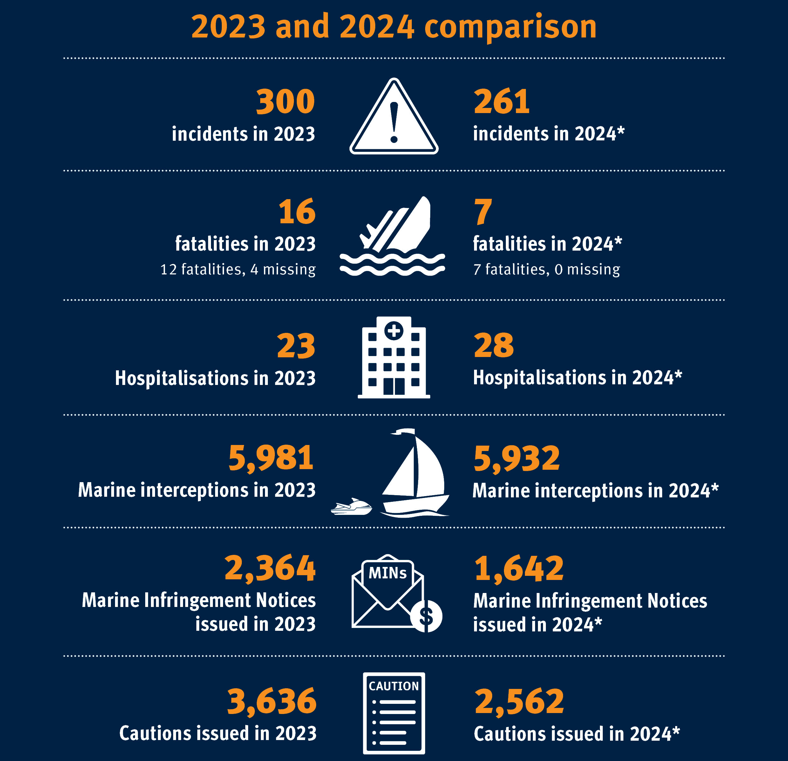
^{Why did the rules change?}
The law changed in the interest of public safety, to ensure you, your passengers and loved ones get home safely.
In the last five financial years, there were 64 boating fatalities in Queensland, and only five were known to be wearing their lifejacket at the time of the incident. Data shows that the people who are at the highest risk of drowning at sea include children and those boating alone or at night, or when crossing coastal bars.
This law change has also brought Queensland in line with the safety standards of other states.

Slide 10
How are these changes being communicated ^{and how will this be enforced?}
How are these changes being communicated and how will this be enforced?
Maritime Safety Queensland has informed industry stakeholders and will continue to push targeted messaging to inform the public, through our website and our online communication channels.
MSQ Marine Officers, Enforcement Officers and our compliance partners, will be out on the water educating boat owners and users about the upcoming law change and providing education and support at intercept.
To ensure everyone is sufficiently informed, MSQ will prioritise public education to ensure everyone understands the importance of the new lifejacket laws. Education and support will be provided through our Marine Officers, Maritime Enforcement Team and online communication channels. In due course, people who choose not to wear their lifejacket as required will receive a fine.

Slide 11
^{Are the rules just} ^{for ‘boats’?}
No, lifejackets are important safety equipment on any water vessel.
These amendments will also affect people crossing a coastal bar when using certain craft, which includes small sail boats (lasers and herons), pedal boats, rafts, including inflatable rafts, rowboats (excluding Club Surfboats by Surf Life Saving Australia), and sea and surf kayaks.
Craft does not include body/boogie boards, surf boards, wind surfers, kite surfers and stand-up paddle boards. It is important the right type of lifejacket is chosen for the activity being undertaken. MSQ provides information on types of lifejackets here.

Slide 12
Is it compulsory for children to wear a lifejacket?
Yes, children will need to wear a lifejacket when on an open ship or an open area of a ship of any length.
Previously it was compulsory for children (over 12 months of age and under 12) to wear a lifejacket when in an open boat that is less than 4.8m in length.

Slide 13
What about for children less than 12 months of age?
In Queensland, lifejacket laws for ships only apply to children who are at least 12 months old. For safety reasons, MSQ doesn’t recommend children under this age travel on ships unless necessary.
If you need to travel with your infant on a ship, we advise that they be held securely by one of the parents or another adult.
If there is a suitable lifejacket available for them, we also recommend they wear it. Information on approved lifejacket standards is available on our website.

Slide 14
What type of lifejackets should ^{I carry?}
There are different types of lifejackets for different types of waters and activities. From 1 September 2025, you must carry a lifejacket made to the current Australian Standard AS 4758. You can find more information about the types of lifejacket by visiting the MSQ website .
^{What other safety equipment} ^{do I need to carry?}
This depends on the size of your ship, whether the ship needs to be registered and where you are operating it. You can find more information on our website about safety equipment for ships in Queensland at this link.

Slide 15
What is a designated coastal bar?
A designated coastal bar is a bar that forms at the entrance to rivers and inshore waterways because of sand drifting along the coasts.
They are detailed in the Transport Operations (Marine Safety) Regulation 2016 in Schedule 1. You can find more information on coastal bars here.

Slide 16
What consultation was undertaken before making these changes?
MSQ undertook extensive industry and public consultation in 2022. The general boating public were engaged via a Queensland Government ‘Get Involved’ survey and industry stakeholders were invited to face-to-face forums to discuss the law change.
The feedback has directly informed MSQ’s amendments to lifejacket laws including mandatory wearing of lifejackets.

Slide 17
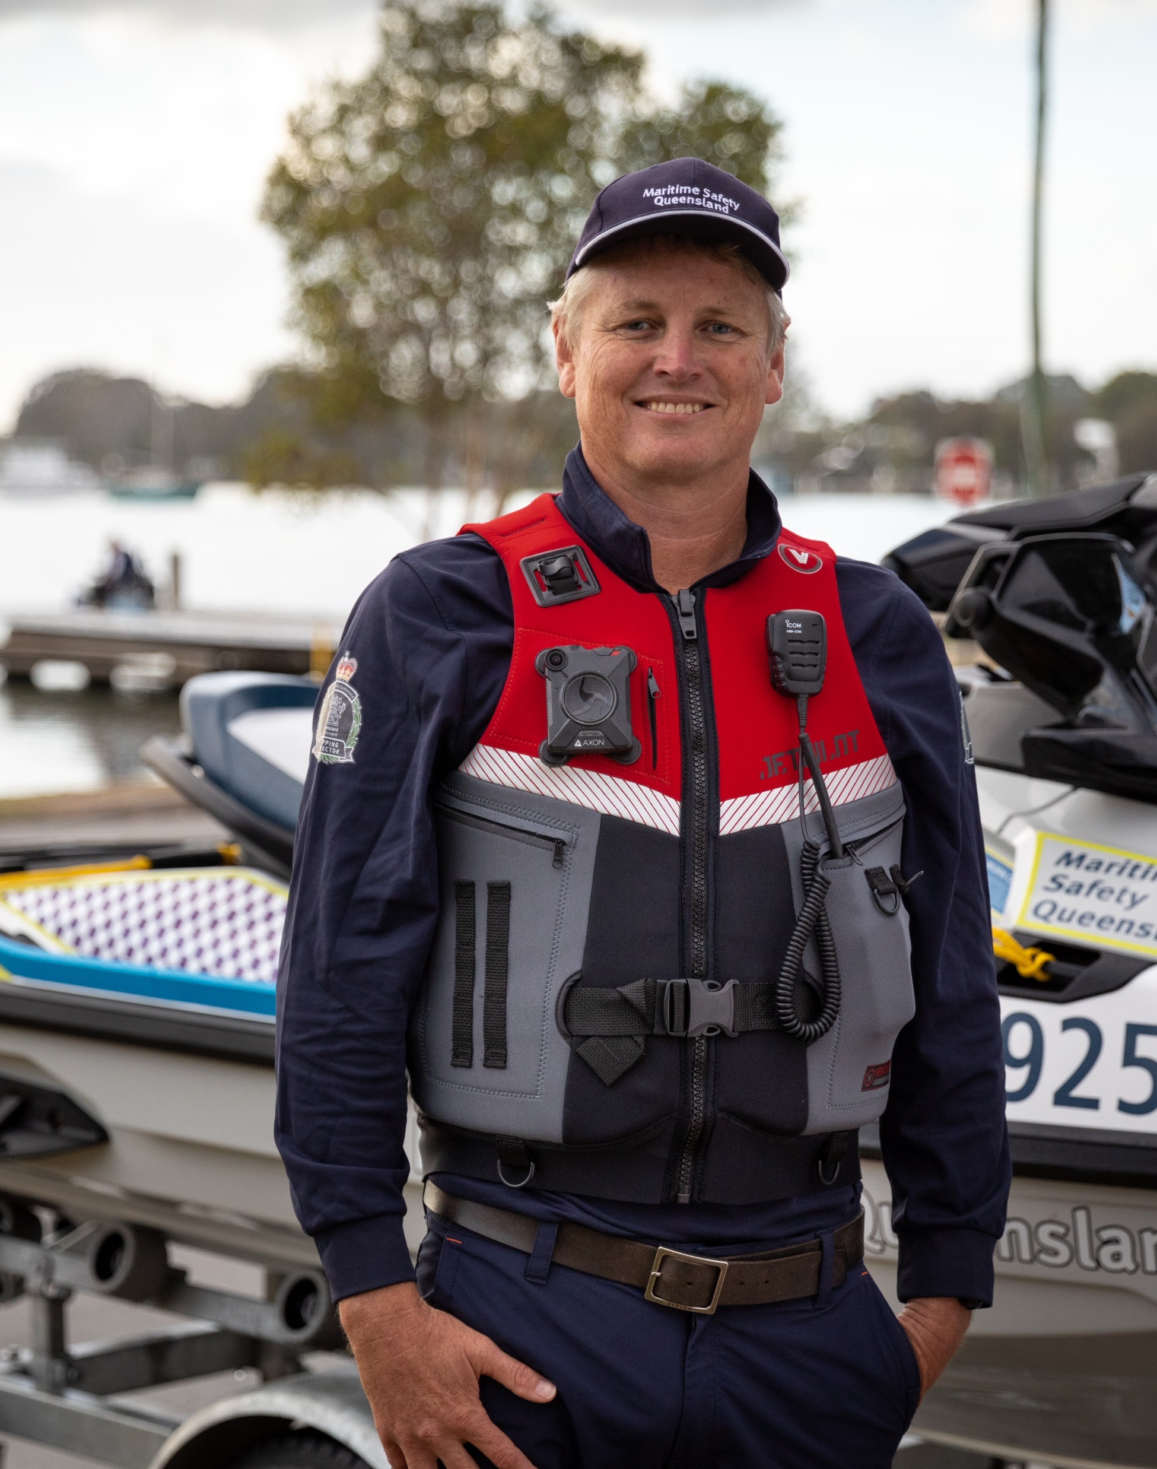
Will I be fined if I do not comply with the new lifejacket rules?
To ensure everyone is sufficiently informed, MSQ will prioritise public education.
Enforcement will be delayed until 1 July 2025 to ensure everyone understands the importance of the new lifejacket laws. Education and support will be provided through our Marine Officers, Maritime Enforcement Team and online communication channels. In due course, people who choose not to wear their lifejacket as required will receive a fine.

Slide 18
Thank you and stay connected
www.msq.qld.gov.au
Notes:
Slide title: Thank you and stay connected
Web: www.tmr.qld.gov.au

