Slide 1


Schoolies adventure simulator
BEGIN!

Slide 2

In this simulator you will encounter a series of decisions you need to make to have a safe Schoolies trip and avoid scams
(note: this game is exclusively clicker only it will not work if you press spacebar etc.)
CONTINUE

Slide 3


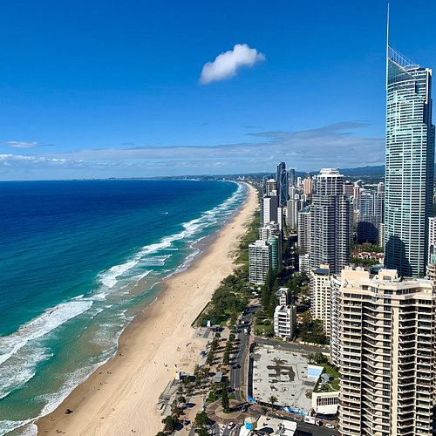
Choose your Destination:
BALI
FIJI
GOLD COAST

Slide 4
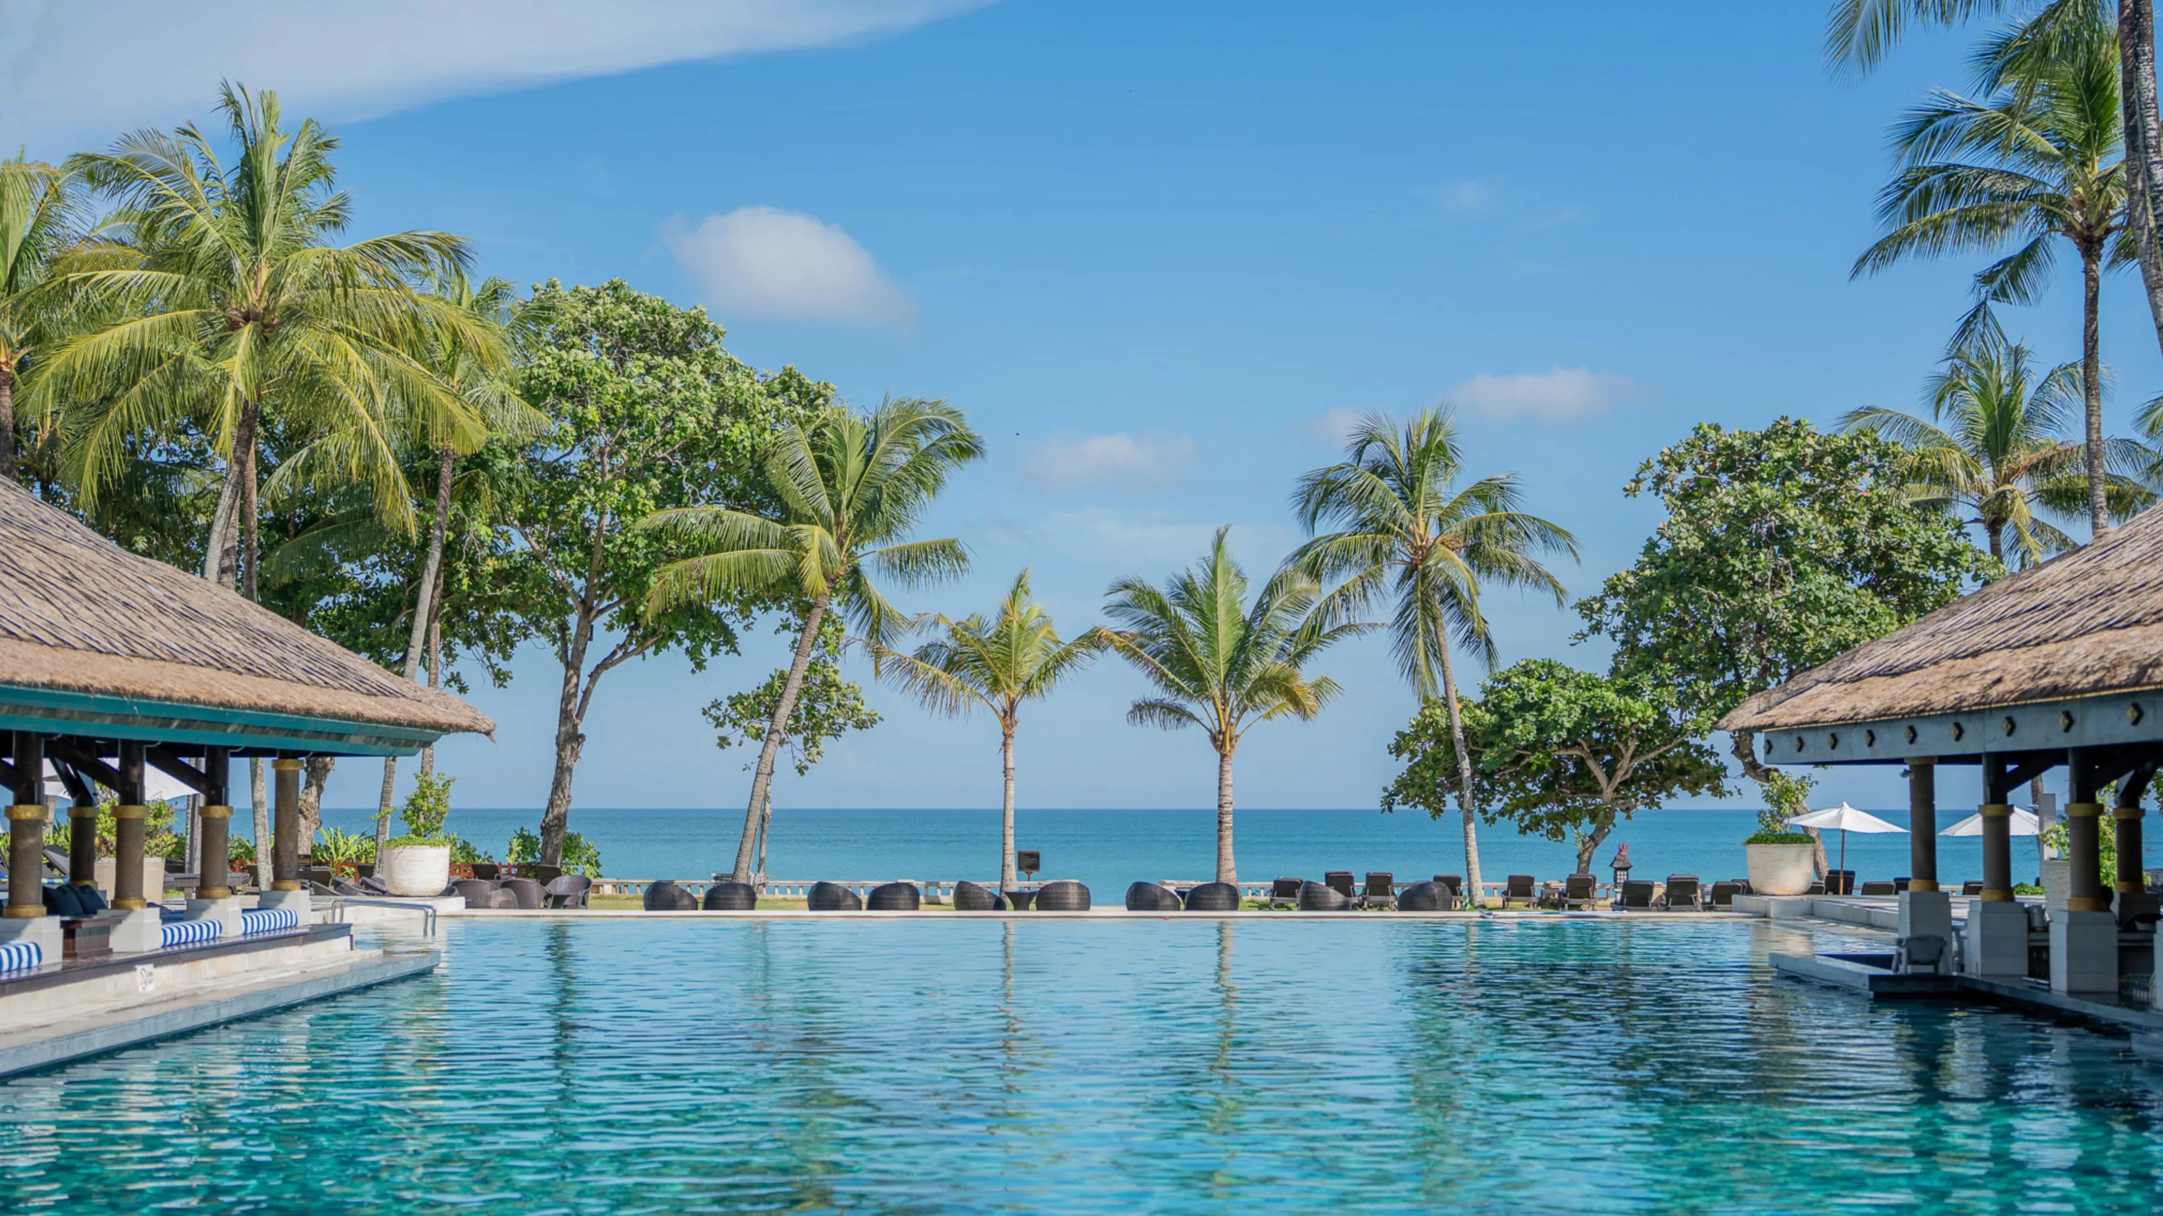
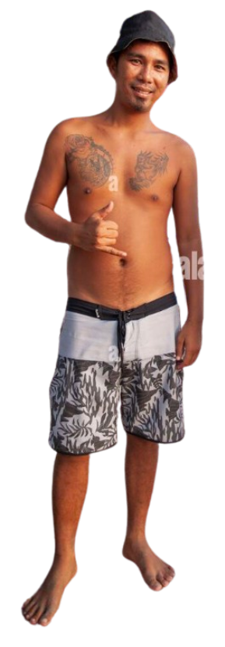
There is something essential we need to sort out before you can get partying
We need to book a hotel for this week.
Welcome to Bali!
Next

Slide 5
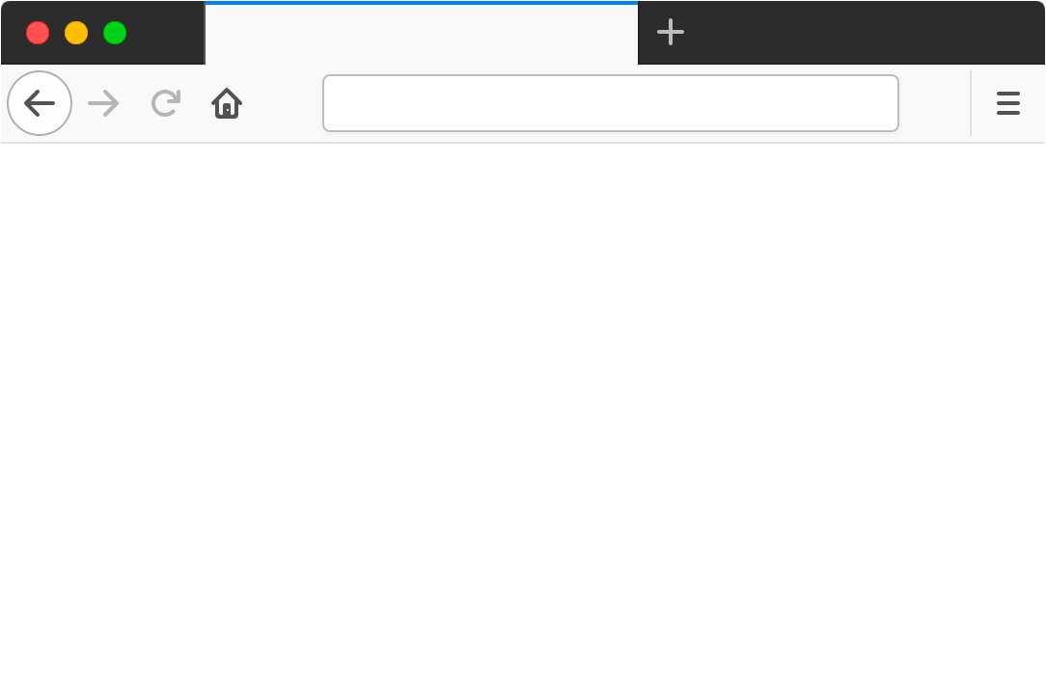
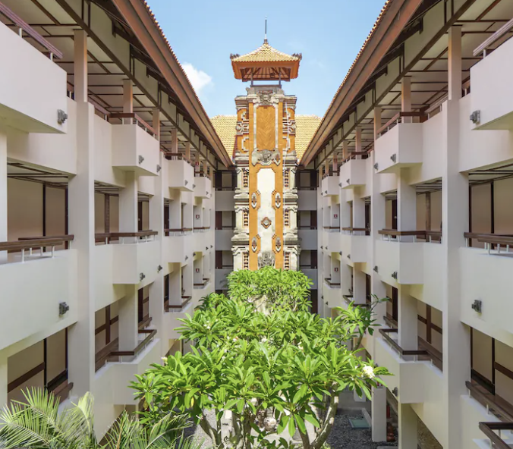

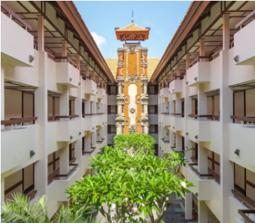

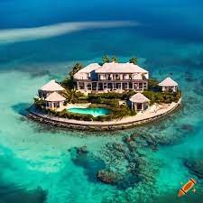

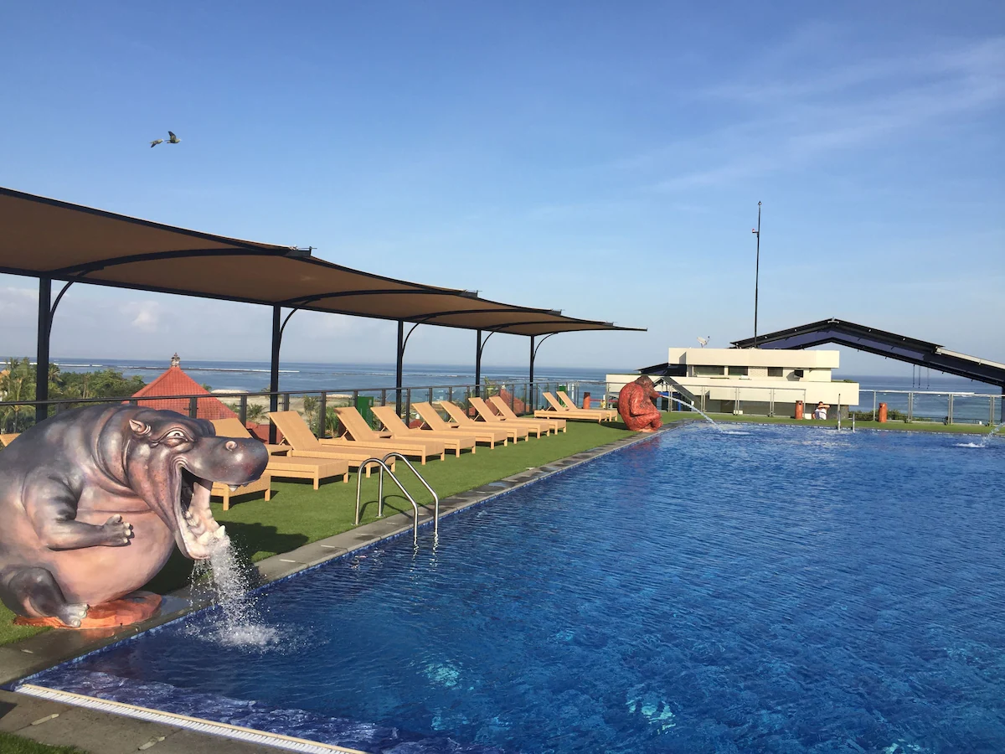

You have put aside a budget of $750 to spend on accommodation.
On this browser, I've searched for hotels around Bali.
Look through these hotels and choose your pick.
Make sure you choose wisely!
Hotels in Bali
Bintang Bali Resort
$590
4.5 stars
“Great Hotel” “Clean Rooms”
Bintang Bali Resort
$590 $450
4.5 stars
“Great Hotel” “Clean Rooms”
Book
Book
99.99% OFF
Sulis Beach Hotel
$340
10 stars
“Bad Service” “Unclean Rooms”
LIMITED TIME LUXURY MANSION HOTEL
$1000 $50 per person
99 Stars
BIG SALE!!!!
Book
Book

Slide 6
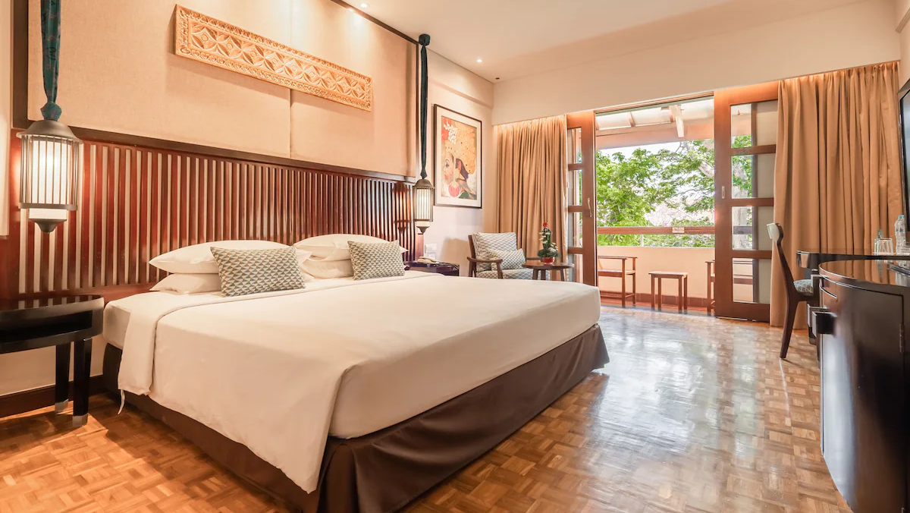

No matter where you are on the internet its always important to look out for scams like these.
There are many, such as the unrealistic discount, star rating and third-party website.
There were some listings that were fake but you managed to carefully discover the right option.
Can you spot everything that indicates it’s a scam?
Here’s an example of one of the scams.
Well done! you weren’t scammed.
Continue

Slide 7
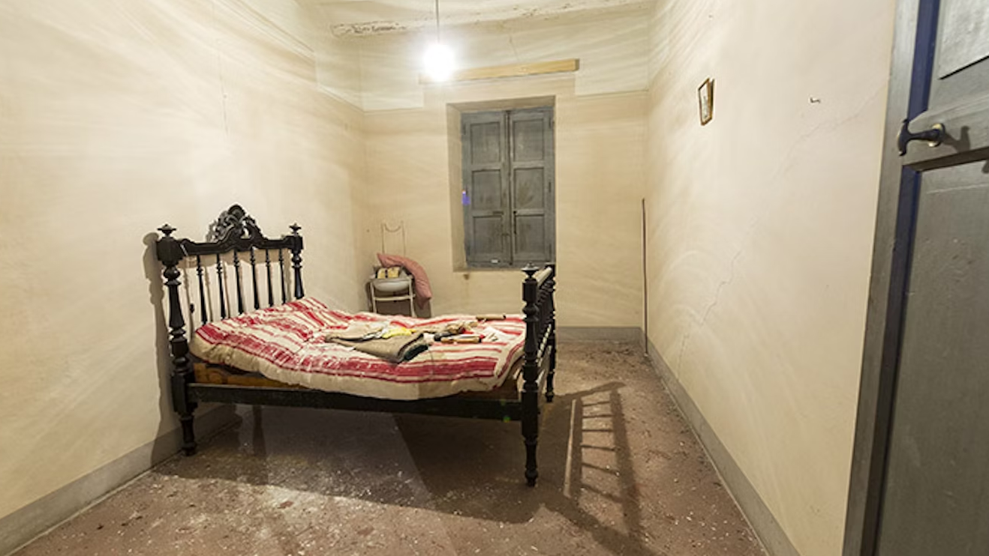
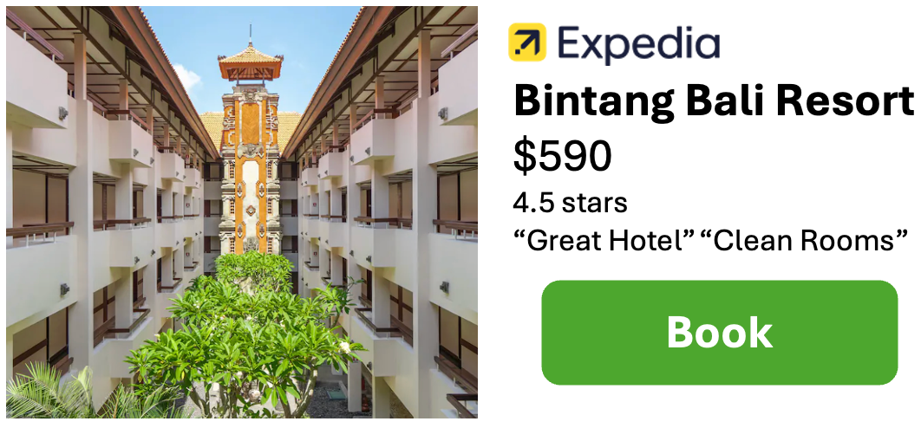
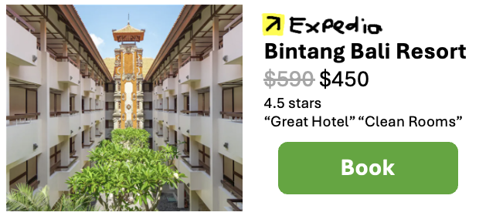
This is a common way of scamming and is one to be aware of.
Here are some things that indicated it was a scam.
This was a fake copy of the real listing.
This can be seen by the copy of the website logo.
Oh no! You were scammed!
Retry

Slide 8
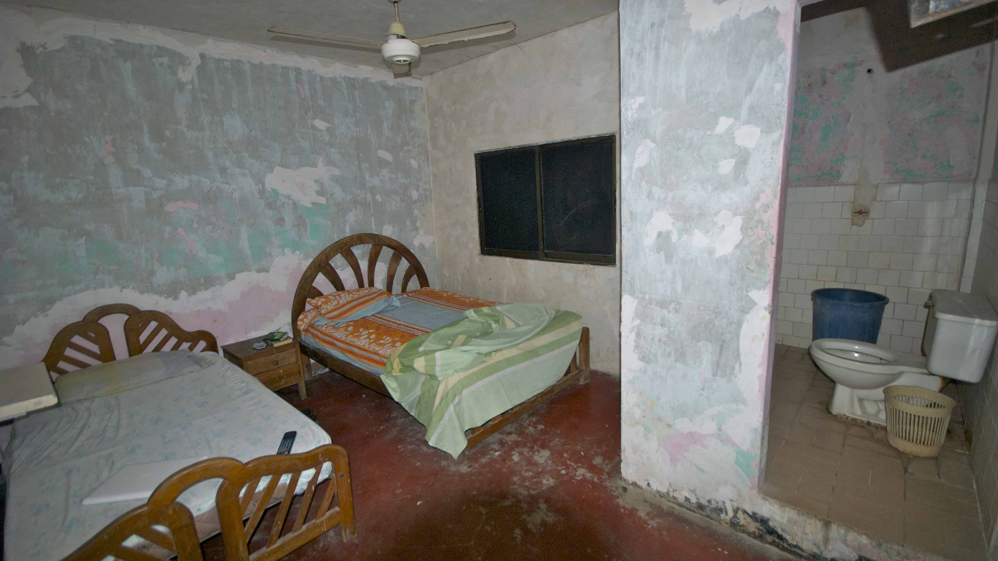
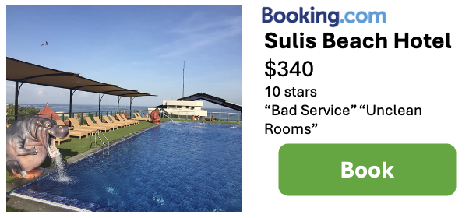
Even though this hotel was listed under a trusted third-party website. Its always possible for there to still be scams.
Reviews from people that have previously stayed at the hotel is a great way to find whether the listing is true.
The hotel with the most stars is 7. This listing has 10 stars which is a clear indicator of a scam.
Here are a few things that indicated the listing was a scam.
Oh no, you were scammed
Retry

Slide 9
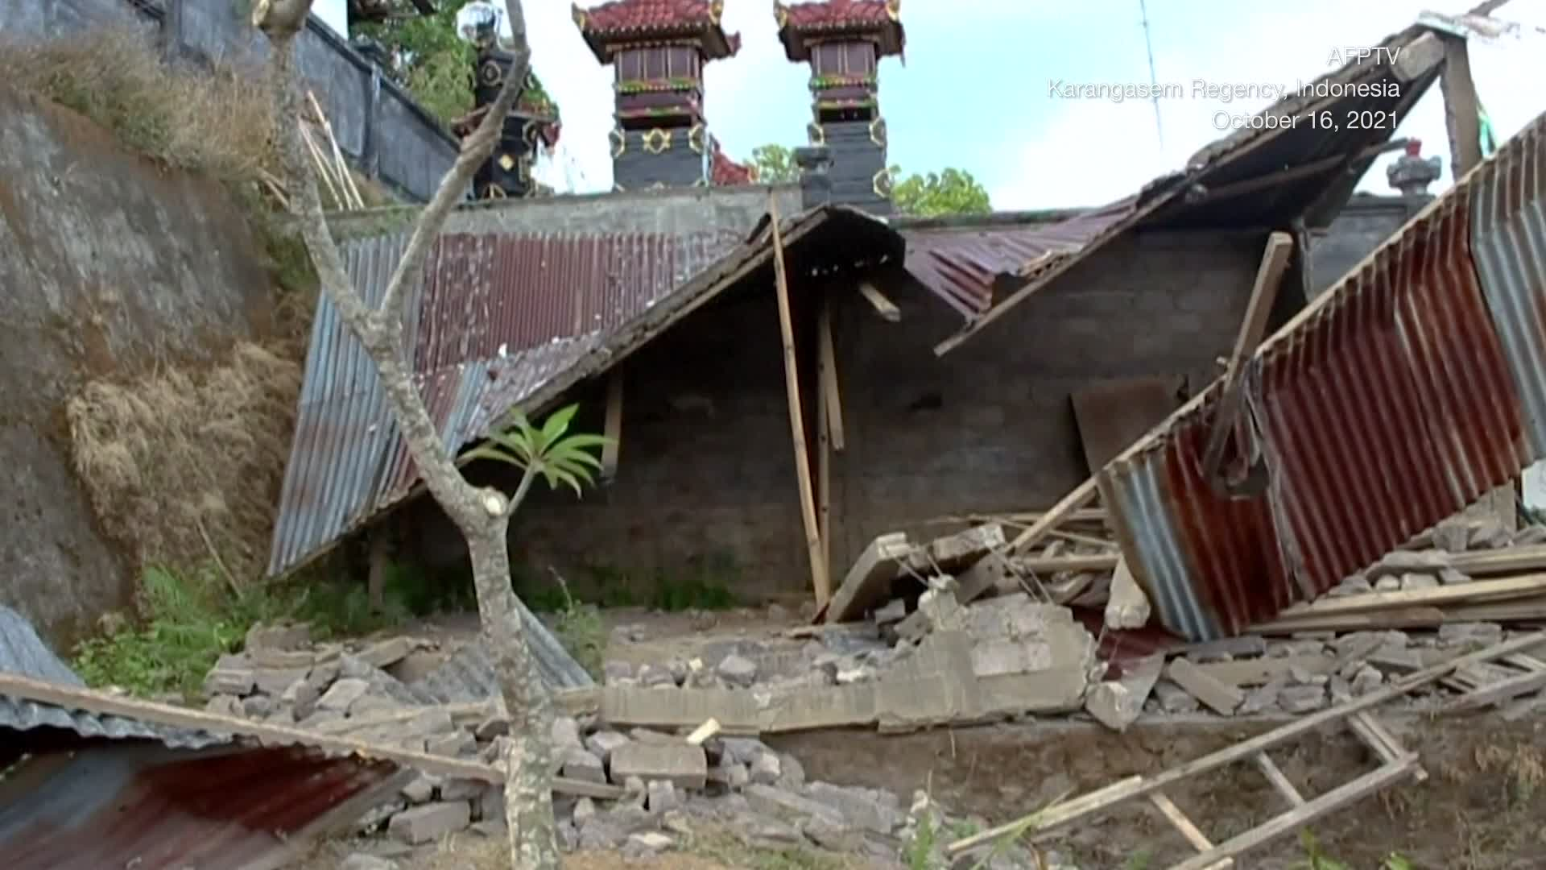
The best way to avoid hotel scams is to book with a trusted third party website. Such as Booking.com or Expedia. As you can see this listing isn’t listed by any trusted website.
First is the unrealistic sale on the listing. The image says it is a 99.99% sale. Whilst the price is only discounted to 94%.
The most stars any hotel has is 7 stars this listing has 99 stars. This is a big indicator to how this is a scam.
Or you can book directly from the hotel website which can be even safer.
Here are a few things that indicated that the listing was a scam.
Oh no! You were scammed!
Retry

Slide 10
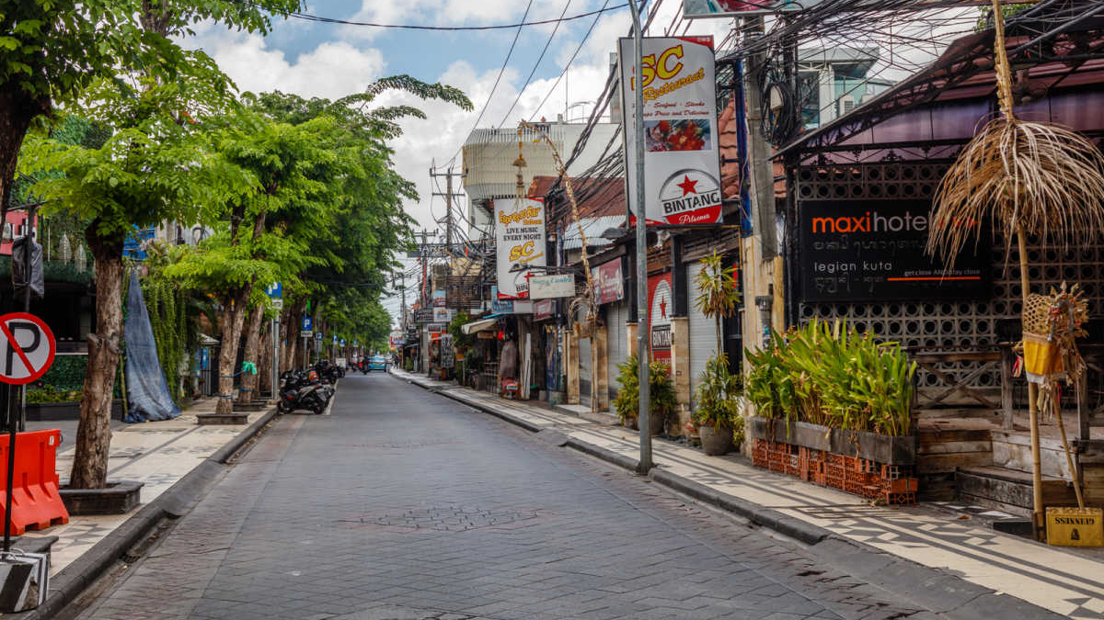

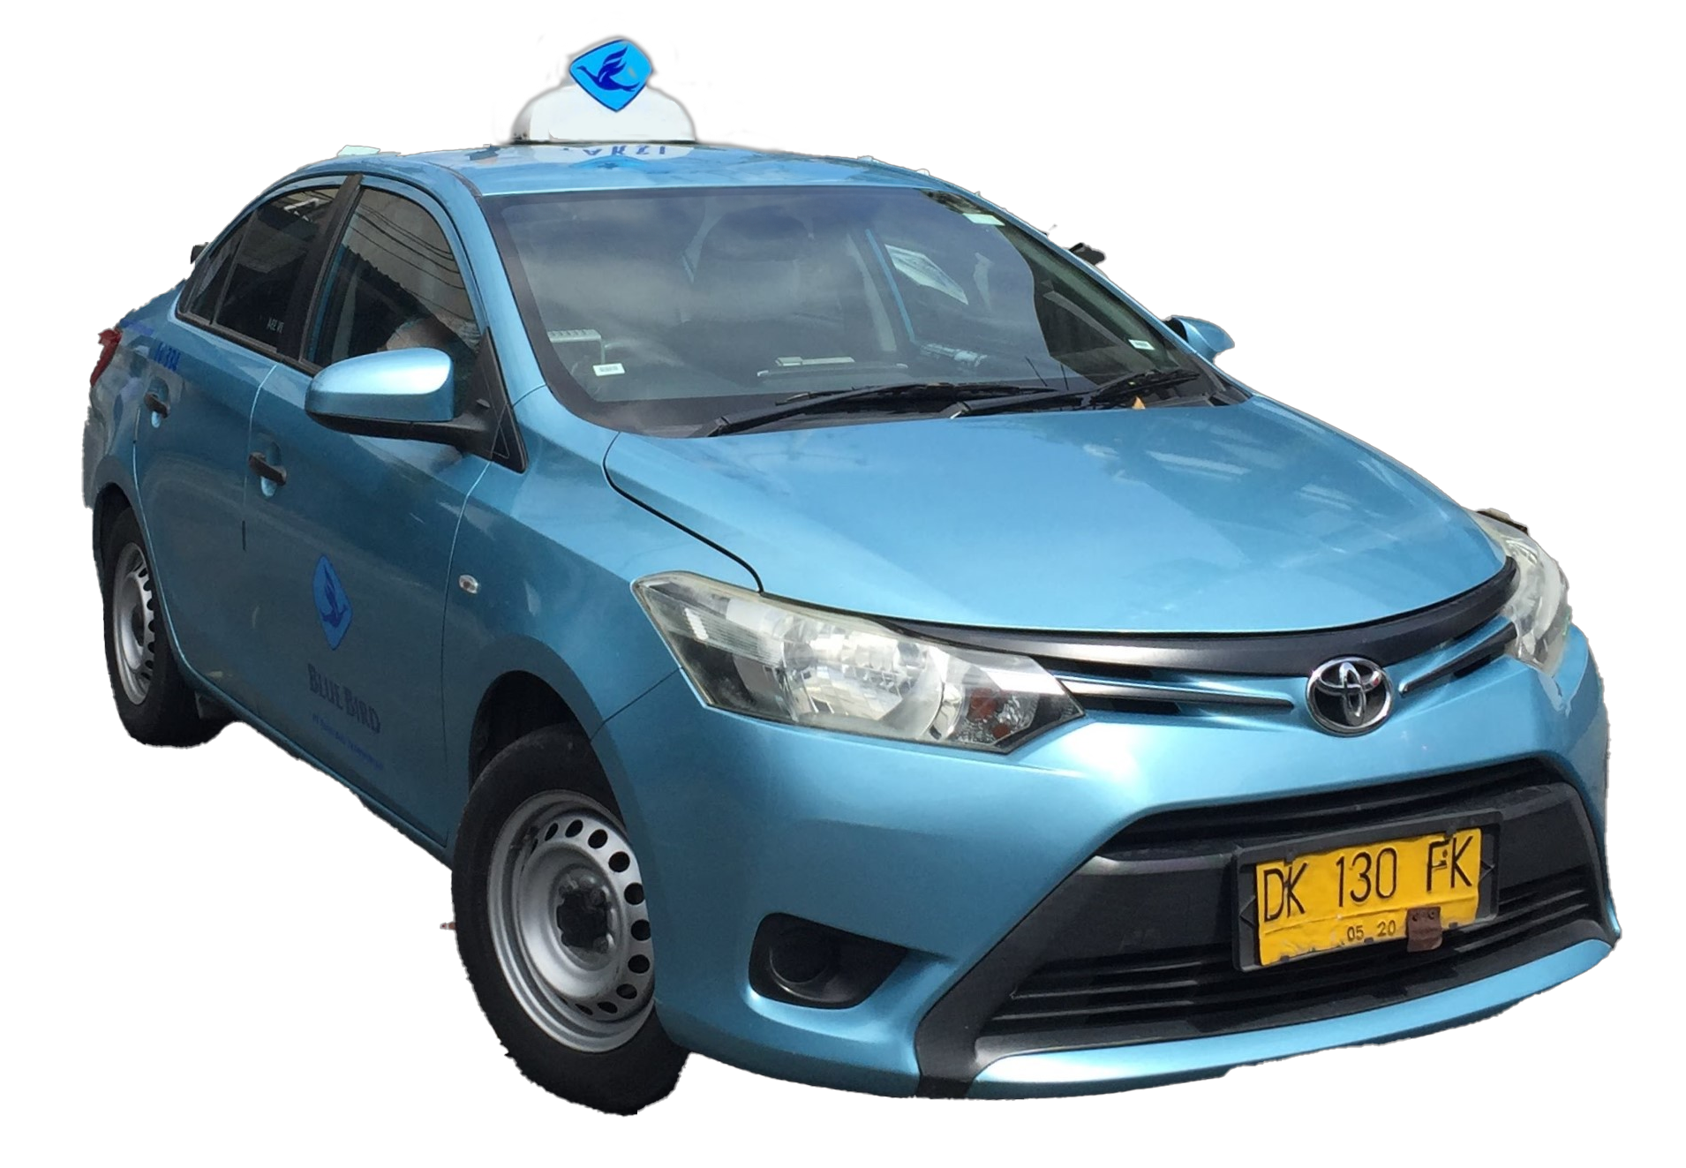
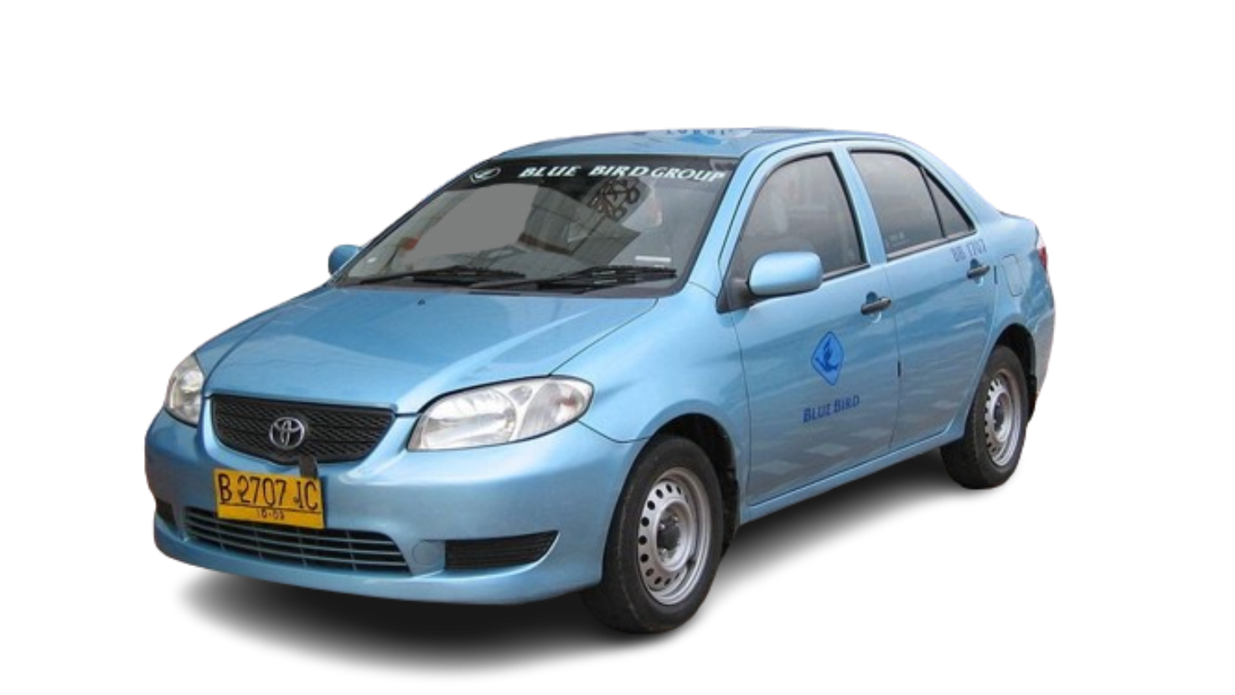


Bluebird taxis are the most popular choice in Bali. But many companies tend to copy them and secretly charge more.
Now that we have booked a hotel its time to go to the party!
The fastest way there is by taxi.
So choose your pick but be careful.

Slide 11
The best thing to look out for is the company name. Usually fake taxis will have a very similar name such as ‘Blue Biro’ that looks like Blue Bird from a distance.
Fake taxis in Bali are pretty tricky to spot.
You chose the fake taxi!
Retry

Slide 12
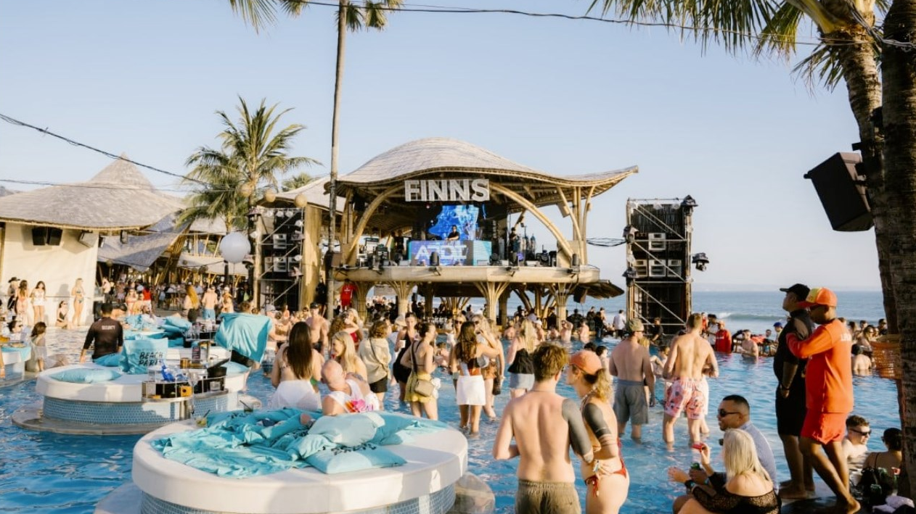


Congratulations on successfully making it to the end of the Bali schoolies adventure!
Return to the menu to try out other locations.
You made it to the party!
SCHOOLIES ADVENTURE
BALI
Return to Menu

Slide 13

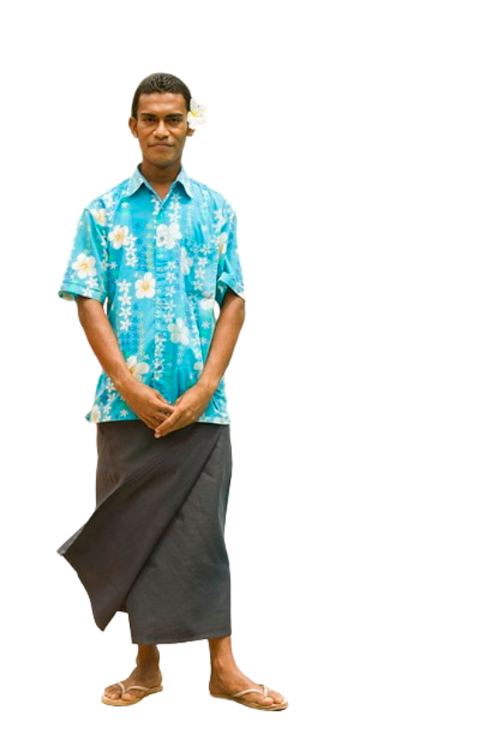
Before the celebrations commence you have a few days to enjoy the wide range of activities Fiji has to offer
But beware there are many scammers trying to cheat you out of your money
Hello welcome to Fiji!
Next

Slide 14
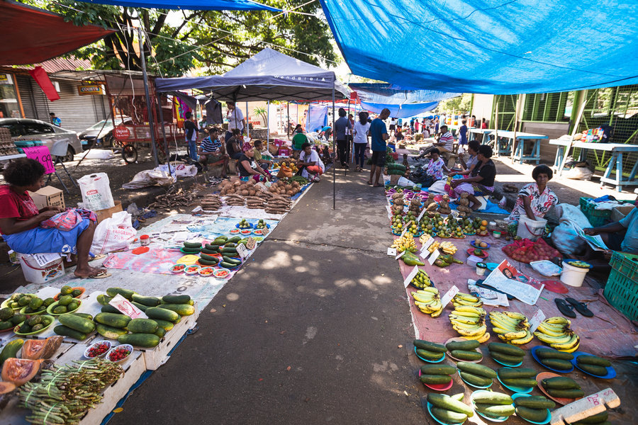
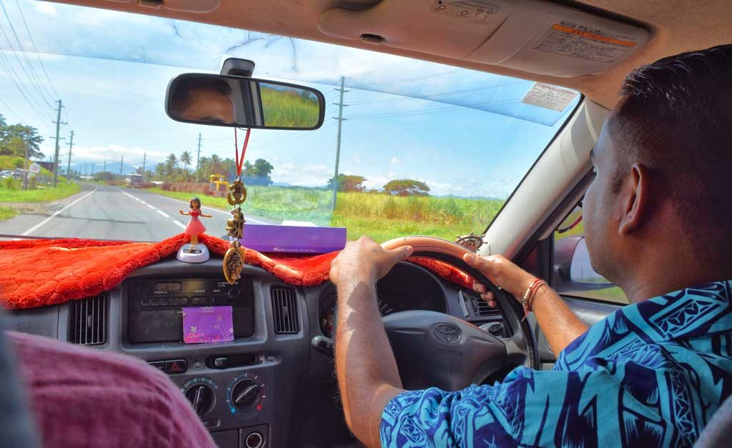
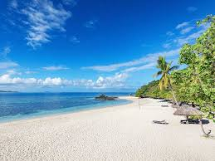
You’ve got a few days before the partying commences, please peruse this browser and decide on an activity to do in the meantime
Things to do in Fiji
Fijian markets
Purchase souvenirs
Eat Fijian street food
Listen to live music
Tours
Experience Fiji in its entirety
Explore beautiful locations recommended by locals
Enjoy the beach
Save money whilst enjoying a nice day out on the beach
Lounge around in the sun, relaxation is key!

Slide 15
Feel free to explore the market and enjoy all it has to offer
However beware of shady people who will try to take advantage of you
Hey you made it !
Explore

Slide 16
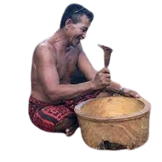
Hello my friend what's your name? you are tourist yes? Where are you from?
Respond
Ignore

Slide 17
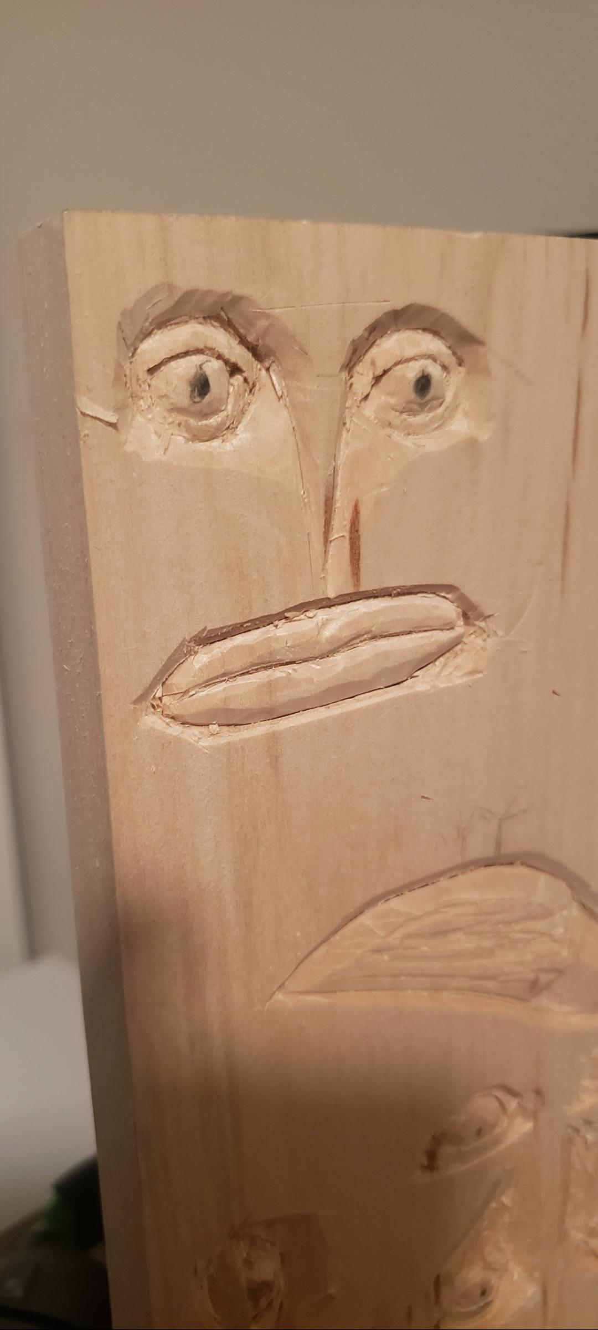
Uh oh you got scammed !A common scam in Fiji occurs when a seemingly friendly
Local will approach you asking for your name and where you're
From however if you reveal this information to them, they will swiftly Whip out a chunk of wood and carve you something they will likely charge you an exuberant amount for this and make you uncomfortable. It is recommended to ignore this to avoid an uncomfortable situation and paying a hefty price (unless you really want to)
continue

Slide 18

Good thinking! You may have avoided a scam and saved some money A common scam in Fiji occurs when a seemingly friendly
Local will approach you asking for your name and where you're
From however if you reveal this information to them they will swiftly Whip out a chunk of wood and carve you something they will likely charge you an exuberant amount for this and make you uncomfortable. It is recommended to ignore this to avoid an uncomfortable situation and paying a hefty price (unless you really want to)
continue

Slide 19
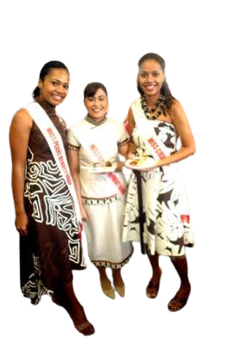
Hey
Hey there you look like a lot of fun we’re going to get some drinks why don’t you join us
Yeah !
Nah!

Slide 20
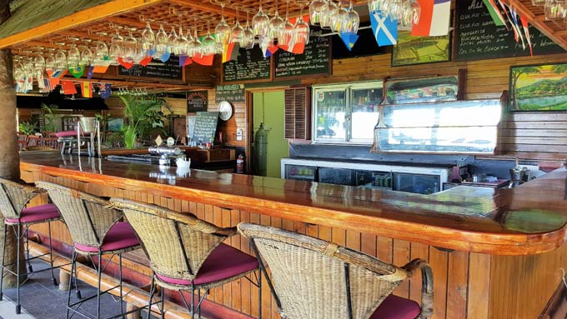
Well here's the place, drink up
Can I see a menu or something I don’t know how much anything costs
Heck yeah party time!

Slide 21
Don’t worry about a menu silly this place is very affordable
Yeah you’re probably right
Nah I’m not trynna get scammed

Slide 22

Okay so 13 shots and 10 beers your total comes to $400 bucks pay or else
next

Slide 23
Bar scams involving over-friendly individuals are common in Fiji. After a little flirtatious chatting, they suggest more drinks in a bar they know. There, you find yourself landed with an exorbitant bill, and some rather large guys will either persuade you to cough up or take you to the nearest ATM to get the cash. The best way to avoid this costly scenario is to choose a different bar altogether and always look at the prices on the drinks menu before ordering.
Schoolies party

Slide 24
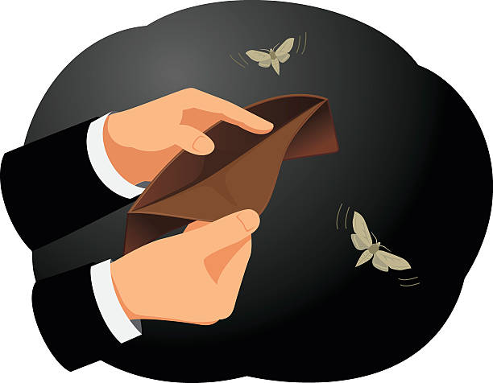
Uh oh you got scammed Bar scams involving over-friendly individuals are common in fiji. After a little flirtatious chatting, they suggest more drinks in a bar they know. There, you find yourself landed with an exorbitant bill, and some rather large guys will either persuade you to cough up or take you to the nearest ATM to get the cash. The best way to avoid this costly scenario is to choose a different bar altogether and always look at the prices on the drink's menu before ordering.
Try again

Slide 25
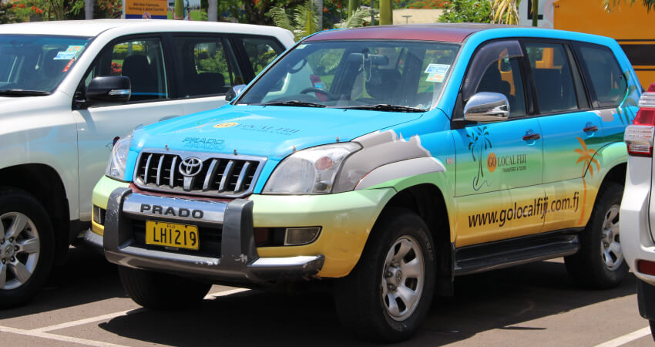
Welcome to the tour have a nice ride and above all stay safe.
Next

Slide 26
Hey how's it going my friend, are you enjoying your stay?
I know a lot of good spots you're gonna have a great time
next

Slide 27
Hey I really like you man how about you come have dinner with me and my family
Wow that was so much fun!
Yeah, sounds great
Nah sorry can you just take me home

Slide 28
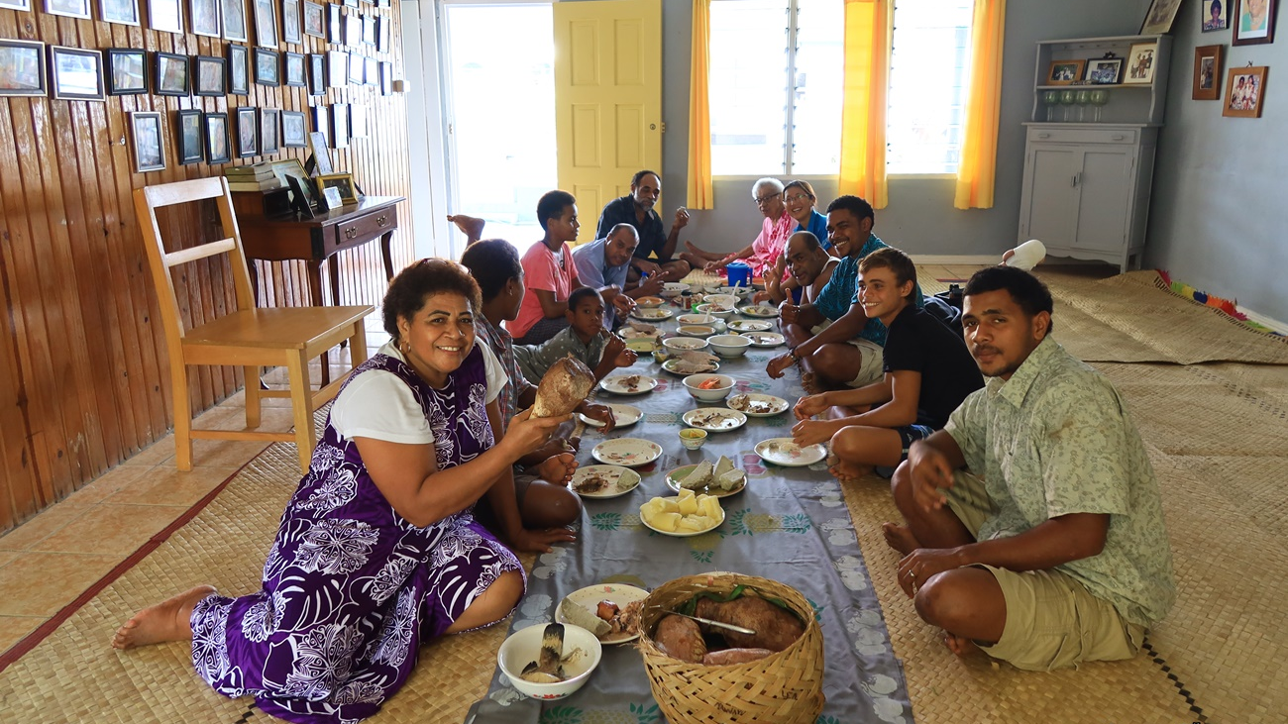
Please make yourself at home come meet my family.
next

Slide 29
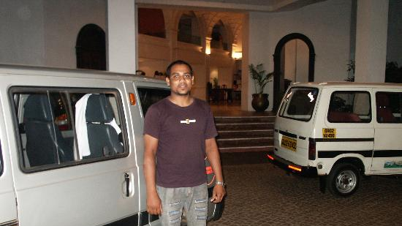
thanks for the fun night my family really liked you here's your bill comes to $500 for the ride and the food and accommodation
Next

Slide 30
Uh oh you got scammed ! A common scam occurs in Fiji where Fijian taxi drivers befriend their passengers before inviting them to dinner at their place. If you accept, you are greeted by their family and enjoy a delicious meal and a pleasant evening. Then comes the sting; when they drive you back to your hotel, your host presents a hefty bill for food and transport. To avoid uncomfortable situations like this, travel safety expert Phil Sylvester advises that visitors should remain "politely alert" and "make firm but gentle inquiries about there being any charge associated with the service you're being offered."
retry

Slide 31
Good thinking! Whilst their hospitality may be enticing it is advised not to get too personal and know how to say no A common scam occurs in Fiji where Fijian taxi drivers befriend their passengers before inviting them to dinner at their place. If you accept, you are greeted by their family and enjoy a delicious meal and a pleasant evening. Then comes the sting; when they drive you back to your hotel, your host presents a hefty bill for food and transport. To avoid uncomfortable situations like this, travel safety expert Phil Sylvester advises that visitors should remain "politely alert" and "make firm but gentle inquiries about there being any charge associated with the service you're being offered."
Party time!

Slide 32
Continue to party
Nice thinking the beach is a great way to relax and not have to worry about potential scams if you find a remote enough beach you may not even encounter another person !
Pick another activity

Slide 33
Feel free to restart the simulator and explore other scams to beware of, if you wish
Congratulations on making it to the party without getting scammed
SCHOOLIES ADVENTURE
Fiji
restart

Slide 34
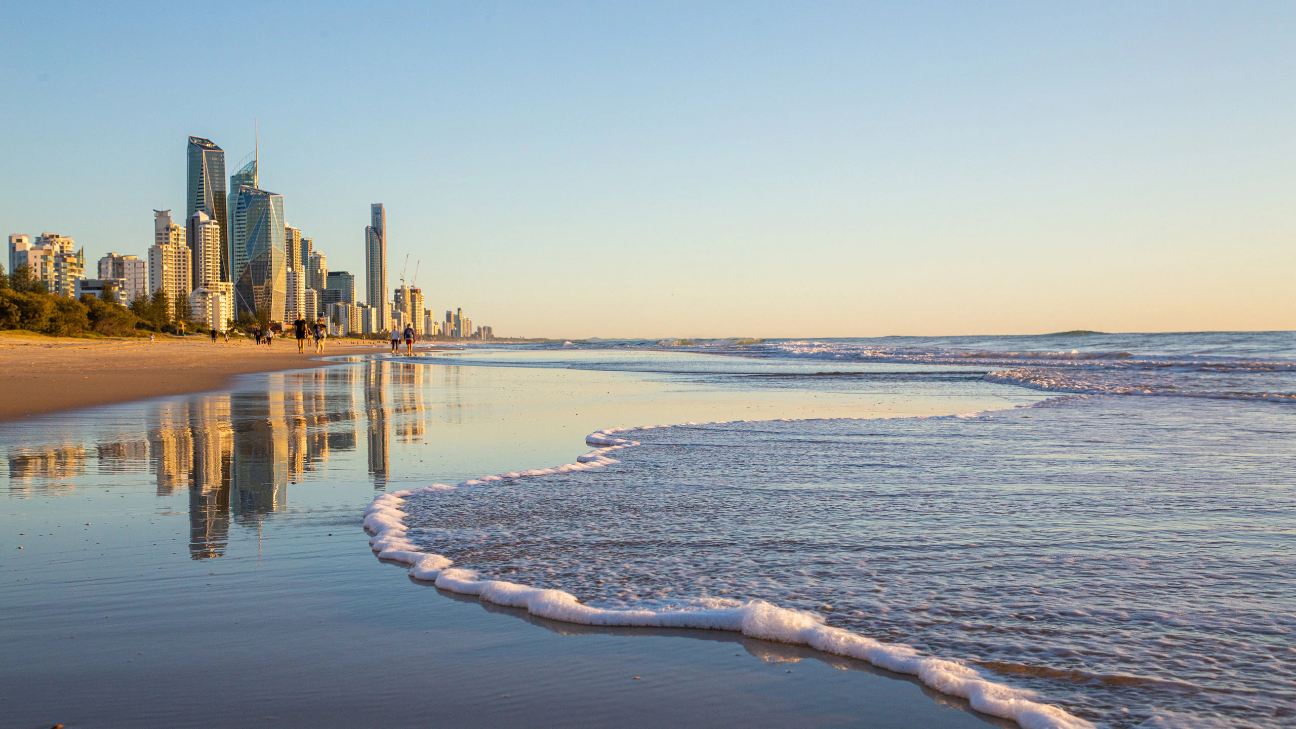

There’s a couple things we need to do before we can get partying.
Hello, welcome to the Gold Coast!
Lets start with booking a hotel for this week.
Next

Slide 35
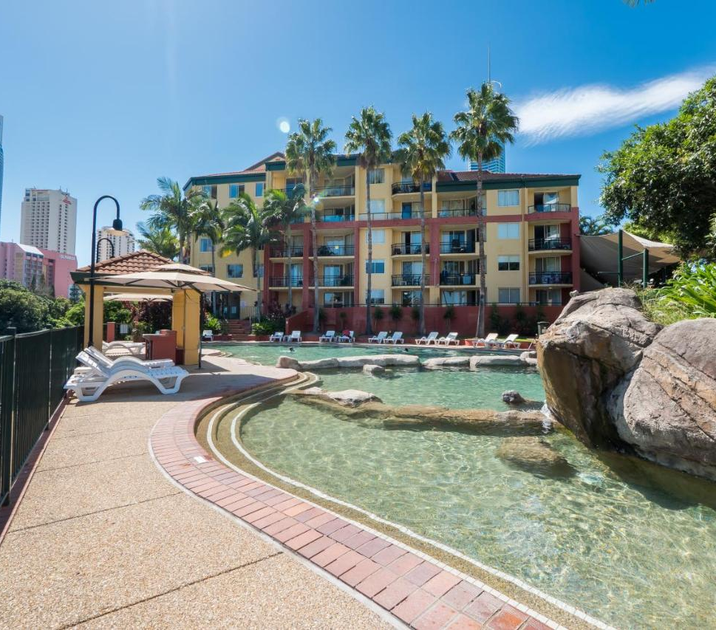
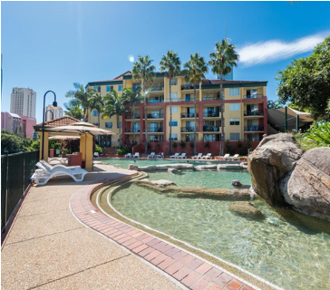

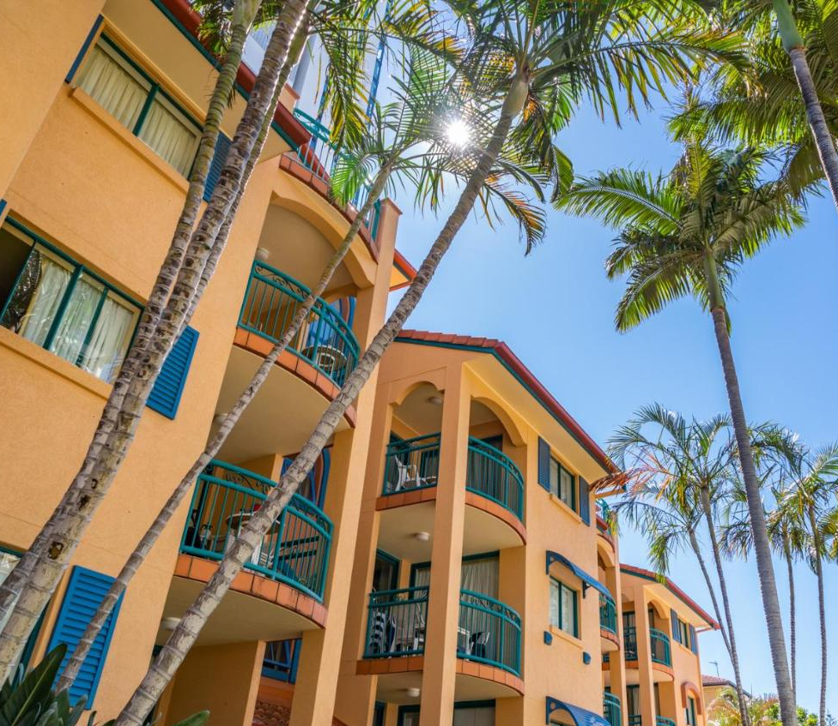
Choose your pick and remember you’ve set aside $800 to spend on hotels.
I’ve searched for hotels around the Gold Coast
Make sure you choose carefully!
Hotels on the Gold Coast
Paradise Island Resort
$750
4.5 stars
“Great Hotel” “Clean Rooms”
Paradise Island Resort
$750 $599
4.5 stars
“Great Hotel” “Clean Rooms”
Book
Book
99.99% OFF
Aruba Sands Hotel
$650
10 stars
“Bad Service” “Unclean Rooms”
LIMITED TIME LUXURY PENTHOUSE HOTEL
$1500 $60 per person
80 stars
Book
Book
BIG SALE!!!!

Slide 36
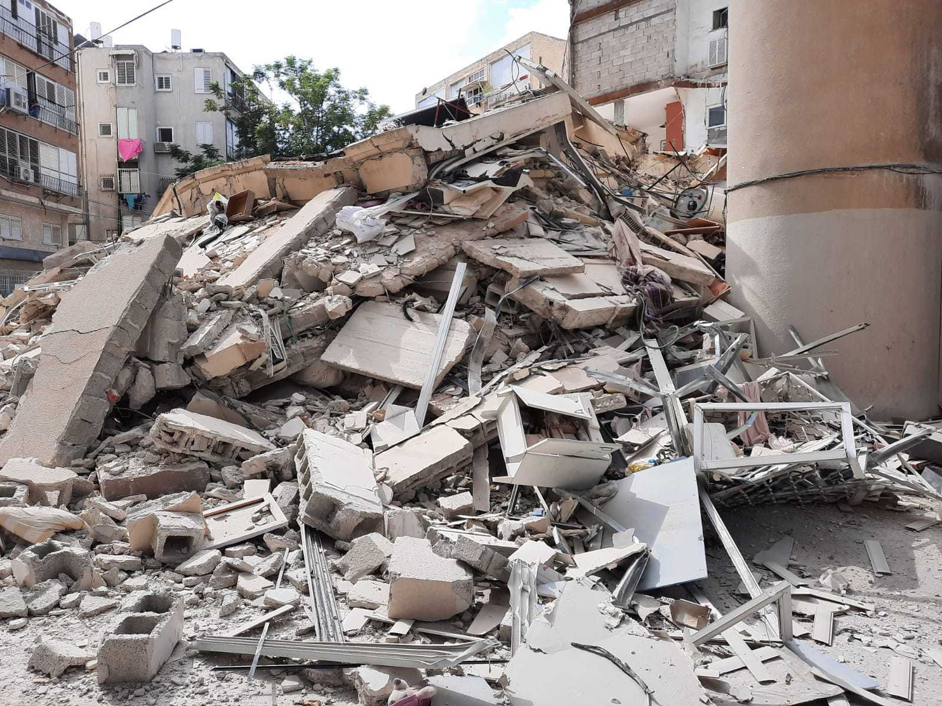


The best way to avoid hotel scams is to book with a trusted third party website. Such as Booking.com or Expedia. As you can see this listing isn’t listed by any trusted website.
First is the unrealistic sale on the listing. The image says it is a 99.99% sale. Whilst the price is only discounted to 96%.
The most stars any hotel has is 7 stars this listing has 99 stars. This is a big indicator to how this is a scam.
Or you can book directly from the hotel website which can be even safer.
Here are a few things that indicated that the listing was a scam.
Oh no! You were scammed!
Retry

Slide 37
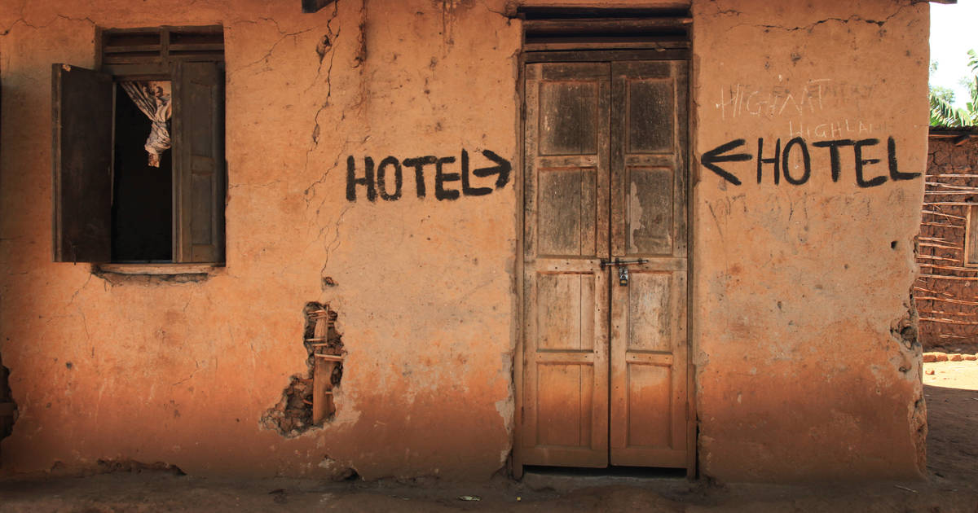
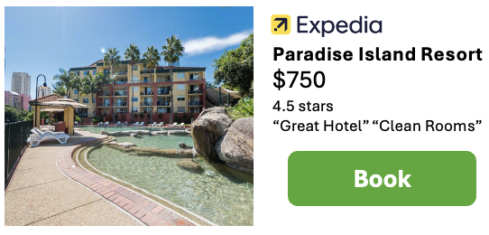

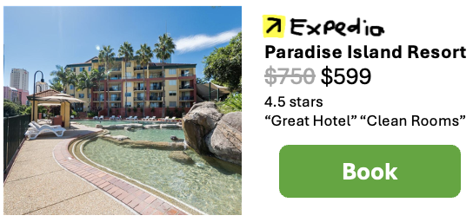
This is a common way of scamming and is one to be aware of.
Here are some things that indicated it was a scam.
This was a fake copy of the real listing.
This can be seen by the copy of the website logo.
Oh no! You were scammed!
Retry

Slide 38
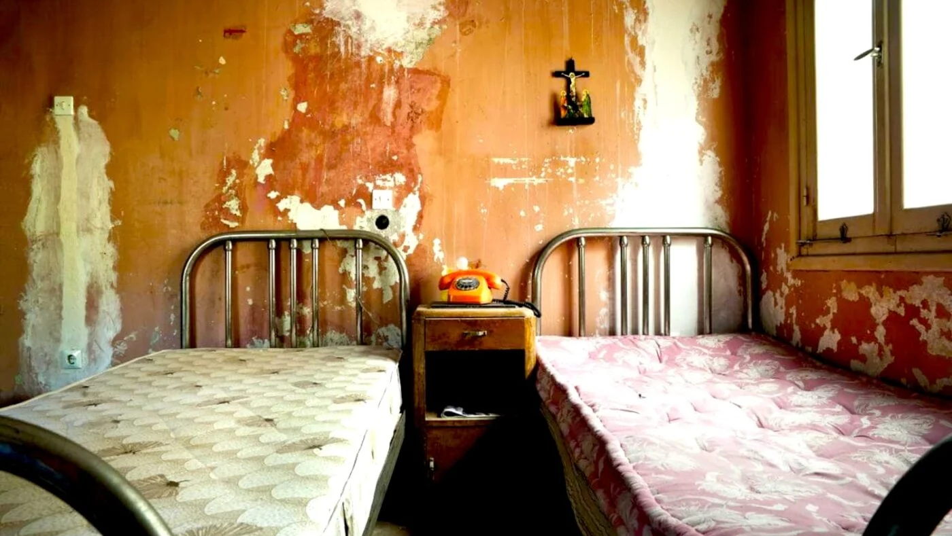
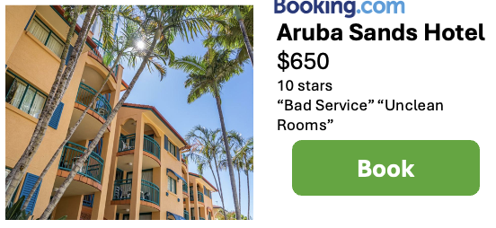
Even though this hotel was listed under a trusted third-party website. Its always possible for there to still be scams.
Reviews from people that have previously stayed at the hotel is a great way to find whether the listing is true.
The hotel with the most stars is 7. This listing has 10 stars which is a clear indicator of a scam.
Here are a few things that indicated the listing was a scam.
Oh no, you were scammed
Retry

Slide 39
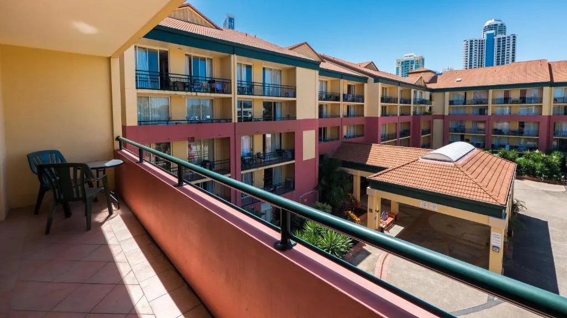

No matter where you are on the internet its always important to look out for scams like these.
There are many, such as the unrealistic discount, star rating and third-party website.
There were some listings that were fake but you managed to carefully discover the right option.
Can you spot everything that indicates it’s a scam?
Here’s an example of one of the scams.
Well done! you weren’t scammed.
Continue

Slide 40
Most of the schoolies activities are around Surfers Paradise. Which is in walking distance.
To go to other parts of the Gold Coast requires a quicker method of transport.
You have a choice between scooters or a rental car.
Scooter
Car

Slide 41
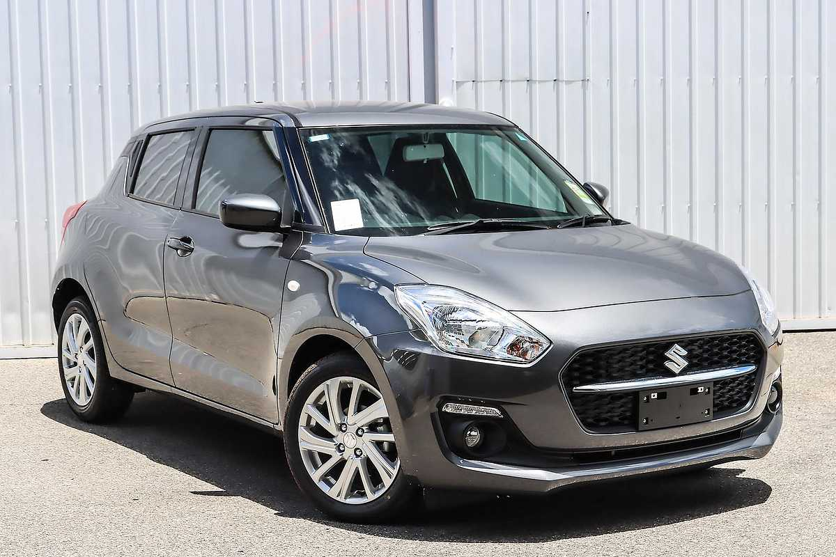

Car hire Gold Coast
←
→
Suzuki Swift 19’
Automatic Transmission
$100/day
Hire

Slide 42

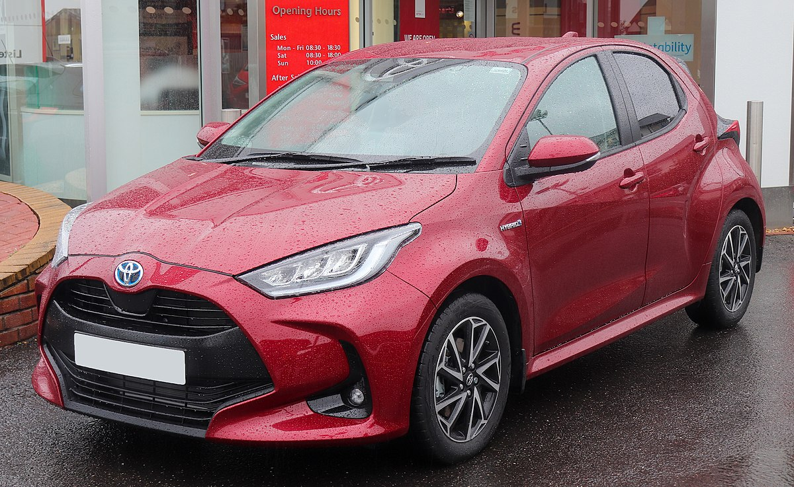
Car hire Gold Coast
←
→
Toyota Yaris 22’
Automatic Transmission
$110 $95/day
Hire

Slide 43
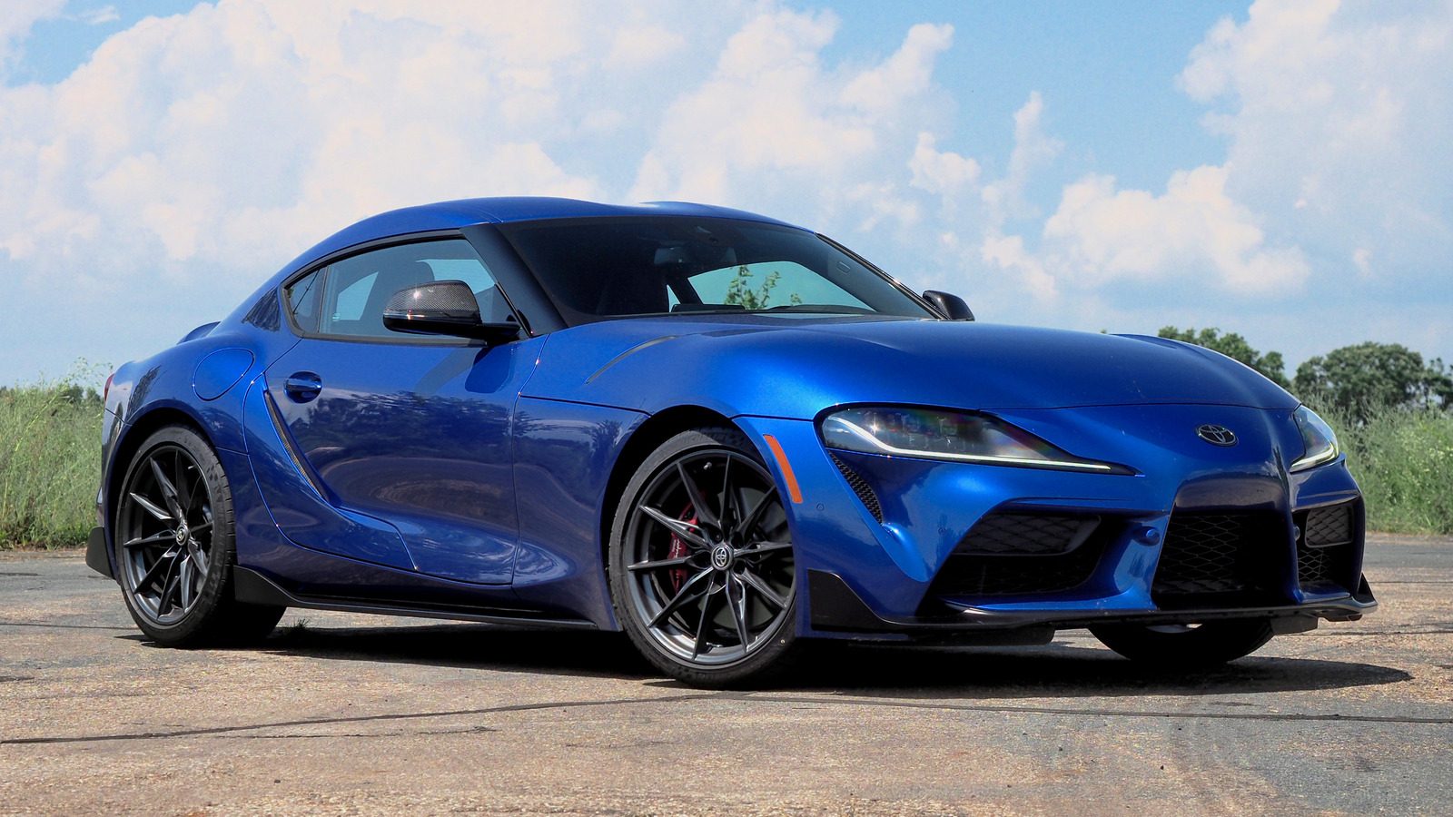

Car hire Gold Coast
←
→
Toyota GR Supra 21’
Limited time summer offer!
$500 $0/day
Hire

Slide 44
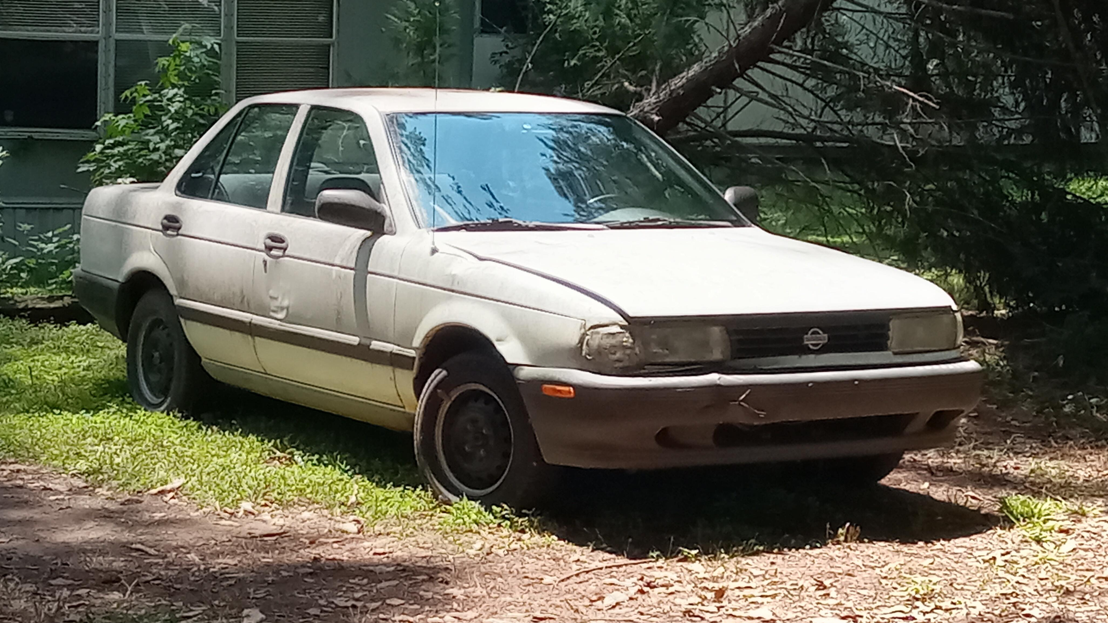

These kind of scams will typically charge you for an unauthorized insurance claim
The “free” hire scam is common and many people fall for it.
Oh no! You were scammed.
Retry

Slide 45
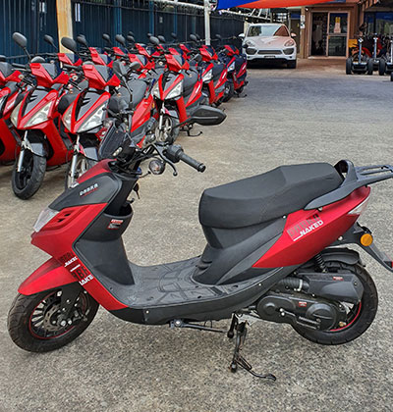
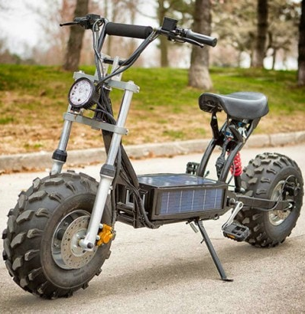
Electric Scooter Hire Gold Coast
scooterhiregoldcoast.com
BIG BEAST SCOOTER HIRE
50cc motor
License required
$35/hour
99,999 watt engine!
Up to 150km/h!
$100 $15/hour
Hire
Hire

Slide 46

Scooters of this kind only have up to around a 2000 watt motor.
The scooter claimed to have a 99,999 watt motor.
The scooter displayed false information on the listing.
Oh no! You were scammed.
Retry

Slide 47
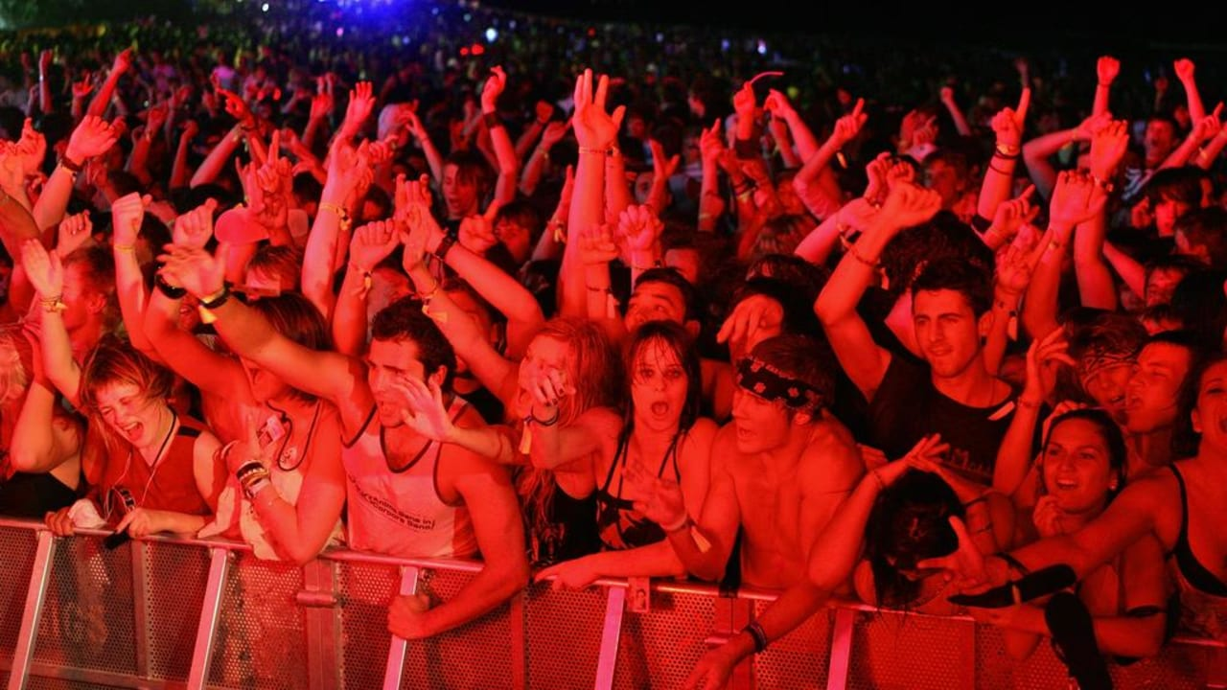
Congratulations on successfully making it to the end of the Gold Coast schoolies adventure!
Return to the menu to try out other locations.
You made it to the party!
SCHOOLIES ADVENTURE
Gold Coast
Return to Menu

