Slide 1


Gambling venue staff training
Notes:
Version: November 2024.

Slide 2

Acknowledgement of Country
We acknowledge the Traditional Custodians of the lands and waters on which we meet today.
We pay our respects to Elders past, present and emerging.
We extend that respect to Aboriginal and Torres Strait Islander peoples here today.
Notes:
Note for presenter:
Please include the name of the First Nations group(s) who are the Traditional Custodians of the land where the presentation is being conducted.
Speaker’s notes:
We’d like to start by acknowledging the Traditional Custodians of the land on which we meet today, the (people) of the (nation), and pay our respects to Elders past, present and emerging, and extend that respect to Aboriginal and Torres Strait Islander peoples here today. We recognise their continuing connection to lands, waters and communities as the original storytellers and sharers of knowledge in Australia and understand the important role that Aboriginal and Torres Strait Islander peoples contribute to conversations about gambling and gambling harm minimisation.

Slide 3
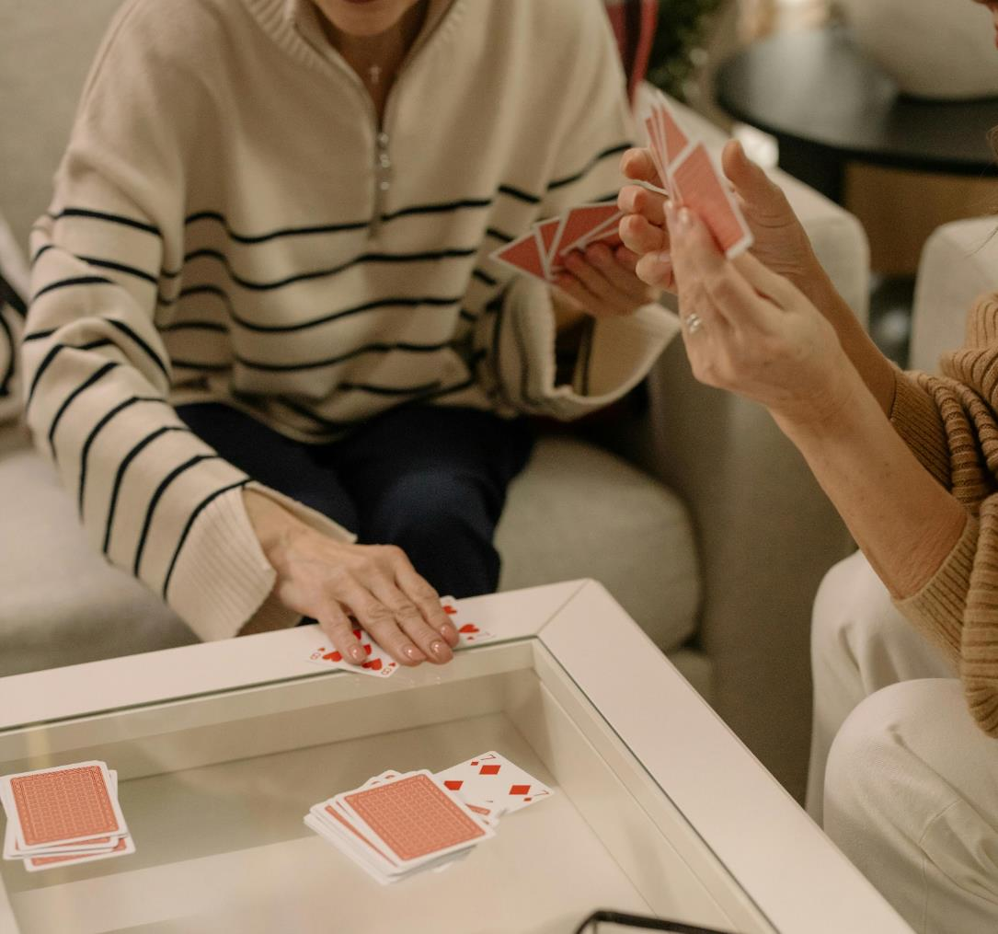
Overview
Introduction to gambling
Gambling harm
Gambling harm risk factors
Your role
Signs of gambling harm
Support services
Notes:
Speaker’s notes:
In this module, we’re going to talk about the basics of gambling. You will learn about gambling harm and its signs and risk factors, your role in the prevention of gambling harm and the available support services for people who might need help.

Slide 4




Gambling Help services
Gambling Help Services are free and funded by the Queensland Government
We provide support for people experiencing gambling harm
We deliver community education and counselling services
[Add community educator contact information here.]
Notes:
Note for presenter:
Please include the relevant GHS community educator contact information.
Speaker’s notes:
To start, we’d like to briefly talk about who we are and what we do. Gambling Help services are free Government-funded services delivered by a network of community-based specialist support agencies, like ours. We provide support to people experiencing gambling harm, including those impacted by someone else's gambling. We deliver community education and training, like what we’re doing here today, and participate in networking activities to teach the community more about safer gambling and gambling harm. You can find our contact information on the screen.
References:
Gambling Help Queensland. (2024). About us. https://www.gamblinghelpqld.org.au/about-us

Slide 5



Our services
Call the 24/7 Gambling Helpline on 1800 858 858
Face-to-face counselling locations
Online counselling and real time chat
Notes:
Speaker’s notes:
As well as community education, we also deliver counselling for people experiencing gambling harm. Our services are free and confidential. We provide safe, warm and non-judgmental environments for people to talk about their experiences of gambling harm and together, we find ways to make changes in that person’s life. Our counselling services are available face-to-face, over the phone, or online.
References:
Gambling Help Queensland. (2024). About us. https://www.gamblinghelpqld.org.au/about-us

Slide 6
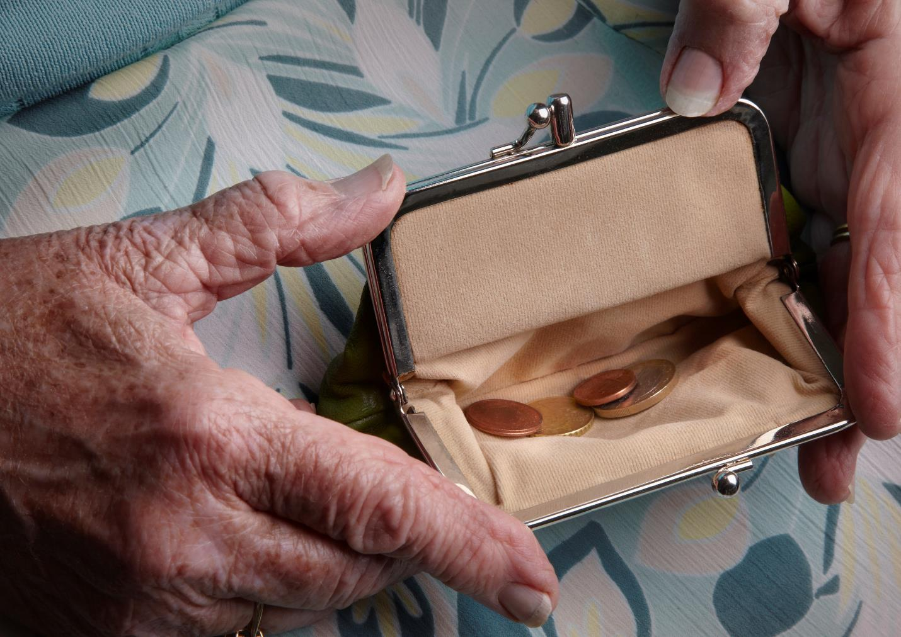
What is gambling?
The act of wagering or betting money or something else of value on an uncertain outcome to try to win more things of value.
It always involves a risk or chance.
Notes:
Speaker’s notes:
Gambling is the act of wagering or betting money or something of value on an event with an uncertain outcome with the hope of winning more money or things of value than was wagered. Gambling involves risking something for the chance of winning more.
References:
Gambling Help Online. (2022). Learn about gambling. https://www.gamblinghelponline.org.au/support-yourself-or-others/understanding gambling/what-is-gambling?language_content_entity=en

Slide 7

What can people gamble on?
Lotteries and scratchies
Race betting
Sports betting
Pokies
Casino games
Keno and bingo
Other novelty events
Notes:
Speaker’s notes:
Someone can gamble on anything deemed to be of value or interest. In Australia, people can gamble on lotteries and scratchies; race betting, such as horse, greyhound and harness racing; sports betting, like the NRL and AFL; the pokies and more. People can gamble at a hotel, club or casino, in their own home, or through websites and mobile apps, like Sportsbet and TAB.
References:
Queensland Government. (2024). Queensland Gambling Survey 2023. https://www.publications.qld.gov.au/dataset/liquor-and-gambling-research
Australian Gambling Research Centre. (2023). Gambling participation and experience of harm in Australia. Australian Institute of Family Studies. https://www.publications.qld.gov.au/dataset/liquor-and-gambling-research/resource/4267f3c2-950b-407e-b88f-d31e116cedcb

Slide 8



Popularity of gambling in Queensland
70% of Queenslanders gambled in 2023
Men are more likely to gamble
18–34-year-olds gamble more than others
Notes:
Speaker’s notes:
In 2024, research found that around 70% of Queensland adults have gambled at least once in the past 12 months. The most popular gambling products were lotteries, scratchies, art union tickets, the pokies and race betting. The research also showed that more men gambled than women, and men were more likely to gamble more often and spend more money. The research also showed that young people aged 18-34 years gambled more than any other age group.
References:
Queensland Government. (2024). Queensland Gambling Survey 2023. https://www.publications.qld.gov.au/dataset/liquor-and-gambling-research
Australian Gambling Research Centre. (2023). Gambling participation and experience of harm in Australia. Australian Institute of Family Studies.

Slide 9

Is it normal to gamble?
Gambling seems normal due to…
The promotion and advertising of gambling products
The support of gambling within communities
Online gambling platforms
Notes:
Speaker’s notes:
Gambling in Australia seems very normal and common. It’s easy to think that everybody does it and that it’s simple and fun. Some things seem so normal to gamble on, you might not even know it’s considered gambling – like entering a raffle at your local community event.
But there are several factors which contribute to why gambling can seem so normal. These include: the promotion and advertising of gambling products on TV and online, making them seem like a regular, easy and fun activity; the support of gambling by socially and culturally valued groups within communities, such as community clubs, and sporting teams and codes; and the accessibility of online gambling platforms, which can be used at any time of the day. Together, these things make gambling seem so normal that it’s easy to think there is no risk or harm involved. But it’s important to know there is always risk and chances are you will lose.
References:
Thomas, S, Pitt, H, Bestman, A, Randle, M, McCarthy, S, Daube, M 2018, The determinants of gambling normalisation: causes, consequences and public health responses, Victorian Responsible Gambling Foundation, Melbourne.

Slide 10

Why do people gamble?
Recreation or excitement
Try to win back losses
Try to deal with difficult emotions and life challenges
Notes:
Speaker’s notes:
There are many reasons why people gamble. ​
Gambling can be a recreational activity for some people, like watching a movie or going to a theme park. People may gamble for excitement, entertainment with family and friends, or to try winning money. ​
People can also gamble for other reasons. This may be to relieve boredom; to try to feel better about themselves; to win back losses or solve financial problems; to avoid sadness, worry, loneliness or other difficult emotions; to avoid relationship problems, work stress or struggles with other life challenges; or to cope with trauma.
References:
Gambling Help Queensland. (2024). Signs of gambling harm. https://www.gamblinghelpqld.org.au/signs-of-gambling-harm

Slide 11

Gambling harm
Any negative impact that gambling can have on a person and the people close to them
Includes
  Health and wellbeing
  Finances
  Relationships
  Culture
  Work or study
Notes:
Note to presenter: There is further background on gambling harm in modules “Gambling harm”, “Gambling and domestic and family violence”, “Gambling and substance use”, and “Gambling and mental health”.
Speaker’s notes:
Gambling harm is a term used to describe the many ways that gambling can impact a person’s life. It refers to any negative impact that gambling can have on a person and the people close to them. It can include harm to a person’s health and wellbeing, their finances, their relationships, their culture, and their work or study. Gambling harm can put immense pressure on families and relationships, and be a factor in DFV, substance misuse, and mental health issues.
Gambling harm can be experienced on a spectrum, ranging from minor or less frequent negative experiences to severe or ongoing impacts. It can be experienced by anybody, no matter how long a person has been gambling or how frequently. Gambling harm can even occur many years after a person’s actual gambling has stopped.
Severe gambling issues can reach a point where a person can be clinically diagnosed with gambling disorder, which is classified as a Substance-Related and Addictive Disorder by the American Psychiatric Association.
References:
Langham, E., Thorne, H., Browne, M., et al. (2015). Understanding gambling related harm: a proposed definition, conceptual framework, and taxonomy of harms. BMC Public Health, 16(1). https://doi.org/10.1186/s12889-016-2747-0
American Psychiatric Association. (2013). Diagnostic and statistical manual of mental disorders (5th ed.). https://doi.org/10.1176/appi.books.9780890425596

Slide 12

Affected others
Gambling harm impacts many people, not just the person who gambles
Affected others include
  Partner/Spouse
  Children
  Other family members
  Friends
  Work colleagues
  Broader community members
Notes:
Speaker’s notes:
It is important to know that gambling harm isn’t only about the person who gambles. It also impacts the people close to them, including their partner, children, other family members, friends, work colleagues, other important relationships, and broader communities. These people are called ‘affected others’.
When we talk about gambling harm, we always talk about how it impacts everyone – people who gamble and affected others. This helps us understand the many ways that gambling harm can impact people’s lives and our community as a whole.
References:
Langham, E., Thorne, H., Browne, M., et al. (2015). Understanding gambling related harm: a proposed definition, conceptual framework, and taxonomy of harms. BMC Public Health, 16(1). https://doi.org/10.1186/s12889-016-2747-0
Browne, M, Langham, E, Rawat, V, et al. (2016) Assessing gambling-related harm in Victoria: a public health perspective. Victorian Responsible Gambling Foundation, Melbourne.

Slide 13

Louise’s story
Notes:
Note to presenter: Choose one of the lived experience videos to play, based on what you think would work for the audience.
Speaker’s notes:
It can help to understand what gambling harm looks and feels like by hearing it from someone who has experienced it. Louise is a mother and grandmother who lives in Hervey Bay in Queensland. This is her story.
References:
Office of Liquor and Gaming Regulation. (2021). 'When gambling took over...' Louise. https://www.youtube.com/watch?v=fQ0GD0_SzCk

Slide 14

David’s story
Notes:
Note to presenter: Choose one of the lived experience videos to play, based on what you think would work for the audience.
Speaker’s notes:
It can help to understand what gambling harm looks and feels like by hearing it from someone who has experienced it. David is a community worker who lives in Brisbane, Queensland. This is his story.
References:
Office of Liquor and Gaming Regulation. (2021). 'When gambling took over...’ David. https://www.youtube.com/watch?v=51snzhCSDw8

Slide 15

Allen’s story
Notes:
Note to presenter: Choose one of the lived experience videos to play, based on what you think would work for the audience.
Speaker’s notes:
Now, we’re going to hear about Allen’s experience of gambling harm. Allen is a retired AFL player who lives in Brisbane, Queensland. This is his story.
References:
Office of Liquor and Gaming Regulation. (2021). 'When gambling took over...’ Allen. https://www.youtube.com/watch?v=FkqP1jqjeOU

Slide 16
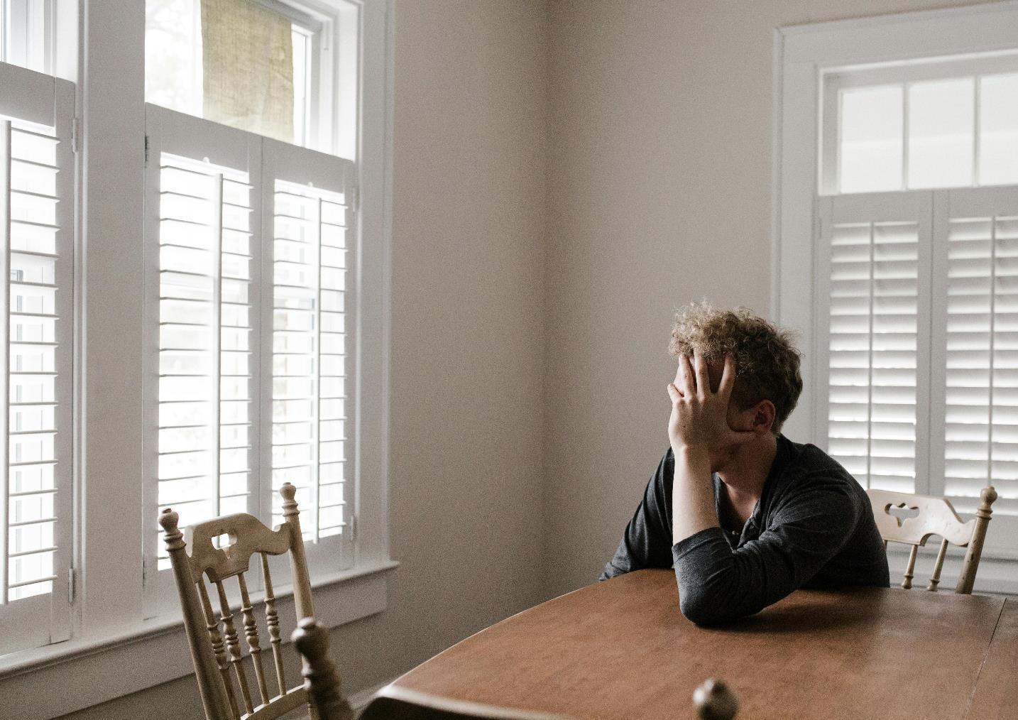
Gambling and mental health
People who experience gambling harm are more likely to experience poor mental health
Includes feelings of sadness, anxiety, anger, guilt and shame
40%
of people who experience gambling harm also have depression or anxiety
Notes:
Speaker’s notes:
Let’s talk about the link between gambling and mental health. Mental health, as many of you will know, refers to a state of well-being in which an individual realises their own abilities, can cope with the normal stresses of life, can work productively and is able to make a contribution to their community.
Research tells us that people who experience gambling harm are more likely to have mental ill-health. About 40% of people who experience gambling harm also have depression or anxiety, with many others reporting feelings of sadness, anxiety, anger, guilt, shame, self-doubt and feelings of failure. Generally, people who are experiencing both gambling harm and mental ill-health usually experience mental health difficulties first and use gambling as a coping mechanism. However, it can also work the other way too – where people who are experiencing gambling harm also experience mental ill-health because of their gambling. That’s why there’s such a strong link between gambling and mental health concerns.
References:
World Health Organisation. (2022). Mental health. https://www.who.int/news-room/fact-sheets/detail/mental-health-strengthening-our-response
Gambling Help Online. (2024). Gambling and mental health issues. https://www.gamblinghelponline.org.au/support-yourself-or-others/understanding-gambling/gambling-and-mental-health-issues
Dowling, N. A., Cowlishaw, S., et al. (2015). Prevalence of psychiatric co-morbidity in treatment-seeking problem gamblers: A systematic review and meta-analysis. The Australian and New Zealand journal of psychiatry, 49(6), 519–539. https://doi.org/10.1177/0004867415575774

Slide 17

Gambling harm risk factors
Social risk factors
Gender: men are more at-risk than women
Age: 18–34-year-olds
Occupation: blue collar workers
Notes:
Speaker’s notes:
There are factors in our lives that can increase our risk of experiencing gambling harm. We have separated these into social risk factors and individual risk factors.
Firstly, let’s talk about social risk factors. Research tells us that there are groups of people who are more vulnerable to gambling harm. In general, men are more at-risk than women. Some research published in 2023 says that amongst men in Australia who gamble, 53% are at-risk of harm. Similarly, people who are aged between 18-34 years are more likely to experience gambling harm than any other age category, but young people under the age of 18 are also of increasing concern.
Likewise, a person’s job can make them more at-risk. People in blue-collar jobs, like construction, vehicle drivers, and factory workers, can be more vulnerable to experiencing gambling harm, according to research.
It can help to be aware of these social risk factors when trying to understand someone one’s risk of gambling harm.
References:
Australian Institute for Health and Wellbeing. (2023). Gambling in Australia. https://www.aihw.gov.au/reports/australias-welfare/gambling
Binde, P., & Romild, U. (2020). Risk of problem gambling among occupational groups: A population and registry study. Nordic Studies on Alcohol and Drugs: NAT, 37(3), 262–278. https://doi.org/10.1177/1455072519899779
Australian Gambling Research Centre. (2023). Gambling participation and experience of harm in Australia. Australian Institute of Family Studies. https://www.publications.qld.gov.au/dataset/liquor-and-gambling-research/resource/4267f3c2-950b-407e-b88f-d31e116cedcb

Slide 18

Gambling harm risk factors
Individual risk factors
Big changes in life
Mental ill-health
Drugs or alcohol
Previous experience of gambling harm
Notes:
Speaker’s notes:
There are also individual risk factors which can make someone more vulnerable to experiencing gambling harm. These are about particular circumstances in our lives.
Some of these factors include: recent major changes to life, including separation or divorce, job loss, or the death of a loved one; struggles with mental health, including anxiety and depression; excess use of drugs or alcohol; having experienced gambling harm before; or having a parent, partner or close friend who has experienced gambling harm.
References:
Gambling Help Queensland. (2024). Signs of gambling harm. https://www.gamblinghelpqld.org.au/signs-of-gambling-harm
Langham, E., Thorne, H., Browne, M., et al. (2015). Understanding gambling related harm: a proposed definition, conceptual framework, and taxonomy of harms. BMC Public Health, 16(1). https://doi.org/10.1186/s12889-016-2747-0
Browne, M, Langham, E, Rawat, V, et al. (2016) Assessing gambling-related harm in Victoria: a public health perspective. Victorian Responsible Gambling Foundation, Melbourne.

Slide 19

Your role
You play an important role in monitoring patrons and helping to minimise their experience of gambling harm
You could be the first point of contact for someone seeking help
What signs of gambling harm have you seen at your venue?
Notes:
Speaker’s notes:
Now we have a better understanding of gambling and gambling harm, let’s talk about your responsibilities. As someone who works in a gambling venue, you play an important role in monitoring patrons and helping to minimise their experience of gambling harm. Gambling industry staff are usually the first point of contact for patrons seeking help. We know that you know your venue, the popular machines, your “regulars”, their behaviour and their stories. It can help to understand the common signs of gambling harm, so you can look out for them in the patrons at your venue. What signs of gambling harm have you seen? We’re going to talk about the different types of signs in the next few slides.
References:
Gambling Help Queensland. (2024). How to spot the early signs of gambling harm in gaming venues. https://www.gamblinghelpqld.org.au/how-spot-early-signs-gambling-harm-gaming-venues

Slide 20
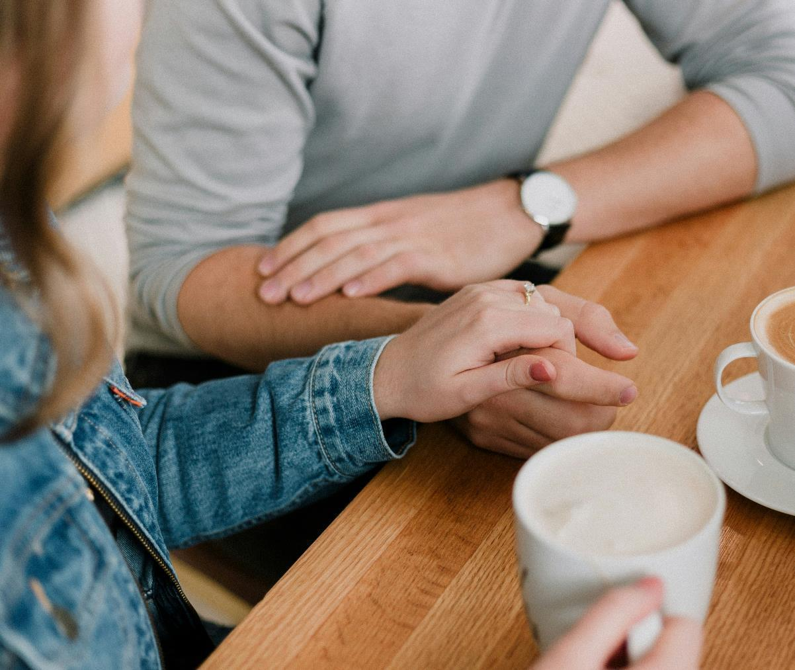
Signs of gambling harm
Different types of gambling harm include physical or behavioural, time-related, financial, emotional and relationship signs
All signs of harm are significant, even the ones that seem less severe
Gambling harm looks different for everybody
Notes:
Speaker’s notes:
We’ve categorised the different types of gambling harm into physical or behavioural, time-related, financial, emotional and relationship signs. It’s important to remember that all signs of gambling harm are significant, as they show that gambling could be having a negative impact on someone’s life. So, it’s important that we talk about all the types of gambling harm, even the ones that seem less severe.
It’s also a good idea to remember that gambling harm looks different for everybody. While one person may be able to spend $200 on gambling, for another, spending just $20 may mean going without basic grocery items that week. Likewise, while someone may enjoy spending two hours on the pokies, for another that might take them away from caring for their children or other important responsibilities. That’s why, it’s important to think about these signs of gambling harm within the context of someone’s broader life – their family, work, emotional or financial stresses – and be mindful of this when you watch out for the signs of gambling harm.
References:
Gambling Help Queensland. (2024). How to spot the early signs of gambling harm in gaming venues. https://www.gamblinghelpqld.org.au/how-spot-early-signs-gambling-harm-gaming-venues

Slide 21

Group discussion
What physical signs of gambling harm have you seen in your venues?
Notes:
Speaker’s notes:
What physical signs of gambling harm have you seen in your venues?

Slide 22
Physical signs of gambling harm
Plays very fast
Rushes from one machine to another
Tries obsessively to win on one machine
Gambles on two or more machines at once
Puts large wins back into the machine and keeps playing
Gambles without reacting to what’s going on around them
Leaves venue to find money to continue gambling
Poor hygiene or significant decline in personal appearance
Have you seen any of these signs in your patrons?
Notes:
Speaker’s notes:
Let’s start by talking about the physical or behavioural signs of gambling harm. Displayed on screen are some of the physical signs of gambling harm to keep an eye out for. Have you seen any of these signs in your patrons?
References:
Gambling Help Queensland. (2024). How to spot the early signs of gambling harm in gaming venues. https://www.gamblinghelpqld.org.au/how-spot-early-signs-gambling-harm-gaming-venues
Thomas, A., Delfabbro, P., & Armstrong, A. R. (2014). Validation Study of In-Venue Problem Gambler Indicators. Report prepared for Gambling Research Australia

Slide 23
Group discussion
What time-related signs of gambling harm have you seen in your venues?
Notes:
Speaker’s notes:
What time-related signs of gambling harm have you seen in your venues?

Slide 24
Time-related signs of gambling harm
Starts gambling when the venue is opening
Only stops gambling when venue is closing
Gambles most days
Gambles through normal mealtimes
Often gambles for long periods (3+ hours) without a break
Stays to gamble when friends leave venue
Have you seen any of these signs in your patrons?
Notes:
Speaker’s notes:
The next type of signs of gambling harm are time-related signs. Have you seen any of these signs in your patrons?
References:
Gambling Help Queensland. (2024). How to spot the early signs of gambling harm in gaming venues. https://www.gamblinghelpqld.org.au/how-spot-early-signs-gambling-harm-gaming-venues
Thomas, A., Delfabbro, P., & Armstrong, A. R. (2014). Validation Study of In-Venue Problem Gambler Indicators. Report prepared for Gambling Research Australia

Slide 25
Group discussion
What financial signs of gambling harm have you seen in your venues?
Notes:
Speaker’s notes:
What financial signs of gambling harm have you seen in your venues?

Slide 26
Financial signs of gambling harm
Increases or changes in spending pattern
Rummages around in purse/wallet for money
Asks to change large notes at venue before gambling
Gets cash out from an ATM/EFTPOS machine on two or more occasions
Spends large amounts at particular times, such as pay day
Tries to borrow money from other people at the venue or asks for credit from the venue
Has run out of all money when they leave the venue
Have you seen any of these signs in your patrons?
Notes:
Speaker’s notes:
The next type of signs of gambling harm are financial signs. Have you seen any of these signs in your patrons?
References:
Gambling Help Queensland. (2024). How to spot the early signs of gambling harm in gaming venues. https://www.gamblinghelpqld.org.au/how-spot-early-signs-gambling-harm-gaming-venues
Thomas, A., Delfabbro, P., & Armstrong, A. R. (2014). Validation Study of In-Venue Problem Gambler Indicators. Report prepared for Gambling Research Australia

Slide 27
Group discussion
What emotional signs of gambling harm have you seen in your venues?
Notes:
Speaker’s notes:
What emotional signs of gambling harm have you seen in your venues?

Slide 28
Emotional signs of gambling harm
Appears stressed or anxious while or after gambling
Appears sad or depressed while or after gambling
Appears agitated, angry or aggressive while or after gambling
Becomes angry or stands over others if someone takes their favourite machine
Uses rituals or superstitious behaviours
Have you seen any of these signs in your patrons?
Notes:
Speaker’s notes:
The next type of signs of gambling harm are emotional signs. Have you seen any of these signs in your patrons?
References:
Gambling Help Queensland. (2024). How to spot the early signs of gambling harm in gaming venues. https://www.gamblinghelpqld.org.au/how-spot-early-signs-gambling-harm-gaming-venues
Thomas, A., Delfabbro, P., & Armstrong, A. R. (2014). Validation Study of In-Venue Problem Gambler Indicators. Report prepared for Gambling Research Australia

Slide 29
Group discussion
What social or interpersonal signs of gambling harm have you seen in your venues?
Notes:
Speaker’s notes:
What social or interpersonal signs of gambling harm have you seen in your venues? These could relate to the social behaviour you might see in a patron, and how they interact people around them.

Slide 30
Social/interpersonal signs of gambling harm
Avoids contact or conversation with others
Rude or impolite to venue staff
Friends or family contact or visit the venue asking for them
Conceals presence at venue (i.e. asks staff not to let others know they are there)
Complains to staff about losing or blames machines for losing
Brags about winning or about their gambling ‘skills’
Have you seen any of these signs in your patrons?
Notes:
Speaker’s notes:
The next type of signs of gambling harm are social or interpersonal. These relate to how patrons interact with other people in your venue.
References:
Gambling Help Queensland. (2024). How to spot the early signs of gambling harm in gaming venues. https://www.gamblinghelpqld.org.au/how-spot-early-signs-gambling-harm-gaming-venues
Thomas, A., Delfabbro, P., & Armstrong, A. R. (2014). Validation Study of In-Venue Problem Gambler Indicators. Report prepared for Gambling Research Australia

Slide 31

Other considerations
The signs of gambling harm can look like other personal circumstances
  Family crisis or relationship breakdown
  Financial stress
  Mental ill-health
  Substance misuse
  Domestic and family violence
Speak to patrons about the different support services available
Notes:
Speaker’s notes:
Sometimes, the signs of gambling harm can look like the signs of other personal circumstances. This might include a family crisis or relationship breakdown, financial stress, mental ill-health, substance misuse, or experiences of domestic and family violence. When speaking with patrons, try to be mindful of how the different parts of somebody’s life can affect a person and the choices they make. Do your best to create a safe and supportive environment for patrons to speak about other personal circumstances, including asking them if they would like to speak to someone from a support service.
References:
Gambling Help Queensland. (2024). Talking to someone about their gambling. https://www.gamblinghelpqld.org.au/talking-to-someone-about-their-gambling

Slide 32

Support services
Free and confidential counselling
Support is available either face-to-face, over the phone or online
Phone us:
Visit our website:
Gambling Helpline, 24/7
1800 858 858
www.gamblinghelpqld.org.au
Notes:
Note for presenter:
Please include the relevant GHS phone number and website.
Speaker’s notes:
If you think a patron might need more support with their gambling, it’s a good idea to refer them to a gambling support service. You can do this simply by giving them more information about the services we provide. We offer free and confidential counselling services. Patrons can seek this support either face-to-face, over the phone or online. Our counsellors will always provide non-judgmental support. We’ll talk about the reasons a patron has decided to seek help and make plans together for the changes we can make to their relationships and their life. You can find our phone number and website on the screen. The Gambling Help Qld website provides further information and useful resources for venue staff.

Slide 33
Other local support services
Support service | Contact information
Mental health support
Domestic and family violence
Alcohol and other drug use
Financial counselling
Notes:
Note for presenter:
Please include a list of some other local support services.
Speaker’s notes:
Sometimes, people gamble because there are other factors in their life that are causing them stress or difficulty. We’ve compiled a list of some of the other support services in our area, including services to help people experiencing mental health concerns, domestic and family violence, alcohol and other drug use, or financial difficulty. You can use these services to get patrons in touch with the other support they need.

Slide 34
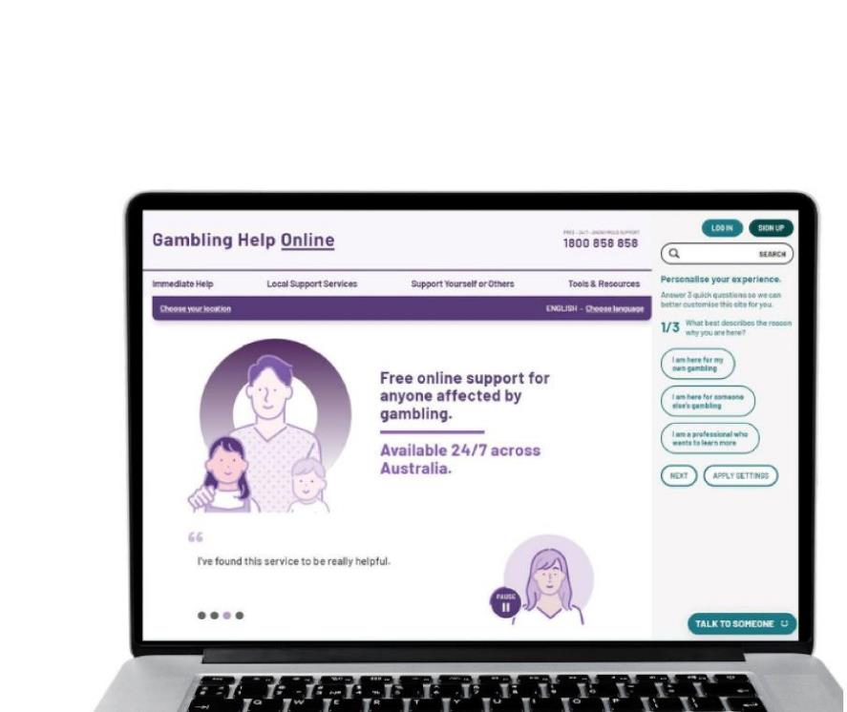
Support services
Gambling Help Online
www.gamblinghelponline.org.au
Gamblers Anonymous
Queensland
0467 655 799
www.gaaustralia.org.au
Notes:
Speaker’s notes:
There are also other services available, outside of our local area. The Gambling Help Online website provides 24/7 free online support for anyone affected by gambling across Australia. Patrons can speak to a counsellor either on an online chat, email or over the phone at any time of the day. Patrons can find more information at the Gambling Help Online website.
Gamblers Anonymous Australia provides group therapy and support across Australia. Members can meet either face-to-face or online, either weekly or whenever suits them, to listen and speak with other people who are experiencing similar gambling-related challenges. Patrons can find more information about session times and locations at the Gamblers Anonymous Australia website.
References:
Gambling Help Online. (2024). Home. www.gamblinghelponline.org.au
Gamblers Anonymous. (2024). Home. www.gaaustralia.org.au

Slide 35
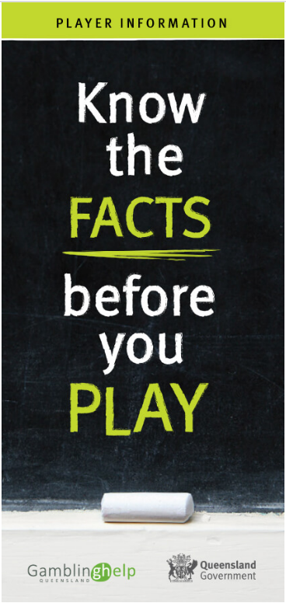
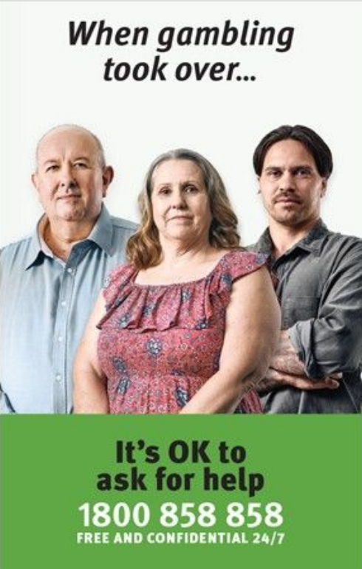
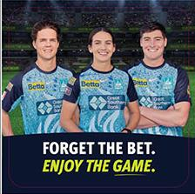
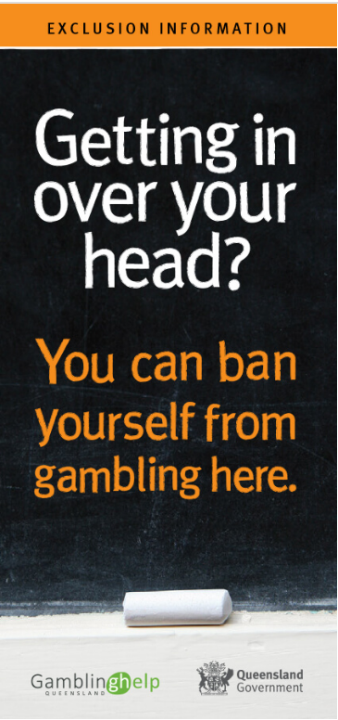
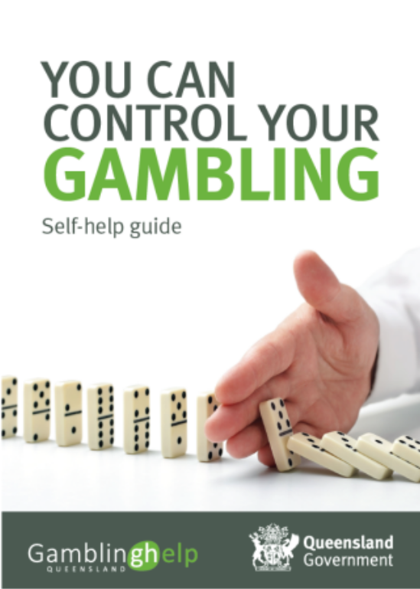
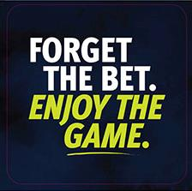
Free resources for your venue
Notes:
Speaker’s notes:
Did you know you can order free gambling harm minimisation resources for your venue? These resources have been created to help gambling venues build awareness of gambling harm and where to find support. This includes A4 posters, brochures, booklets, postcards, coasters and wallet-size takeaway cards. They can be delivered to your venue for free, or you can print a copy yourself using the link provided.
References:
Queensland Government. Order gambling harm minimisation resources. https://www.business.qld.gov.au/industries/hospitality-tourism-sport/liquor-gaming/gaming/order-a-resource

Slide 36
Questions?

Slide 37
Connecting with patrons
Notes:
Version: November 2024.

Slide 38

Overview
Blind spots
When to have a conversation
Starting the conversation
Language matters
Dealing with challenges
Notes:
Speaker’s notes:
In this module, we’re going to talk about connecting with patrons. We’ll start with a self-reflection and talk about blind spots, and then we’ll discuss your role in talking to people who might be experiencing gambling harm in your venue, including when to have a conversation, the type of language to use, and action you can take to help someone.

Slide 39
Group discussion
What do you think of people who gamble?
How do you think society treats people who gamble?
What biases or stereotypes exist about people who gamble?
How do you think society’s perceptions shape your opinions of people who gamble?
Notes:
Speaker’s notes:
Let’s start with a group discussion about gambling and its perceptions in society. What do you think of people who gamble? How do you think society treats people who gamble? What biases or stereotypes exist about people who gamble? How do you think society’s perceptions shape your opinions of people who gamble?
References:
Hing, N, Russell, A, Nuske, E & Gainsbury, S. (2015). The stigma of problem gambling: Causes, characteristics and consequences. Victorian Responsible Gambling Foundation, Melbourne.

Slide 40
The signs of gambling harm
Physical signs of gambling harm
Rushes from one machine to another
Tries obsessively to win on one machine
Plays very fast
Gambles on two or more machines at once
Rituals or superstitious behaviours
Financial signs of gambling harm:
Significant increase in spending pattern
Asks to change large notes at venue before gambling
Spends $300 or more in a session
Bets $2.50 or more per spin most of the time
Gets cash out on two or more occasions
Time-related signs of gambling harm
Starts gambling when the venue is opening or only stops gambling when venue is closing
Gambles most days or through normal mealtimes
Often gambles for long periods (3+ hours) without a break
Emotional or relationship signs of gambling harm:
Appears stressed, anxious, angry, sad or depressed while or after gambling
Conceals presence at venue
Friends or family contact or visit the venue asking for them
Notes:
Speaker’s notes:
Need a quick refresher about the signs of gambling harm? Here’s a quick look at some of the things to keep an eye out for in your venue. If you see any of these signs, even if only on one occasion, it’s worth mentioning to your manager or CLO.
References:
Gambling Help Queensland. (2024). How to spot the early signs of gambling harm in gaming venues. https://www.gamblinghelpqld.org.au/how-spot-early-signs-gambling-harm-gaming-venues
Thomas, A., Delfabbro, P., & Armstrong, A. R. (2014). Validation Study of In-Venue Problem Gambler Indicators. Report prepared for Gambling Research Australia

Slide 41

Self-reflection
A worldview is a collection of attitudes, values and expectations
Influenced by our background, family and culture
Be mindful of your attitudes towards people who gamble
Notes:
Speaker’s notes:
This group discussion highlighted that many of our attitudes towards people who gamble are shaped by society’s broader perceptions. Our understanding of something or someone is usually formed by our worldviews. A worldview is a collection of attitudes, values and expectations about the world around us, which inform our thoughts and actions. It generally decides what we deem “normal” or “right”. Our worldviews are formed by our upbringing or background, the opinions or values of the important people in our lives (such as our family and friends), and our culture or community more broadly. When we had our group discussion, some of our opinions about people who gamble may have been influenced by biases and stereotypes. It’s important to be mindful of your attitudes towards people who gamble when you connect with the patrons in your venue and do your best to keep an open mind.
References:
Hing, N, Russell, A, Nuske, E & Gainsbury, S. (2015). The stigma of problem gambling: Causes, characteristics and consequences. Victorian Responsible Gambling Foundation, Melbourne.
Gray A. (2011). Worldviews. International psychiatry : bulletin of the Board of International Affairs of the Royal College of Psychiatrists, 8(3), 58–60.

Slide 42

Blind spots
Aspects of ourselves we aren’t conscious of
Includes our personality traits, values, actions, habits, feelings and thoughts
Narrows our attitudes and beliefs
What blind spots might someone have about people who gamble?
Notes:
Speaker’s notes:
These stereotypes and biases that we might hold towards a person or group of people are called blind spots. Blind spots refer to the aspects of ourselves we aren’t conscious of – things we are unable to see or understand. This can include our personality traits, values, actions, habits, feelings and thoughts. These blind spots can narrow our attitudes and beliefs towards something and influence our decisions and behaviours. It’s important to think about what blind spots you might have about people who gamble, and how this might influence your interactions with patrons.
References:
Bazerman, Max H. and Tenbrunsel, Ann E. (2011). Blind Spots: Why We Fail to Do What's Right and What to Do about It, Princeton: Princeton University Press. doi.org/10.1515/9781400837991

Slide 43



Understanding emotional intelligence
Identify: Recognise your emotions
Reflect: Understand how your emotions can impact yourself and others
Act:
Find other ways to engage with your emotions
Notes:
Speaker’s notes:
Once we’ve learnt to better identify and understand our emotions, we can take action. There are three steps to this.
Identify – Understand your emotions, like using a Feeling Wheel to identify how you are feeling.
Reflect – Take the time to understand how your emotions might be impacting yourself, your choices and behaviour. Think too about how these emotions may impact the other people around you and try to learn more about what you could do to change this.
Act – Once you’ve understood how your feelings may be impacting yourself and others, seek ways to make change. Try to understand how you can better engage with your emotions. Take the time to sit with your feelings, make plans to address the situation and ask for help from others when you need it.
References:
Bru-Luna, et al. (2021). Emotional Intelligence Measures: A Systematic Review. Healthcare, 9(12). 1696. https://doi.org/10.3390/healthcare9121696

Slide 44
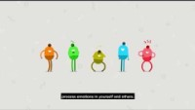
Emotional intelligence
Notes:
Speaker’s notes:
This 3-minute video provides some useful insight into what emotional intelligence is and how we can develop it.
References:
MindTools. (2019). Developing Emotional Intelligence. https://www.youtube.com/watch?v=n9h8fG1DKhA

Slide 45

Emotional intelligence
The ability to recognise, understand and process emotions
Can help us communicate more effectively with patrons.
Notes:
Speaker’s notes:
One useful way to overcome the harmful impacts of shame is by developing your emotional intelligence. Emotional intelligence refers to the ability to recognise, understand and process emotions in yourself and others. If we are better able to access our emotional intelligence, we can better communicate with patrons.
References:
Bru-Luna, et al. (2021). Emotional Intelligence Measures: A Systematic Review. Healthcare, 9(12). 1696. https://doi.org/10.3390/healthcare9121696
Time Magazine. (2021). Brené Brown Thinks You Should Talk About These 87 Emotions. https://time.com/6122081/brene-brown-atlas-of-the-heart/

Slide 46
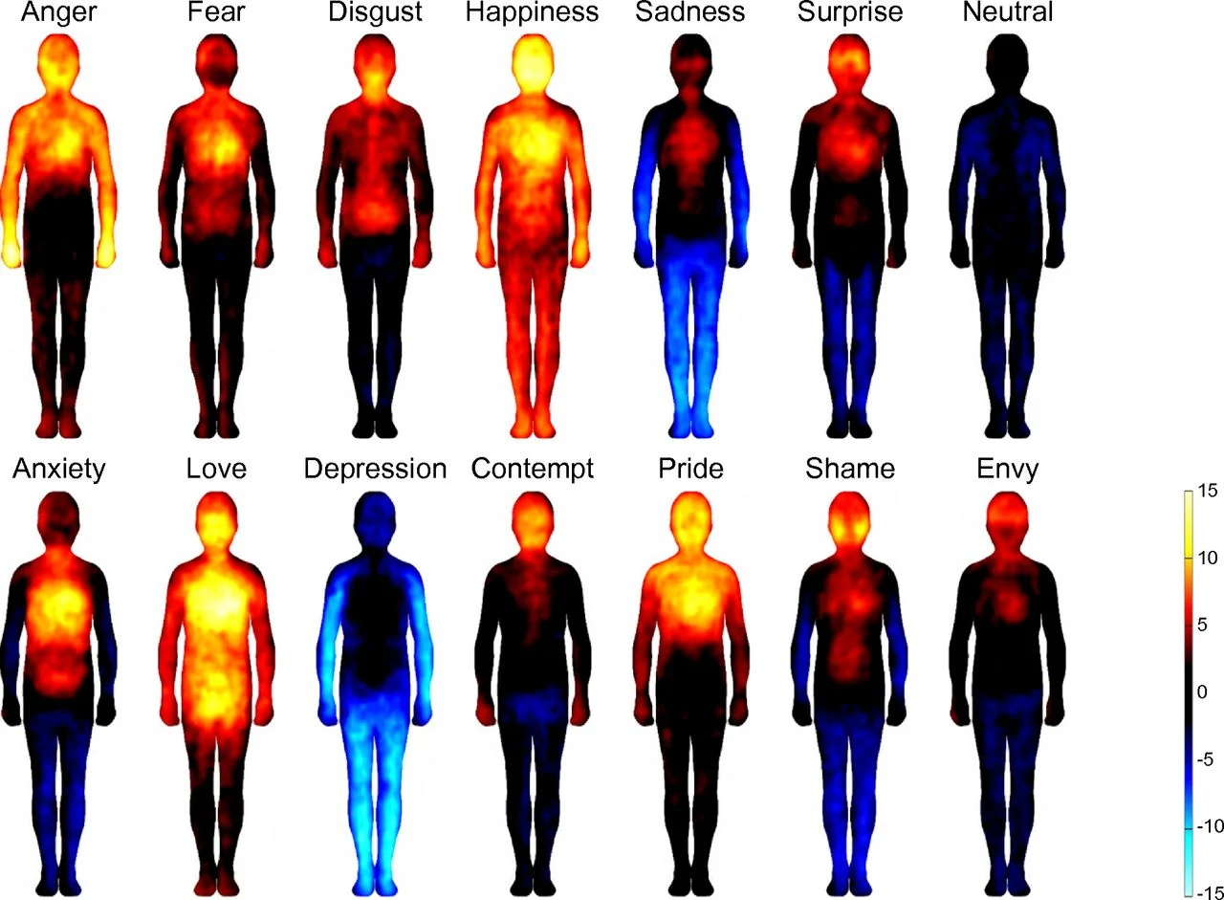
Body maps of emotions
Notes:
Speaker’s notes:
Did you know you people often feel emotions directly in the body? These Bodily Sensation Maps were created from an experiment using data from 701 people across various cultural and language backgrounds.
References:
Nummenmaa, L., Glerean, E., Hari, R., & Hietanen, J. K. (2013). Bodily Maps of Emotions. Proceedings of the National Academy of Sciences of the United States of America. https://www.pnas.org/doi/full/10.1073/pnas.1321664111#sec-1

Slide 47
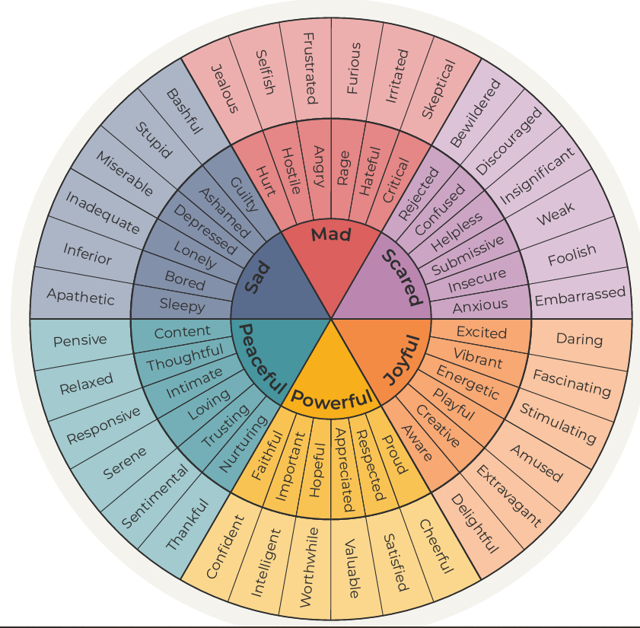
The Feeling Wheel
Developed by Dr. Gloria Willcox from the Gottman Institute
Useful tool to better identify emotions in ourselves, to learn to recognise and support others who are experiencing similar emotions
Notes:
Speaker’s notes:
One useful way to improve our emotional intelligence is through a Feeling Wheel. This Feeling Wheel, displayed on screen, was developed by Dr. Gloria Willcox from the Gottman Institute – a research institute that focus on mental health and relationships. This wheel can help someone to learn more about the depth and breadth of emotions, to better identify and understand how they are feeling. For example, let’s pretend that one day you’re feeling sad. You might look at this wheel and learn that what you are really feeling is bored or lonely, which is prompting feelings of inadequacy or inferiority. By using this wheel, it can help us better recognise and name emotions in ourselves, as a helpful way for us to learn to recognise and support others when they are experiencing similar emotions. This can be a useful tool in your interactions with patrons.
References:
All The Feelz. (2024). The Feeling Wheel. https://allthefeelz.app/feeling-wheel

Slide 48

What is shame?
A person’s negative perception of themself
Someone’s belief about their whole self
Notes:
Speaker’s notes:
Shame is an emotion founded in someone’s negative perception of themself. Generally, shame is not associated with a specific behaviour or event, but instead relates to a person’s beliefs about their whole self. It is often associated with feelings of worthlessness and inadequacy.
Often, people experience shame due to society’s perceptions of inappropriate attitudes, behaviours or characteristics. People can experience shame for many different reasons, including sexuality, disability, ethnicity or race, gender and certain health conditions. People who gamble often experience shame.
References:
Miceli, M., & Castelfranchi, C. (2018). Reconsidering the Differences Between Shame and Guilt. Europe’s Journal of Psychology, 14(3), 710–733. https://doi.org/10.5964/ejop.v14i3.1564
Alcohol and Drug Foundation. (2019). Understanding the impact of stigma. https://adf.org.au/insights/stigma-impact/
Hing, N, Russell, A, Nuske, E & Gainsbury, S 2015. The stigma of problem gambling: Causes, characteristics and consequences. Victorian Responsible Gambling Foundation, Melbourne.

Slide 49

Consequences of shame
Worthlessness
Low self-esteem
Feelings of failure
Fears of judgement or discrimination
Hesitating or choosing not to seek help
Notes:
Speaker’s notes:
Shame has big impacts on people who gamble. Many people who gamble report feeling disappointed in themselves, embarrassed, guilty, worthless, inadequate, stupid, weak and like a failure. It has been linked with increased mental health concerns, alcohol and drug use, and suicidal thoughts and behaviours.
These kinds of fears or expectations of being negatively judged, devalued or discriminated against often lead people to hide or deny their gambling habits from themselves and their loved ones, and are common reasons why people hesitate to seek help.
References:
Hing, N, Russell, A, Nuske, E & Gainsbury, S. (2015). The stigma of problem gambling: Causes, characteristics and consequences. Victorian Responsible Gambling Foundation, Melbourne.

Slide 50

Shame and guilt
Guilt can make someone feel like they did something bad
Shame can make someone feel like they are bad
Notes:
Speaker’s notes:
Sometimes, people confuse shame with guilt, as they are related but very different emotions. Guilt is a feeling that arises when someone makes a decision that doesn’t align with their values, like lying or cheating. This can lead someone to feel bad, remorseful or responsible for something they did wrong. Shame, however, is a feeling related to someone’s sense of self, where they believe the parts of themself they feel shameful about represent the whole of who they are. While a person who is experiencing guilt may feel like they did something bad, a person who is experiencing shame might believe that they themselves are bad. Often people who experience gambling harm feel shame, rather than guilt. This experience can have big impacts, leading to poor self-worth and mental ill-health.
References:
Miceli, M., & Castelfranchi, C. (2018). Reconsidering the Differences Between Shame and Guilt. Europe’s Journal of Psychology, 14(3), 710–733. https://doi.org/10.5964/ejop.v14i3.1564
Alcohol and Drug Foundation. (2019). Understanding the impact of stigma. https://adf.org.au/insights/stigma-impact/
Hing, N, Russell, A, Nuske, E & Gainsbury, S 2015. The stigma of problem gambling: Causes, characteristics and consequences. Victorian Responsible Gambling Foundation, Melbourne.

Slide 51
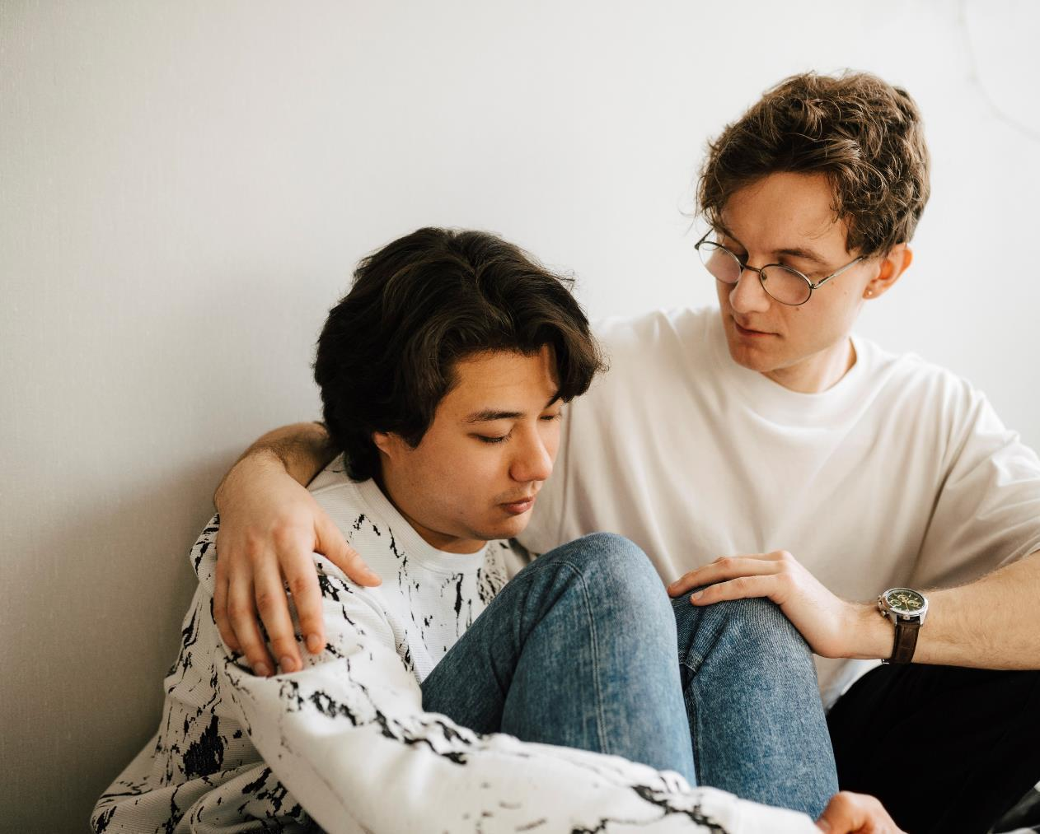
Causes of shame
The belief that gambling is the sole responsibility of the individual
Understood as a ‘problem’ that could be controlled or fixed
Notes:
Speaker’s notes:
In general, society has largely negative attitudes towards people who experience severe gambling harm. According to research, many people believe that people who gamble excessively are foolish, impulsive, irresponsible, anti-social, untrustworthy or unproductive. Some people don’t want to socialise with people who experience severe gambling harm or form personal relationships with them. This leads to discrimination in social and employment settings.
These kind of negative attitudes are born out of other social beliefs. In general, people believe that gambling is the responsibility of the individual and put blame on them for having a “problem”. Society often believes that if someone is experiencing harm from their gambling, it is their responsibility to take “control” of their gambling or “fix their problem”. It’s often viewed as a conscious decision, a character flaw or a weakness. These kinds of social attitudes and beliefs are inappropriate and outdated. Together, we are moving towards conversations which acknowledge the responsibility of all of us, including the gambling industry, to create safer gambling environments and change societal perceptions.
References:
Hing, N, Russell, A, Nuske, E & Gainsbury, S 2015. The stigma of problem gambling: Causes, characteristics and consequences. Victorian Responsible Gambling Foundation, Melbourne.

Slide 52

Harmony claps
Notes:
Note to presenter: If you need to give the audience a break you can use this interactive exercise to energise and focus the audience, either before or after the break. Use this exercise either at this stage of the presentation, or anywhere you would like to add a break. Use this slide along with the next slide which includes a focus meditation, or you can just choose one.
Speaker’s notes:
Let’s take a break. If you would like to stand up and join in, let’s get re-energised with this short exercise.
References:
Brain Power Wellness. (2020). One minute exercise: Harmony claps. https://www.youtube.com/watch?v=06z3HyVC1-w&t=1s

Slide 53

Quick reset meditation
Notes:
Note to presenter: If you need to give the audience a break you can use this interactive exercise to energise and focus the audience, either before or after the break. Use this exercise either at this stage of the presentation, or anywhere you would like to add a break. Use this slide along with the previous slide which includes an energising interactive exercise, or you can just choose one.
Speaker’s notes:
Let’s take a break. If you would like to join in with this quick mindfulness meditation, let’s recentre and refocus.
References:
Headspace. (2023). Free 2-minute quick focus reset meditation: regain focus to work, study, or get tasks done. https://www.youtube.com/watch?v=QtE00VP4W3Y&t=29s

Slide 54

How does breathing impact the brain?
Notes:
Speaker’s notes:
Sometimes, when we're feeling stressed or overwhelmed, our minds can feel like they're spinning out of control. Stress can have big impacts on your body, in a lot of different ways. Deep breathing can help regulate your nervous system.
References:
Headspace. (2023). How does breathing impact the brain? Learn from a neuroscientist. https://www.youtube.com/watch?v=2HojLhKlJto&t=13s

Slide 55

Key insights
Gambling behaviours are complex
Gambling is not just the responsibility of the individual
We can all play a part in changing the way gambling is talked about and creating safer, more supportive environments
Notes:
Speaker’s notes:
Remember, gambling behaviours are complex. There are many reasons why someone might gamble frequently, despite it negatively impacting their life. Some of these reasons are individual risk factors like major life changes, mental health concerns, or previous exposure or experience of gambling harm. But there are also many bigger factors which influence a person’s gambling, like constant exposure to gambling advertising and promotion, their family or community’s attitudes to gambling, and the impact of gambling products and environments which make gambling accessible and addictive, including the availability of online betting. It’s important to keep in mind that gambling is not just the responsibility of the individual. We can all play a part in changing the way gambling is talked about and creating safer and more supportive environments for people experiencing harm to get the help they need.
References:
Brown, K. L., & Russell, A. M. T. (2019). Exploration of intervention strategies to reduce public stigma associated with gambling disorder. Journal of Gambling Studies. Advance online publication.
Thomas, S, Pitt, H, Bestman, A, Randle, M, McCarthy, S, Daube, M 2018, The determinants of gambling normalisation: causes, consequences and public health responses, Victorian Responsible Gambling Foundation, Melbourne.

Slide 56

The role of team members
Watch out for the signs of gambling harm in your patrons
Be aware of your venue’s safer gambling policies and procedures
Alert your manager or a Customer Liaison Officer if you think someone is displaying signs of harm
Notes:
Speaker’s notes:
Let’s talk about the role of team members, including waiters, bartenders, and other gaming staff. As a team member, you’re often the first point of contact for patrons seeking help for gambling harm. It's your role to watch out for the signs of gambling harm in your patrons and be aware of your venue's safer gambling policies and procedures. Ask your manager if you're unsure. If you see someone displaying signs of gambling harm, or think there might be reason for concern, it is your role to alert your manager or your venue’s Customer Liaison Officer. It is not your responsibility to directly help the person you believe might need support, unless you feel comfortable to do so.
A CLO is a staff member who is trained to help people that are experiencing gambling harm in venues. The voluntary Queensland Responsible Gambling Code of Practice (the Code of Practice) recommends gambling venues have a CLO available during approved gambling hours. For some venues, a CLO being available is a mandatory condition of the gaming licence. The CLO is responsible for providing information to help patrons who show signs of gambling harm. Their duties can include preparing self-exclusion forms when patrons request to be banned from the venue or gaming services. They may also be responsible for referring patrons to their nearest Gambling Help service, linking with local community groups to establish support networks for people experiencing gambling harm, enforcing exclusions and notifying the Office of Liquor and Gaming Regulation (OLGR) of exclusion breaches. If you have any concerns about a patron, the CLO is the best person to speak to in your venue.
Managers also play an important role in connecting with patrons. A manager can also approach patrons who are displaying signs of gambling harm and speak to them about whether they might need further support. A manager can encourage someone to seek support from a Gambling Help service or facilitate contact with the CLO, to ensure they get the help they need.
References:
Queensland Government. (2024). Helping patrons experiencing gambling harm. https://www.business.qld.gov.au/industries/hospitality-tourism-sport/liquor-gaming/liquor/training/gaming/rsg-refreshers/problem-gambling/help

Slide 57
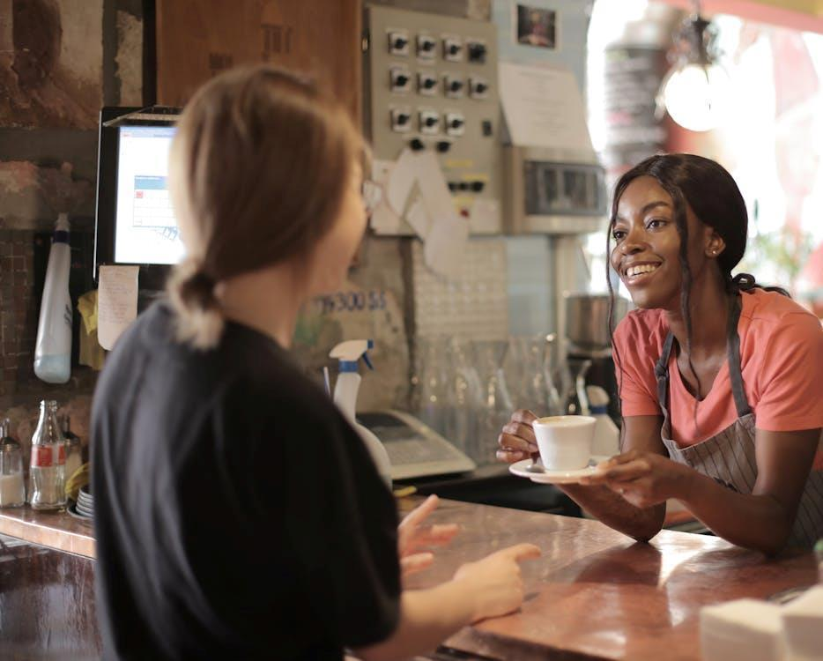
Get to know your patrons
If you get to know your regular patrons, you can understand when something is out of the ordinary in their mood or behaviour
Greet each patron and chat to them when you can
“How are you going?”
“What are you doing for the rest of the day?”
Notes:
Speaker’s notes:
The best way to look out for the signs of gambling harm in your patrons is by getting to know them. If you get to know your regular patrons, you will start to see patterns in their gambling, like the length of time or amount of money they typically spend in your venue. This can help you understand when something is out of the ordinary in their mood or behaviour. It’s a good idea to take every opportunity to get to know your patrons. Greet each person and chat to them when you can, such as when they enter the venue, as you walk around the gaming area, when they order at the bar or restaurant, or during cashier interactions, like changing or withdrawing money. These conversations don’t have to be long. You might simply ask “How are you going?” or “What are you doing for the rest of the day?”. These kinds of gentle interactions can help patrons check in with themselves and remind them of their responsibilities outside of your venue.
References:
Queensland Government. (2024). Helping patrons experiencing gambling harm. https://www.business.qld.gov.au/industries/hospitality-tourism-sport/liquor-gaming/liquor/training/gaming/rsg-refreshers/problem-gambling/help

Slide 58

When to have a conversation
If you see any of the signs of gambling harm, we recommend mentioning it to your manager or CLO
If you think something needs to be said, you’re usually right
Remember that there’s no harm in flagging something
Notes:
Speaker’s notes:
There’s no one-size-fits all when it comes to conversations about gambling harm. Every patron is different and so is every venue. But generally, if you see any of the signs of gambling harm, even if it’s only on one occasion, we recommend mentioning it to your manager or CLO, so they can decide if they need to have a conversation with the patron about their gambling. Your manager or CLO can then speak to the patron to see if they need support, like encouraging them to contact a Gambling Help service or helping them to self-exclude.
Not sure if something is worth speaking to your manager about? Generally, if you think something needs to be said, you’re usually right. Follow your intuition and remember that there’s no harm in flagging something you’re concerned about.
References:
Queensland Government. (2024). Helping patrons experiencing gambling harm. https://www.business.qld.gov.au/industries/hospitality-tourism-sport/liquor-gaming/liquor/training/gaming/rsg-refreshers/problem-gambling/help
Gambling Help Queensland. (2024). How to spot the early signs of gambling harm in gaming venues. https://www.gamblinghelpqld.org.au/how-spot-early-signs-gambling-harm-gaming-venues

Slide 59

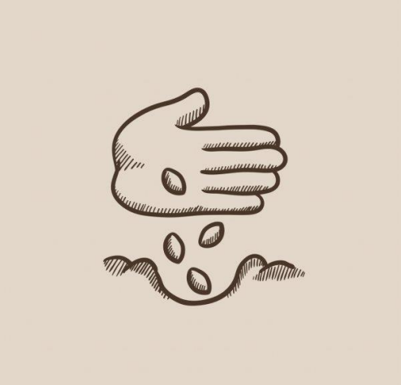
Starting the conversation
Gently check in with patrons
See if they might need a more in-depth conversation with your manager or CLO
Think about your interaction like planting a seed
Notes:
Speaker’s notes:
Starting a conversation about gambling harm can be difficult. For many people, it’s a very sensitive topic and its often accompanied with shame or guilt. So, it’s a good idea to be conscious of the way we approach the conversation. Think of your interactions with a patron like planting a seed. You can gently check in with patrons and see if they might need to have a more in-depth conversation with your manager or CLO. They can help the person you’re speaking to understand that you want to help, that you are concerned, and reduce feelings of blame or accusations for the other person. Once you’ve had these initial ‘planting the seed’ conversations, and it appears that the patron is looking for further support, a manager or CLO can further the conversation.
References:
Queensland Government. (2024). Helping patrons experiencing gambling harm. https://www.business.qld.gov.au/industries/hospitality-tourism-sport/liquor-gaming/liquor/training/gaming/rsg-refreshers/problem-gambling/help
Gambling Help Queensland. (2024). Talking to someone about their gambling. https://www.gamblinghelpqld.org.au/talking-to-someone-about-their-gambling
GambleAware. (2024). Start the conversation. https://www.gambleaware.nsw.gov.au/supporting-someone/supporting-family-and-friends/starting-the-conversation

Slide 60
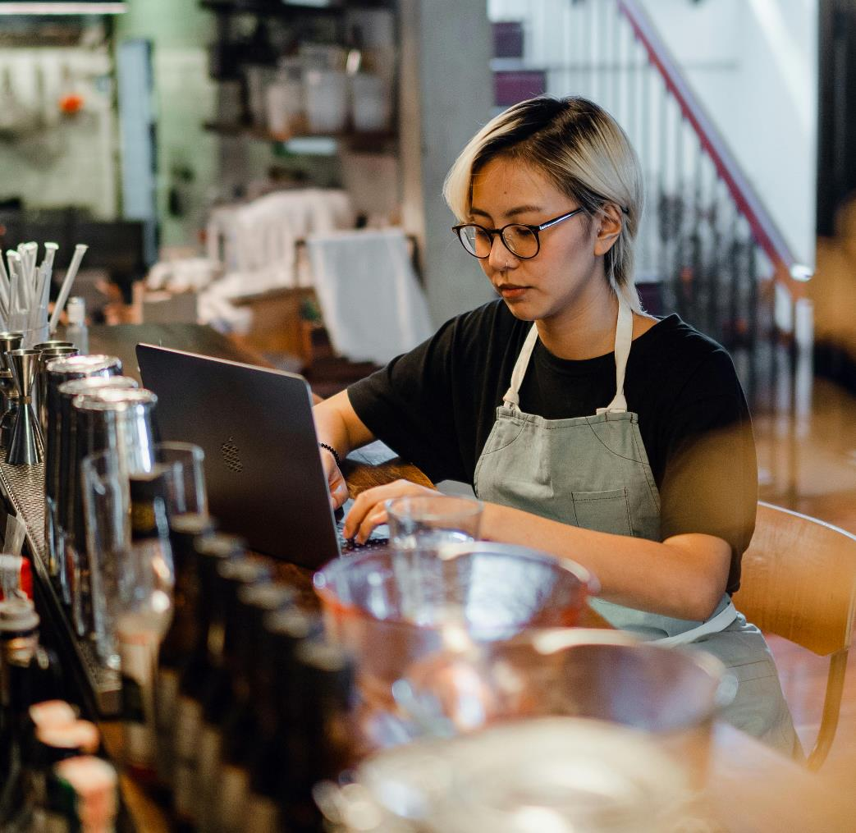
Key insights
Never engage in a conversation where you feel unsafe or uncomfortable
Talk to your manager if you’re unsure
If you feel like something needs to be said, you’re generally right
If you are concerned about a patron’s health and wellbeing, always speak to your manager or CLO
Notes:
Speaker’s notes:
Remember, it is never your responsibility to engage in a conversation where you feel unsafe or uncomfortable. If you’re unsure if you should speak to a patron about their gambling, talk to your manager. But, if you feel like something needs to be said, you’re generally right. If you are concerned about a patron’s health and wellbeing, always speak to your manager or CLO, so they can decide if further action needs to be taken.
References:
Queensland Government. (2024). Helping patrons experiencing gambling harm. https://www.business.qld.gov.au/industries/hospitality-tourism-sport/liquor-gaming/liquor/training/gaming/rsg-refreshers/problem-gambling/help
Gambling Help Queensland. (2024). How to spot the early signs of gambling harm in gaming venues. https://www.gamblinghelpqld.org.au/how-spot-early-signs-gambling-harm-gaming-venues

Slide 61

Starting the conversation
Notes:
Note to presenter: Choose one of the High Stakes videos to play, based on what you think would work for the audience.
Speaker’s notes:
This 3-minute video is a useful way to understand when and how to start a conversation with a patron.
References:
Office of Liquor and Gaming Regulation. (2019). The warning signs (chaptered)—High stakes RSG training video. https://www.youtube.com/watch?v=qKfZaLA-5uA

Slide 62
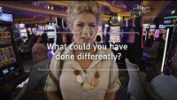
Starting the conversation
Notes:
Note to presenter: Choose one of the High Stakes videos to play, based on what you think would work for the audience.
Speaker’s notes:
This 2-minute video is a useful way to understand when and how to start a conversation with an affected other.
References:
Office of Liquor and Gaming Regulation. (2019). The warning signs (chaptered)—High stakes RSG training video. https://www.youtube.com/watch?v=qKfZaLA-5uA

Slide 63

Language matters
Avoid words like “gambling problem”, “problem gambler” or “gambling addict”
Instead, try using the phrase “gambling harm”
Notes:
Speaker’s notes:
It’s important to be mindful of the words you use when you speak to your patrons about gambling. The words we use to talk about gambling can have big impacts. Words like “gambling problem”, “problem gambler” or “gambling addict” are common phrases used to describe someone who gambles or their behaviour. But these kinds of words put blame and shame on the individual and aren’t helpful to the conversation. This can stop people getting the help they need. Instead, try using words like “gambling harm” to describe the ways gambling might be impacting someone’s life.
The Victorian Government has published a useful guide called ‘Reducing stigma: A guide for talking about gambling harm’. The guide suggest saying “frequent gambling” or “harmful gambling” instead of “gambling habit”. It also suggests avoiding “responsible gambling”, as this can imply a person experiencing gambling harm is irresponsible, and using “gambling without negative effects” instead.
References:
Gambling Help Queensland. (2024). Talking to someone about their gambling. https://www.gamblinghelpqld.org.au/talking-to-someone-about-their-gambling
GambleAware. (2024). Start the conversation. https://www.gambleaware.nsw.gov.au/supporting-someone/supporting-family-and-friends/starting-the-conversation
Victorian Responsible Gambling Foundation. (2024). Reducing stigma: A guide for talking about gambling harm. https://responsiblegambling.vic.gov.au/documents/1266/FINAL_-_Gambling_harm_language_guide_-_March_2024.pdf

Slide 64
Group discussion
What do you think is the difference between sympathy and empathy?
What role would these two concepts play in your interactions with patrons?
Notes:
Speaker’s notes:
Now, let’s talk about the role of empathy when interacting with your patrons. What do you think is the difference between sympathy and empathy? What role would this play in your interactions with patrons?

Slide 65
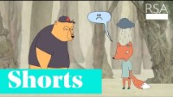
The role of empathy
Notes:
Speaker’s notes:
We’re now going to watch a 3-minute video about the role of empathy when connecting with your patrons.
References:
RSA. (2013). Brené Brown on Empathy. https://www.youtube.com/watch?v=1Evwgu369Jw

Slide 66
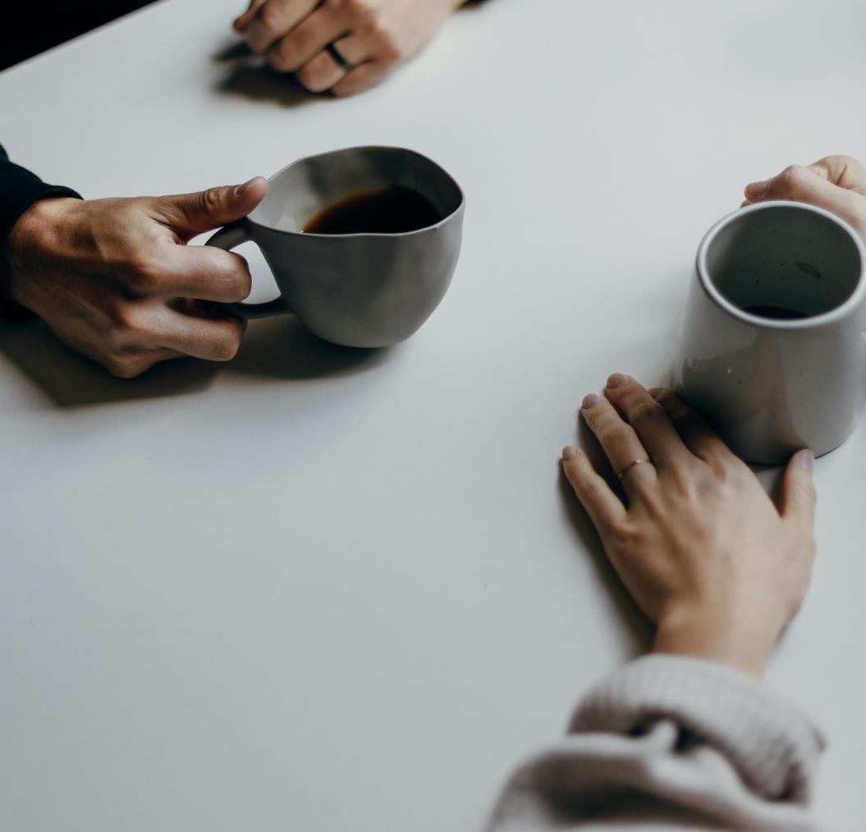
The role of empathy
Seeing something from someone else’s perspective
Relating to how someone else feels and having compassion towards them
Notes:
Speaker’s notes:
The main difference between sympathy and empathy is how somebody responds to someone else’s experiences or feelings. Sympathy involves an acknowledgement of how somebody feels. Empathy requires an understanding of someone’s feelings. While sympathy often involves feelings of pity, empathy is about seeing a situation or experience from somebody else’s perspective, relating to how they feel and having compassion towards that person. Sometimes, when you see people who gamble in venues, it might be difficult to relate to their decisions or behaviours. You might think, “If they’re running out of money, why don’t they just stop gambling?”. Empathy is about understanding the many factors that contribute to someone’s gambling and engaging in conversations with patrons with this mind.
References:
Ramsey Solutions. (2024). Empathy vs Sympathy: What’s the Difference? https://www.ramseysolutions.com/personal-growth/empathy-vs-sympathy

Slide 67

The whole picture
Many factors can contribute to someone’s gambling
Notes:
Speaker’s notes:
Sometimes, when you see people who gamble in venues, it might be difficult to relate to their decisions or behaviours. You might think, “If they’re running out of money, why don’t they just stop gambling?”. Empathy is about understanding the many factors that contribute to someone’s gambling and engaging in conversations with patrons with this mind.

Slide 68
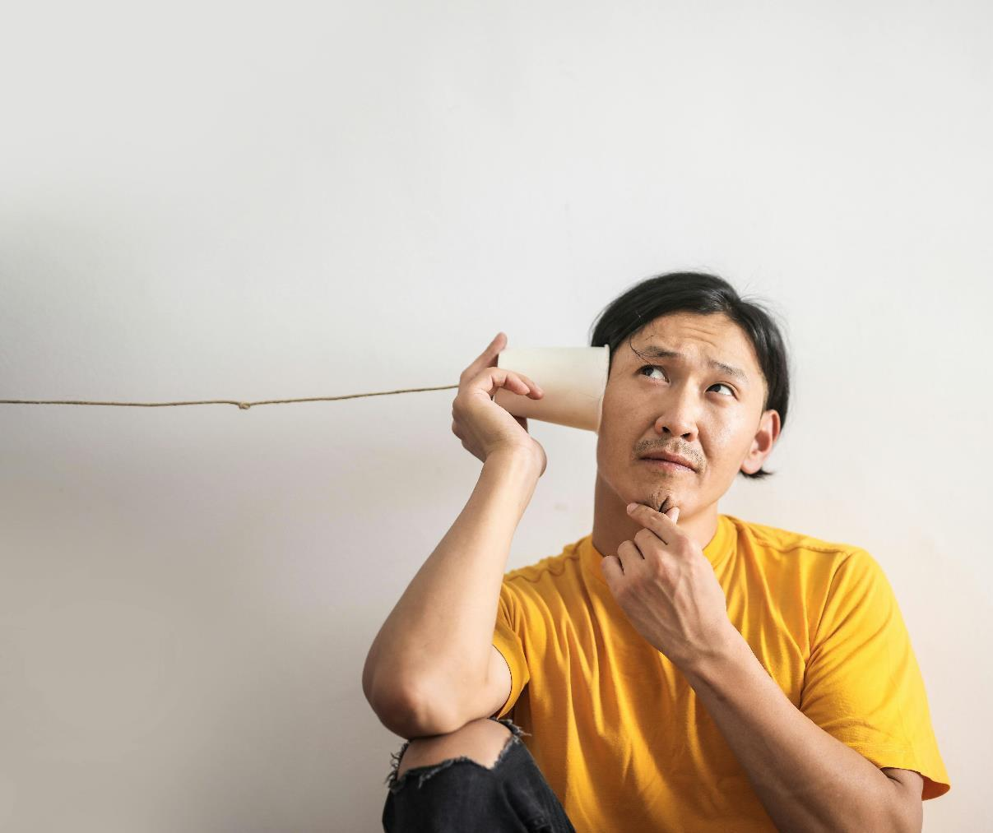
The role of listening
Listen to understand, rather than to respond
Your job is not to fix the person
Try to understand what the other person is really saying
Notes:
Speaker’s notes:
A useful way to further develop empathy is to become a better listener. Listening plays an important role in your responsibilities in venues, as it can allow you to better understand someone’s experiences, identify whether they might be experiencing gambling harm and decide whether action should be taken to seek support. There a few strategies that we can enact in our everyday lives that can make us better listeners. This can include listening to understand rather than to respond, understanding that our role is not to fix or change the person, tuning into what the other person is really saying, confirming what you have heard from the speaker to see if you understand it correctly, staying curious, asking clarifying questions, being mindful of how much time you spend talking in the conversation, and apologising if you interrupt, get distracted, become defensive or misunderstand.
References:
Abrahams, R., & Groysberg, B. (2024). How to Become a Better Listener. https://hbr.org/2021/12/how-to-become-a-better-listener

Slide 69
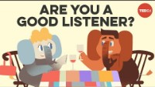
The role of listening
Notes:
Speaker’s notes:
We’re now going to watch a 5-minute video about the role of listening when connecting with your patrons.
References:
TED-Ed. (2021). 4 things all great listeners know. https://www.youtube.com/watch?v=i3ku5nx4tMU

Slide 70

The role of nonverbal cues
Pay attention to both the explicit and implicit parts of a conversation
Includes tone of voice, facial expression, and body language
Notes:
Speaker’s notes:
Another important part of communication is nonverbal cues. Being an active listener means paying attention to both the explicit and implicit information that you’re receiving in a conversation. Nonverbal cues, such as tone of voice, facial expression, and body language, are usually where the motivation and emotion behind the words is expressed and are a helpful way to better understand what someone is thinking or feeling. Nonverbal cues can be a helpful way for you to better understand your interactions with patrons.
References:
Abrahams, R., & Groysberg, B. (2024). How to Become a Better Listener. https://hbr.org/2021/12/how-to-become-a-better-listener

Slide 71



What happens next?
For more information, visit gamblinghelpqld.org.au
Self-help
Self-exclusion
Support services
Notes:
Speaker’s notes:
During a conversation with a patron, you might learn that they are wanting to make changes to their gambling. There are different ways they can do this. A patron could explore ways they can support themselves; they could ban themselves from a gambling venue or product; or they could seek help from our support services. You can find more information about each of these different pathways at the Gambling Help Queensland website.
References:
Gambling Help Queensland. (2024). Let us help you. https://www.gamblinghelpqld.org.au/let-us-help-you

Slide 72
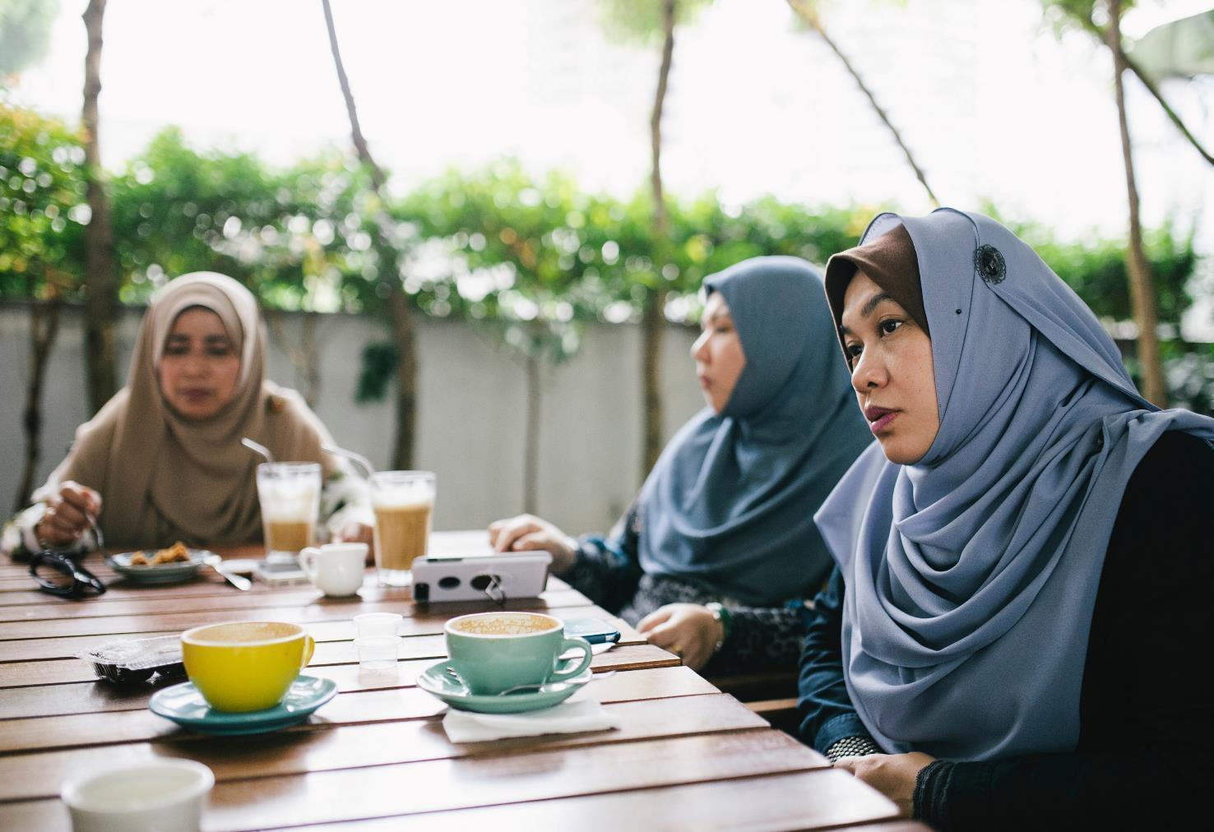
Dealing with challenges
If a patron isn’t ready to make a change:
Remember it is not your responsibility to force change
Continue to watch out for the signs of gambling harm
Notes:
Speaker’s notes:
When you have a conversation with a patron about their gambling, there’s a chance they might not be ready to talk. If a patron isn’t ready to make a change in their life, remember it is not your responsibility to force that change. Instead, you can continue to watch out for the signs of gambling harm by keeping an eye on them. Try to keep open communication with the patron. Remind them that there are support services available if they need help and try speaking to them again at another time.
References:
Gambling Help Queensland. (2024). Talking to someone about their gambling. https://www.gamblinghelpqld.org.au/talking-to-someone-about-their-gambling

Slide 73




BIFF responses
Brief
Informative
Friendly
Firm
Notes:
Speaker’s notes:
If an interaction with a patron starts to become challenging, consider using the BIFF method. BIFF stands for Brief, Informative, Friendly and Firm.
Brief – Keep your interactions with patrons brief. This is the simplest way to check in on someone, let them know you’re available if they’d like further support, and limits the potential for confrontation.
Informative – Focus on the facts. Try not to make any accusations or to put blame or shame on the patron. Instead, keep your interactions informative by focusing on what you know, i.e. how long a patron has been gambling, or how many times they’ve used the ATM.
Friendly – Keep your interactions friendly. Avoid using words which are critical or belittling, which nag or put blame and shame on the patron or their behaviour, as it isn’t helpful to the conversation. Try to stay positive and let the patron know you want to help.
Firm – Clearly tell the patron your observations or concerns. Avoid negative comments, sarcasm, threats or any personal remarks about the patron’s behaviour. Try to express your concern in a non-threatening, non-judgemental way.
References:
High Conflict Institute. (2007). How to Write a BIFF Response. https://highconflictinstitute.com/high-conflict-strategies/how-to-write-a-biff-response/

Slide 74
Questions?

Slide 75
Taking care of yourself
Notes:
Version: September 2024.

Slide 76

Overview
Increased risk of gambling harm
Mental health and wellbeing
The role of gambling venues
Mental health building blocks
Notes:
Speaker’s notes:
In this module, we’re going to explore what research tells us about your increased risk of experiencing gambling harm, as a gambling venue staff member. We’ll talk about mental health and wellbeing, the signs of mental ill-health, and strategies to look after yourself at work, as well as what venues can do to create safe environments for their employees.

Slide 77

Increased risk of gambling harm
Did you know that, as a gambling venue staff member, you’re more at-risk of experiencing gambling harm?
9.6 times
Gambling venue staff members in Queensland are 9.6 times more likely to experience gambling harm than the general Queensland population.
Notes:
Speaker’s notes:
Did you know that, as someone who works in a gambling venue, you’re more at risk of experiencing gambling-related harm than other people? Research tells us that gambling venue staff members in Queensland are 9.6 times more likely to experience gambling harm than the general Queensland population. In general, you’re more likely to gamble more often, for longer amounts of time and to spend more money. You’re also more likely to be at risk if you’re male and if you work around your venue’s gambling facilities and activities.
References:
Hing, N & Gainsbury, S. (2011). Risky business: Gambling problems amongst gaming venue employees in Queensland, Australia. Journal of Gambling Issues. 25. 10.4309/jgi.2011.25.2.

Slide 78
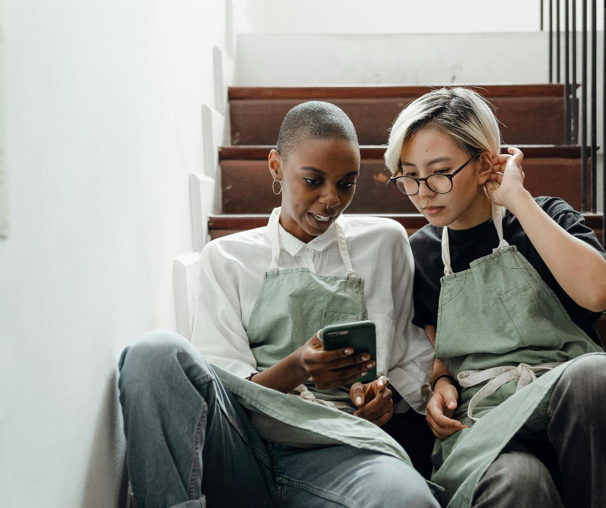
Causes of increased risk
Increased exposure to gambling while in the workplace
Normalisation of gambling
Increased familiarity with gambling can change attitudes towards gambling odds of winning
Influence of shift work
Notes:
Speaker’s notes:
There are several reasons why, as a venue staff member, you have increased risk of gambling harm, according to research. This is largely related to your repeat exposure to gambling. Research shows that people with greater exposure to gambling can have increased risk of gambling harm. As a gambling venue staff member, you are constantly surrounded by gambling while at work. This can normalise gambling, making it seem like a common form of entertainment, given the large amount of people you see gambling on a regular basis. This exposure can encourage you to start gambling or gamble more often.
Also, this greater exposure to gambling might lead you to believe you have a better understanding of gambling activities than other people who gamble, because of your familiarity with gambling. This might lead you to believe you have a greater chance of winning, which could encourage you to start or continue gambling. This can be worsened if you see people have several big wins in your venue.
Another potential risk factor is the influence of shift work (or casual work). People who work in gambling venues often work late at night, might socialise with other hospitality workers, and might choose to gamble to fill in time between shifts. You might also experience social isolation due to your work, leading to poor mental health. All of these things can make you more likely to start or increase gambling.
References:
Hing, N & Gainsbury, S. (2011). Risky business: Gambling problems amongst gaming venue employees in Queensland, Australia. Journal of Gambling Issues. 25. 10.4309/jgi.2011.25.2.
Hing, N. & Breen, H. (2006). Gambling by Employees of Queensland Gaming Venues: Workplace Influences on Responsible Gambling and Problem Gambling. Centre for Gambling Education and Research. Southern Cross University, Lismore.

Slide 79
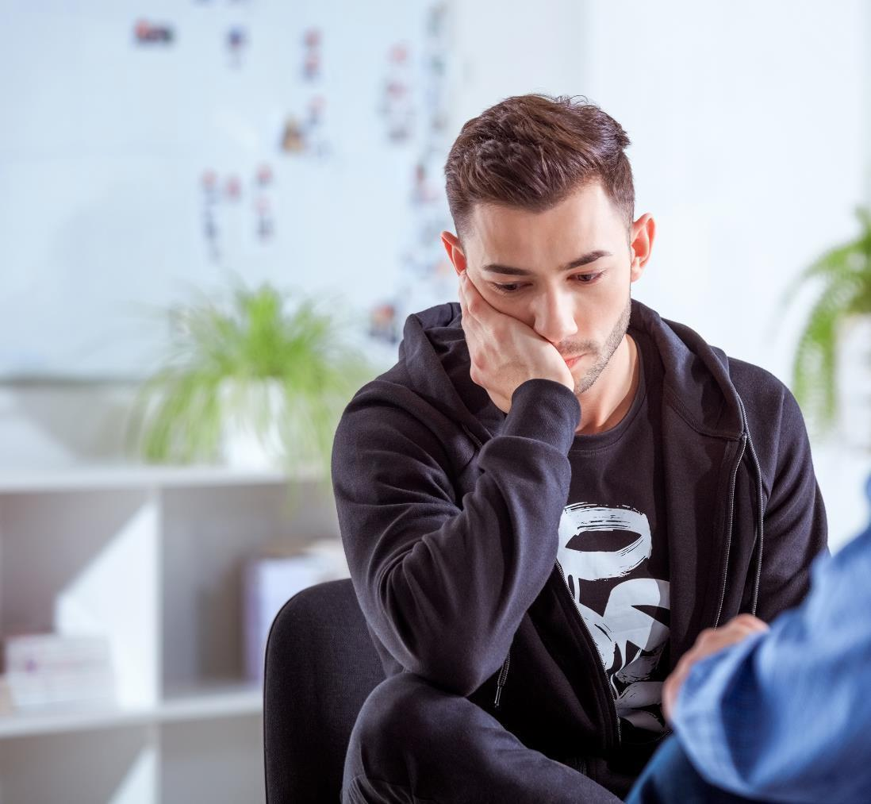
Signs of mental health issues
Worried, anxious, or easily irritated
Unhappy, depressed, or unmotivated
Changes to sleep or eating
Quieter or more withdrawn
Disconnected or detached
Guilty, worthless or empty
Notes:
Speaker’s notes:
It’s important to know that everybody’s mental health is different and so, the signs of mental ill-health can look different in everybody. However, there are several common signs of mental ill-health. This might include feeling worried, anxious, or easily irritated; feeling unhappy, depressed, or unmotivated to do things you usually enjoy; experiencing changes to sleep or eating, including sleeping or eating too little or too much; feeling quieter or more withdrawn than usual; feeling disconnected or detached from yourself and others; or feeling guilty, worthless or empty.
References:
Queensland Government. (2024). Signs of mental illness. https://www.qld.gov.au/health/mental-health/signs

Slide 80

The role of gambling venues
Gambling venues have a responsibility to provide safe work environments for their employees
Strategies can include
  Clear policies and procedures about gambling in the workplace
  Provide safer gambling staff training
  Assist staff experiencing gambling harm
  Promote a strong culture of safer gambling
Notes:
Speaker’s notes:
There are different strategies that you can adopt to look after your mental health. But first, let’s talk about the role of gambling venues and what employers can do to provide a safer work environment. This includes having strong and clear policies and procedures about gambling in the workplace, including implementing the Queensland Code of Practice; providing safer gambling staff training, including refresher sessions like this one; assisting staff who might be experiencing gambling harm, through open communication, active management support, and liaising with local Gambling Help services; and taking a preventative approach to promote a stronger culture of safer gambling, including involvement in Gambling Harm Awareness Week. As a manager, you have a responsibility to protect the mental health of your employees, by providing workplace environments that mitigate the risk of gambling harm.
References:
Hing, N. & Breen, H. (2006). Gambling by Employees of Queensland Gaming Venues: Workplace Influences on Responsible Gambling and Problem Gambling. Centre for Gambling Education and Research. Southern Cross University, Lismore.

Slide 81

The role of self-compassion
Act the same way towards yourself when things are difficult.
Can help prevent burnout.
Notes:
Speaker’s notes:
Having compassion for yourself is really no different than having compassion for others. Self-compassion involves acting the same way towards yourself when you are having a difficult time, fail, or notice something you don’t like about yourself. Instead of just ignoring your pain with a “stiff upper lip” mentality, you stop to tell yourself “this is really difficult right now,” how can I comfort and care for myself in this moment?
Self-compassion can help relieve many mental health concerns for example, burnout.
References:
Good therapy. (2019). Self-compassion. https://www.goodtherapy.org/learn-about-therapy/issues/self-compassion

Slide 82
Group discussion
How do you look after your mental health?
Notes:
Speaker’s notes:
Now we’re going to talk about the different strategies you can adopt to look after your own mental health. What strategies do you currently use to look after your mental health?

Slide 83





Mental health building blocks
Get healthy
Keep learning
Show kindness
Connect more
Take notice
Embrace nature
For more information, visit mentalwellbeing.initiatives.qld.gov.au
Notes:
Speaker’s notes:
There are many different ways you can support your mental health, and different strategies work for different people. We’re going to talk about the six building blocks for good mental health – get healthy, keep learning, show kindness, connect more, take notice and embrace nature. These strategies are part of a larger Queensland Government initiative called Dear Mind. If you’d like to find out more information about this initiative, or how you can support your mental health more broadly, visit the website on the screen.
Taking good care of your body is one of the most important things you can do to improve your mental wellbeing. A healthy, well-nourished and rested body provides the foundation for your mind to function at its best.
Keeping your mind engaged with new ideas and experiences is an important part of your mental wellbeing. This could be as easy as doing a daily Sudoku, learning a new skill through an online tutorial or listening to an informative podcast. Your ability to reason and make good decisions depends on how well your brain interprets and processes information. Doing regular mental challenges trains these mental pathways, improving their effectiveness and refreshing old or unhelpful thought patterns. Research shows that lifelong learning may improve brain function and prevent or delay the symptoms of dementia. Think about what activities you might enjoy and try something new!
One of the best ways to be kind to yourself is to be kind to others. Research tells us that performing an act of kindness triggers the release of a chemical called oxytocin. This stimulates the area of your brain associated with social connection and trust, which makes you feel good. Showing gratitude can improve your self-esteem, enhance empathy, reduce aggression and even help you sleep better. Acts of gratitude create strong positive emotions and practising them regularly will also help build your mental resilience. You can show kindness in many ways. Try an act of giving, like volunteering or helping a neighbour, or an act of gratitude, like sending a thank you note or just writing down something you are grateful for each day.
Feeling connected to people, groups, places and culture plays an important part in your mental wellbeing. Regular positive interactions stimulate the production of a feel-good chemical in your brain called dopamine which boosts your mood. Fostering stronger relationships and connections to your community can also strengthen your social networks for times when you might need extra support. There are plenty of ways you can make meaningful connections with people. This could include spending time with family and friends, inviting co-workers or classmates for lunch, or joining a team or club. Think about what activities you could try to connect with the people around you.
Daily life can be busy and stressful. But an easy way to calm that pressure is by taking a moment to stop and focus on the present. Mindfulness is about connecting with your immediate thoughts and feelings without judging them. You can practise mindfulness anywhere by taking a deep breath, then allowing yourself to focus only on what is happening in that moment – both in the world around you and in your mind. Studies have shown that mindfulness has a strong positive effect on your mental wellbeing. By directing your attention to what is happening in the present, you’re less likely to focus on worrying about things from the past, or things that might happen in the future. Take a moment the next time you feel stressed to practice some mindfulness.
Spending time in nature has big benefits for your mental wellbeing. Studies have shown that spending time in nature can improve your mood and reduce stress. It’s also been shown to have wider health benefits like building your immune system and lowering your blood pressure. More time outdoors also means that you’ll get more exposure to the sun. Sun exposure helps produce mood-stabilising chemicals like serotonin and gives your vitamin D levels a boost, which helps regulate your sleep cycles. There are plenty of ways to enjoy nature, like walking through local bushland, going for a picnic, kayaking or even doing some gardening. Environmentally friendly activities like recycling and composting can also help you feel a deeper connection with the world around you. Think about what ways you enjoy spending time outside and find new ways to connect with the natural world.
References:
Queensland Government. (2024). Your mental wellbeing. https://www.mentalwellbeing.initiatives.qld.gov.au

Slide 84
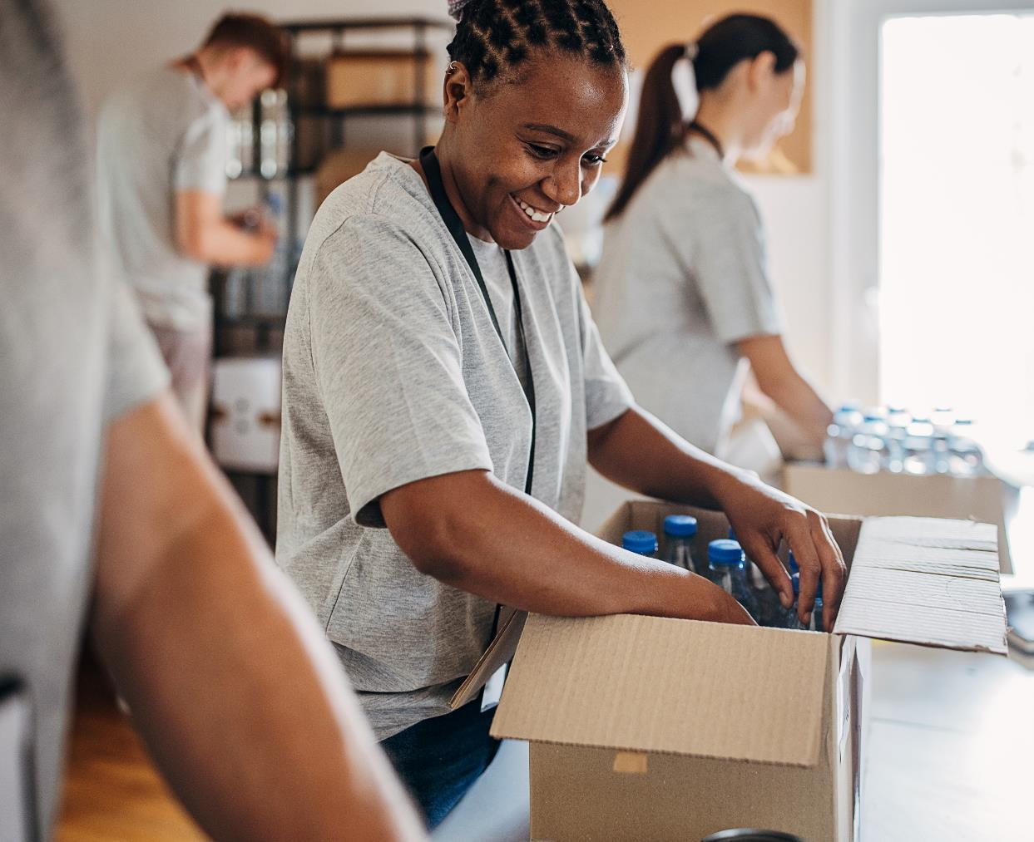
Life balance
Every aspect of your life influences your state of wellbeing.
Maintaining balance in your life helps with wellbeing.
Notes:
Speaker’s notes:
Wellbeing is not just the absence of disease or illness. It’s a complex combination of a person's physical, mental, emotional and social health factors. The factors that influence wellbeing are interrelated.
If you’re experiencing prolonged stress or burnout, finding ways to regain a sense of balance and wellbeing may include:
Turn to other people for support: friends, colleagues, or community groups
Reframe the way you look at work or your home life by finding value, meaning and balance
Reevaluate your priorities by taking time off or regular breaks during the day
Nourishing your creativity by doing something interesting
Make physical activity a priority to boost your mood and energy
Support your body with a healthy diet and quality sleep.
References:
Victoria Department of Health. (2024). Your mental wellbeing. https://www.mentalwellbeing.initiatives.qld.gov.au
Queensland Government (2021). Signs you might be experiencing a burnout and how to regain balance in your life. https://www.darlingdowns.health.qld.gov.au/about-us/our-stories/feature-articles/signs-you-might-be-experiencing-a-burnout-and-how-to-regain-balance-in-your-life

Slide 85

Underlying calm
Notes:
Speaker’s notes:
Even when you may be stressed and overwhelmed by thoughts or events, you can tap into the underlying calm and stillness present in your mind.
References:
Headspace. (2017). Underlying calm. https://www.youtube.com/watch?v=F0WYFXxhPGY

Slide 86

1-minute guided meditation
Notes:
Note to presenter: There are three slides in this section which each include a guided video meditation or exercise. You can use which of these will best suit your audience.
Speaker’s notes:
If you would like to, join in with this one-minute guided meditation focussing on identifying feelings.
References:
Queensland Health. (2024). Identifying feelings, Guided Meditation. https://www.youtube.com/watch?v=tlbybfd82UE&list=PLyD3_5mPPgQ7gIHbEvOX9EPWpYadg7sx_&index=13

Slide 87
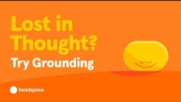
2-minute guided meditation
Notes:
Note to presenter: There are three slides in this section which each include a guided video meditation or exercise. You can use which of these will best suit your audience.
Speaker’s notes:
If you would like to, join in with this two-minute grounding exercise, to settle your mind and body.
References:
Headspace. (2022). Managing anxious thoughts and stress with mindfulness. https://www.youtube.com/watch?v=EfubAj5f_rM

Slide 88

5-minute guided meditation
Notes:
Note to presenter: There are three slides in this section which each include a guided video meditation or exercise. You can use which of these will best suit your audience.
Speaker’s notes:
If you would like to, join in with this five-minute guided meditation, and learn to practice self-compassion and prioritise taking care of yourself.
References:
Headspace. (2023). Free five-minute guided meditation with Eve. https://www.youtube.com/watch?v=pB_qUY1dPrs

Slide 89
Support services
Free and confidential counselling
Support is available either face-to-face, over the phone or online
Phone us:
Visit our website:
Gambling Helpline, 24/7
1800 858 858
www.gamblinghelpqld.org.au
Notes:
Note for presenter:
Please include the relevant GHS phone number and hours.
Speaker’s notes:
If you or someone you know is experiencing gambling harm, you can seek help from our support services. We offer free and confidential counselling services to both the person experiencing gambling harm and the people close to them. You can seek this support either face-to-face, over the phone or online. Our counsellors will always provide non-judgmental support. We’ll talk about the reasons you’ve decided to seek help and make plans together for the changes we can make to your gambling, your relationships and your life. You can find our phone number and website on the screen.

Slide 90
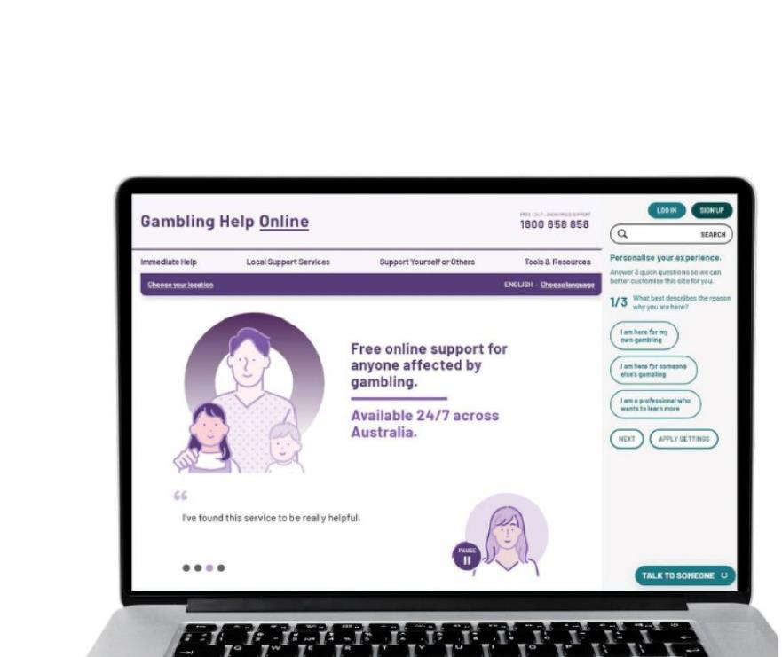
Support services
Gambling Help Online
1800 858 858
www.gamblinghelponline.org.au
Gamblers Anonymous Queensland
0467 655 799
www.gaaustralia.org.au
Notes:
Speaker’s notes:
There are also other services available, outside of our local area. The Gambling Help Online website provides 24/7 free online support for anyone affected by gambling across Australia. You can speak to a counsellor either on an online chat, email or over the phone at any time of the day. You can find more information at the Gambling Help Online website.
Gamblers Anonymous Australia provides group therapy and support across Australia. Members can meet either face-to-face or online, either weekly or whenever suits them, to listen and speak with other people who are experiencing similar gambling-related challenges. You can find more information about session times and locations at the Gamblers Anonymous Australia website.
References:
Gambling Help Online. (2024). Home. www.gamblinghelponline.org.au
Gamblers Anonymous. (2024). Home. www.gaaustralia.org.au

Slide 91

Crisis support
Notes:
Speaker’s notes:
If anything we have talked about today raises immediate concern for you, please know you are not alone. Help is always available. You can call the number on the screen or visit the Lifeline website.
References:
Lifeline. (2024). Home. www.lifelineqld.org.au

Slide 92
Questions?

