Slide 1
Lived experience
Notes:
Version: September 2024.

Slide 2
Overview
What is lived experience?
Significance of lived experience
David’s story
Allen’s story
Gambling harm consultations
Notes:
Speaker’s notes:
In the next few slides, we’re going to talk about lived experience. We’ll talk about what lived experience is and why it’s important, watch a few videos about people with lived experience of gambling harm, and talk about an opportunity for people with lived experience to provide valuable insight as part of a Queensland Government project.

Slide 3
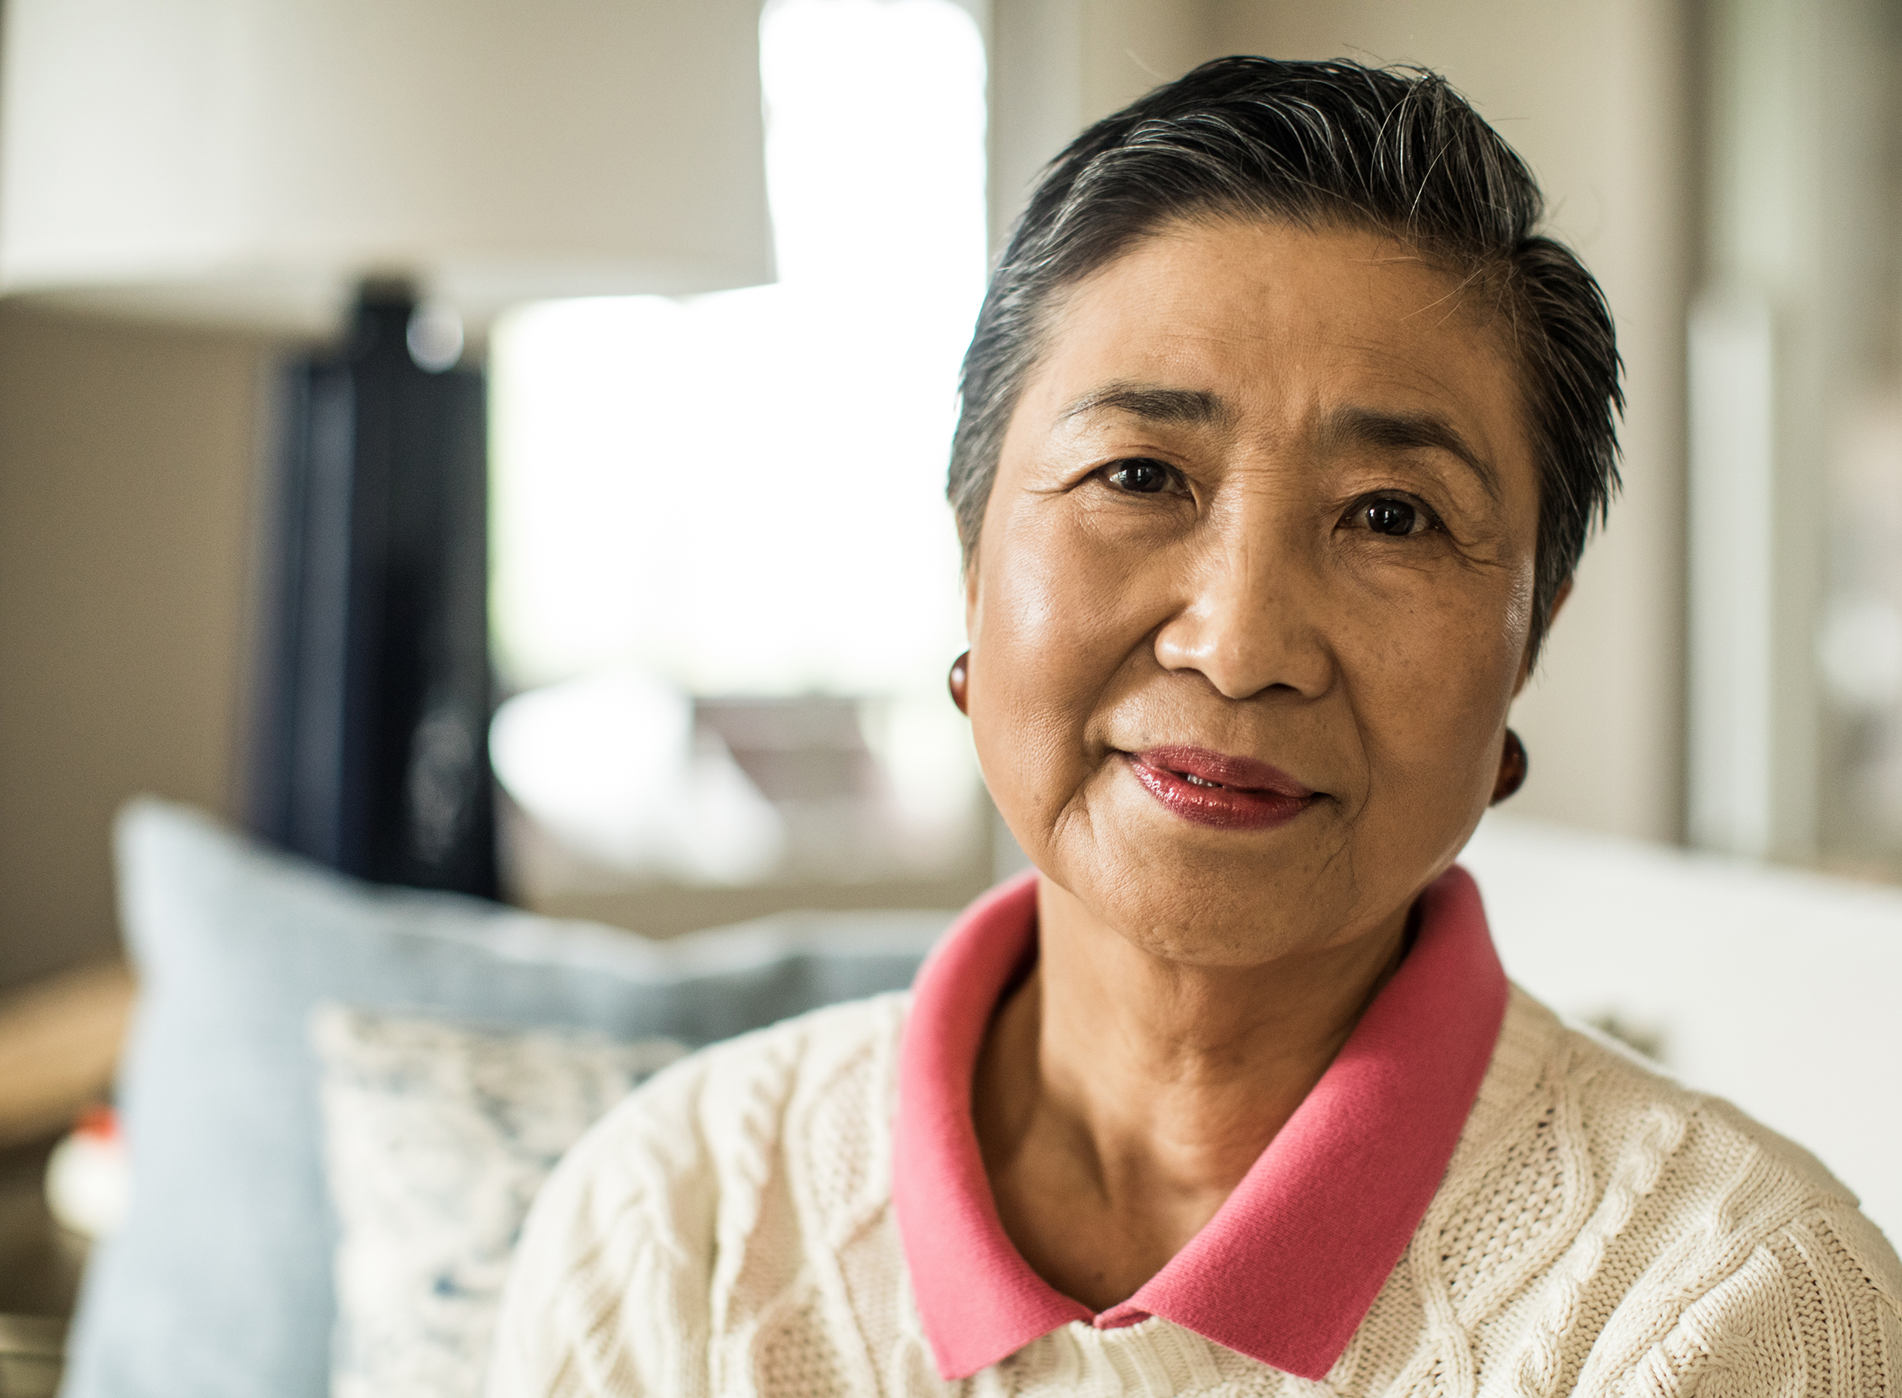
What is lived experience?
First-hand personal involvement in something and the knowledge somebody gains from it
People who have lived experience of gambling harm can be:
The person who gambles
Affected others
Notes:
Speaker’s notes:
Lived experience refers to someone’s first-hand personal involvement in something and the knowledge which they gain from it. People can have lived experience of many things, including different genders, sexualities, disabilities and certain health conditions. People who have lived experience of gambling harm have experienced the harmful impacts of gambling because of either their own gambling or the gambling of somebody close to them, such as a family member or friend.
References:
Victorian Department of Health. (2022). Lived experience. https://www.health.vic.gov.au/mental-health-reform/lived-experience
Suomi, A, P., Dowling, N. (2020). Lived experience of help-seeking in the presence of gambling related harms and coexisting mental health conditions, Victorian Responsible Gambling Foundation, Melbourne.

Slide 4
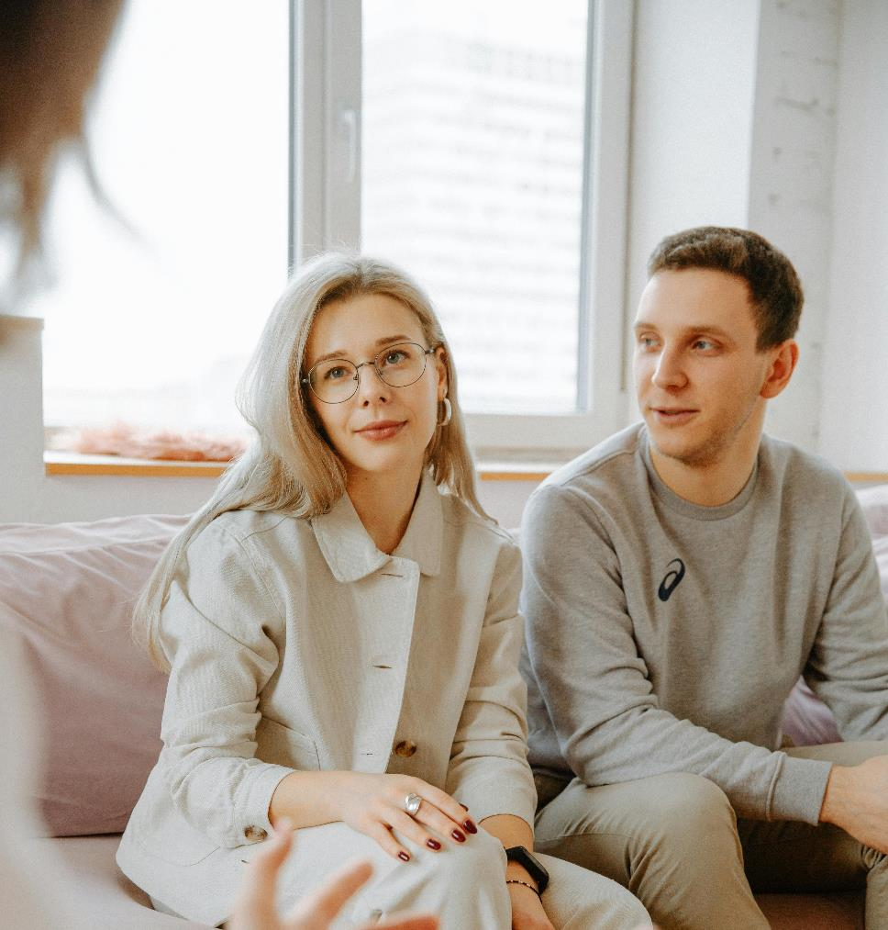
Why is lived experience important?
Ensures services are designed to meet people’s needs
Reduces shame and stigma
Leads to improved awareness of gambling harm
Improves quality of care
Notes:
Speaker’s notes:
People with lived experience are experts in their own experiences. They can provide meaningful insight into their thoughts and feelings through their own accounts, in their own words. Involving people with lived experience of gambling harm in policy and research ensures that services meet the needs of the people they are designed to support. This reduces shame and stigma, leads to improved awareness of the harm associated with gambling, and provides greater opportunities for help-seeking and better quality of care.
References:
Suomi, A, P., Dowling, N. (2020). Lived experience of help-seeking in the presence of gambling related harms and coexisting mental health conditions, Victorian Responsible Gambling Foundation, Melbourne.

Slide 5
Louise’s story
Notes:
Note to presenter: Choose 1 or 2 of the lived experience videos to play, based on what you think would work for the audience.
Speaker’s notes:
It can help to understand what gambling harm looks and feels like by hearing it from someone who has experienced it. Louise is a mother and grandmother who lives in Hervey Bay in Queensland. This is her story.
[After the video]: What did you learn about gambling harm from listening to someone’s lived experience?
References:
Office of Liquor and Gaming Regulation. (2021). 'When gambling took over...' Louise. https://www.youtube.com/watch?v=fQ0GD0_SzCk

Slide 6
David’s story
Notes:
Note to presenter: Choose 1 or 2 of the lived experience videos to play, based on what you think would work for the audience.
Speaker’s notes:
It can help to understand what gambling harm looks and feels like by hearing it from someone who has experienced it. David is a community worker who lives in Brisbane, Queensland. This is his story.
[After the video]: What did you learn about gambling harm from listening to someone’s lived experience?
References:
Office of Liquor and Gaming Regulation. (2021). 'When gambling took over...’ David. https://www.youtube.com/watch?v=51snzhCSDw8

Slide 7
Allen’s story
Notes:
Note to presenter: Choose 1 or 2 of the lived experience videos to play, based on what you think would work for the audience.
Speaker’s notes:
Now, we’re going to hear about Allen’s experience of gambling harm. Allen is a retired AFL player who lives in Brisbane, Queensland. This is his story.
[After the video]: What did you learn about gambling harm from listening to someone’s lived experience?
References:
Office of Liquor and Gaming Regulation. (2021). 'When gambling took over...’ Allen. https://www.youtube.com/watch?v=FkqP1jqjeOU

Slide 8
Gambling harm consultations
Do you have lived experience of gambling harm?
You can make a difference to the policies and programs that support people with lived experience of gambling harm in Queensland.
Register your interest at qld.gov.au/gamblingharmconsultations
Notes:
Speaker’s notes:
The Queensland Government is looking for people who have lived experience of gambling harm who would like to share their knowledge and expertise. By registering to share their experiences of gambling harm, Queenslanders can make a meaningful difference to ensure that the policies and programs developed by the Queensland Government better support the needs of people affected by gambling harm. If you have experienced gambling harm, either through your own gambling or someone else’s, you can share your voice by registering your interest on the Queensland Government website.
References:
Queensland Government. (2024). Gambling harm consultations. www.qld.gov.au/gamblingharmconsultations

Slide 9
Questions?

