Slide 1
Guidance for health professionals
Understanding gambling harm in your patients
Notes:
Version: September 2024.

Slide 2
Acknowledgement of Country
We acknowledge the Traditional Custodians of the lands and waters on which we meet today.
We pay our respects to Elders past, present and emerging.
We extend that respect to Aboriginal and Torres Strait Islander peoples here today.
Notes:
Note for presenter:
Please include the name of the First Nations group(s) who are the Traditional Custodians of the land where the presentation is being conducted.
Speaker’s notes:
We’d like to start by acknowledging the Traditional Custodians of the land on which we meet today, the (people) of the (nation), and pay our respects to Elders past, present and emerging, and extend that respect to Aboriginal and Torres Strait Islander peoples here today. We recognise their continuing connection to lands, waters and communities as the original storytellers and sharers of knowledge in Australia and understand the important role that Aboriginal and Torres Strait Islander peoples contribute to conversations about gambling and gambling harm minimisation.

Slide 3
Overview
Gambling harm
Signs of gambling harm
Comorbidities
Your role
When to have a conversation
Starting the conversation
Gambling harm screening tools
Referral pathways
Notes:
Speaker’s notes:
This module is designed to support health professionals – such as GPs, psychologists and allied health practitioners – understand gambling harm and the important role they can play in supporting their patients through gambling. In this module, we’ll discuss the signs of gambling harm and common comorbidities, when and how to have a conversation about gambling harm, gambling harm screening tools and referral pathways.

Slide 4
Gambling harm
Any negative impact that gambling can have on a person and the people close to them
Includes
Health and wellbeing
Finances
Relationships
Culture
Work or study
Notes:
Speaker’s notes:
Gambling harm is a term used to describe the many ways that gambling can impact a person’s life. It refers to any negative impact that gambling can have on a person and the people close to them. It can include harm to a person’s health and wellbeing, their finances, their relationships, their culture, and their work or study. Gambling harm can be experienced on a spectrum, ranging from minor or less frequent negative experiences to severe or ongoing impacts. It can be experienced by anybody, no matter how long a person has been gambling or how frequently. Gambling harm can even occur many years after a person’s actual gambling has stopped.
References:
Langham, E., Thorne, H., Browne, M., et al. (2015). Understanding gambling related harm: a proposed definition, conceptual framework, and taxonomy of harms. BMC Public Health, 16(1). https://doi.org/10.1186/s12889-016-2747-0

Slide 5
Affected others
Gambling harm impacts many people, not just the person who gambles
Affected others include
Partner/Spouse
Children
Other family members
Friends
Work colleagues
Broader community members
Notes:
Speaker’s notes:
It is important to know that gambling harm isn’t only about the person who gambles. It also impacts the people close to them, including their partner, children, other family members, friends, work colleagues, other important relationships, and broader communities. These people are called ‘affected others’. When we talk about gambling harm, we always talk about how it impacts everyone – people who gamble and affected others. This helps us understand the many ways that gambling harm can impact people’s lives and our community as a whole.
References:
Langham, E., Thorne, H., Browne, M., et al. (2015). Understanding gambling related harm: a proposed definition, conceptual framework, and taxonomy of harms. BMC Public Health, 16(1). https://doi.org/10.1186/s12889-016-2747-0
Browne, M, Langham, E, Rawat, V, et al. (2016) Assessing gambling-related harm in Victoria: a public health perspective. Victorian Responsible Gambling Foundation, Melbourne.

Slide 6
Signs of gambling harm
Changes in sleep, eating or sex
Increased headaches, stomach or bowel problems
Overeating or loss of appetite
Increased use of alcohol or other drugs
Neglecting personal or parental responsibilities
Changes to mental health
Notes:
Speaker’s notes:
It helps to understand some of the common signs of gambling harm so you can look out for it during conversations with your patients. Some of the common signs include changes in their patterns of sleep, eating or sex; increased headaches, stomach or bowel problems; overeating or loss of appetite; using alcohol or other drugs more often; neglecting personal or parental responsibilities, including self-care, work, study or family tasks; experiencing mood swings, anger or frustration; unexplained stress or anxiety; seeming depressed or suicidal.
References:
Langham, E., Thorne, H., Browne, M., et al. (2015). Understanding gambling related harm: a proposed definition, conceptual framework, and taxonomy of harms. BMC Public Health, 16(1). https://doi.org/10.1186/s12889-016-2747-0
Browne, M, Langham, E, Rawat, V, et al. (2016) Assessing gambling-related harm in Victoria: a public health perspective. Victorian Responsible Gambling Foundation, Melbourne.

Slide 7
Comorbidities
Gambling harm often intersects with other personal considerations
Mental ill-health
Alcohol, tobacco and other drugs
Financial or housing stress
Family crisis or relationship breakdown
Domestic and family violence
Speak to your patient about the different support services available
Notes:
Speaker’s notes:
Gambling harm is a complex issue that often co-occurs alongside other personal considerations. This might include experiences of mental ill-health, use of alcohol, tobacco and other drugs, financial or housing stress, family and relationship conflict, or various forms of trauma, including experiences of domestic and family violence. It is important to be mindful of how these comorbidities often influence one another, as it is likely to make some of your patients more at-risk of experiencing gambling harm than others. When speaking with your patient, try to be mindful of how the different parts of somebody’s life can affect a person and their health. Do your best to create a safe and supportive environment for your patient to speak about the many aspects of their life, including asking them if they would like more information about other available support services.
References:
Victorian Responsible Gambling Foundation. (2024). Screening and supporting patients for gambling harm. https://responsiblegambling.vic.gov.au/for-professionals/health-and-community-professionals/screening-and-supporting-patients

Slide 8
Your role
People who are experiencing harm might disclose their struggles to health professionals
You play an important role in talking to your patients about gambling harm
You can help them seek support
Notes:
Speaker’s notes:
As a health professional, you play an important role in understanding and addressing the signs of gambling harm in your patients. People who are experiencing harm sometimes disclose their struggles to someone they already trust before seeking further help. Often, the person they trust is a health professional - such as a GP, psychologist, or allied health practitioner - who provides support or treatment for other health and wellbeing issues. Stigma associated with gambling, and a lack of awareness of the signs of gambling harm, can act as barriers to a person seeking help from gambling support services. Therefore, there is an opportunity for health professionals to talk to patients about gambling harm within the context of a broader health and wellbeing conversation and provide options for support.
References:
Victorian Responsible Gambling Foundation. (2024). Screening and supporting patients for gambling harm. https://responsiblegambling.vic.gov.au/for-professionals/health-and-community-professionals/screening-and-supporting-patients

Slide 9
When to have a conversation
You can screen someone for gambling harm during a:
Lifestyle assessment
Mental health assessment
Consultation about:
Stressors
Financial pressure
Poor self-care
Intimate partner or family conflict
Notes:
Speaker’s notes:
If you have identified some of the common signs of gambling harm in a patient, there are several ways you can start a conversation about gambling harm. You can screen someone for gambling harm during a lifestyle assessment, as part of a mental health assessment, or when the patient has presented for stress, financial distress or pressure, poor self-care or intimate partner or family conflict.
References:
GambleAware. (2024). How to identify a patient’s gambling issues. https://www.gambleaware.nsw.gov.au/for-professionals/for-general-practitioners/how-to-identify-a-patients-gambling-issues

Slide 10
Starting the conversation
“In the past 12 months, have you had an issue with gambling?”
This screening question is validated as having a 92% detection rate for identifying gambling harm in patients in a primary and allied health care setting.
92%
Notes:
Speaker’s notes:
The easiest way to start a conversation with someone you think is experiencing gambling harm is by asking ‘In the past 12 months, have you had an issue with gambling?’ This screening question is validated as having a 92% detection rate for identifying gambling harm in patients in a primary and allied health care setting. Initiating the conversation with this screening question gives the patient permission to talk about gambling in a non-judgmental way and gives health professionals the opportunity to recommend a range of free, confidential and tailored support options.
References:
Victorian Responsible Gambling Foundation. (2024). Screening and supporting patients for gambling harm. https://responsiblegambling.vic.gov.au/for-professionals/health-and-community-professionals/screening-and-supporting-patients
Dowling, N. A., Merkouris, S. S., Dias, S., et al. (2019). The diagnostic accuracy of brief screening instruments for problem gambling: A systematic review and meta-analysis. Clinical psychology review, 74, 101784. https://doi.org/10.1016/j.cpr.2019.101784

Slide 11
Language matters
The words we use to talk about gambling have big impacts
Avoid words like “gambling problem”, “problem gambler” or “gambling addict”
Instead, try using the phrase “gambling harm” to describe the ways gambling can impact someone’s life
Notes:
Speaker’s notes:
It’s important to be mindful of the words you use when you speak to your patients about gambling. The words we use to talk about gambling can have big impacts, because how we speak about gambling influences what people think about those who are harmed by gambling. Words like “gambling problem”, “problem gambler” or “gambling addict” are common phrases used to describe someone who gambles, or their behaviour. But these kinds of words put blame and shame on the individual and aren’t helpful to the conversation. This can stop people getting the help they need. Instead, try using words like “gambling harm” to describe the ways gambling might be impacting someone’s life.
References:
Gambling Help Queensland. (2024). Talking to someone about their gambling. https://www.gamblinghelpqld.org.au/talking-to-someone-about-their-gambling
GambleAware. (2024). Start the conversation. https://www.gambleaware.nsw.gov.au/supporting-someone/supporting-family-and-friends/starting-the-conversation

Slide 12
Gambling harm screening tools
Problem Gambling Severity Index (PGSI)
Self-assessment of gambling behaviour over the last 12 months
Nine items
The higher the score, the more severe the impact of gambling
For more information, visit gamblinghelponline.org.au
Notes:
Speaker’s notes:
There are several tools available to screen for gambling harm. We recommend regularly screening patients who you think are at-risk of experiencing gambling harm, regardless of the reason they are seeking your professional help. This can help you identify gambling harm early and provide timely support and assistance to the people you’re working with.
The most popular gambling harm screening tool is the Problem Gambling Severity Index (PGSI). The PGSI is the standardised measure of at-risk behaviour for gambling harm, based on research on the common signs and consequences of harmful gambling. The PGSI quiz asks participants to self-assess their gambling behaviour over the past 12 months by scoring themselves against nine items. The higher their score, the more severe the impact that gambling is having on the patient’s life.
References:
GambleAware. (2024). How to identify a patient’s gambling issues. https://www.gambleaware.nsw.gov.au/for-professionals/for-general-practitioners/how-to-identify-a-patients-gambling-issues
Victorian Responsible Gambling Foundation. (2024). Screening and supporting patients for gambling harm. https://responsiblegambling.vic.gov.au/for-professionals/health-and-community-professionals/screening-and-supporting-patients
Gambling Help Online. (2024). Identifying gambling harm. https://www.gamblinghelponline.org.au/support-yourself-or-others/taking-action/identifying-gambling-harm?language_content_entity=en
Dowling, N. A., Merkouris, S. S., Dias, S., et al. (2019). The diagnostic accuracy of brief screening instruments for problem gambling: A systematic review and meta-analysis. Clinical psychology review, 74, 101784. https://doi.org/10.1016/j.cpr.2019.101784

Slide 13
Gambling harm screening tools
NODS-CLiP
Measures gambling harm over a lifetime
3 items
BPGS-2
Measures gambling harm in the last 12 months
2 items
For more information, visit gamblinghelponline.org.au
Notes:
Speaker’s notes:
Some workplaces might have limited time and resources available to administer a screening tool to identify gambling-related harm. These two gambling harm screening tools are much shorter questionnaires than the PGSI, and it can be indicative of gambling harm if a patient answers ‘yes’ to one or more items. This can support you to identify gambling harm, before starting longer conversations with your patients.
References:
Gambling Help Online. (2024). Identifying gambling harm. https://www.gamblinghelponline.org.au/support-yourself-or-others/taking-action/identifying-gambling-harm?language_content_entity=en
Dowling, N. A., Merkouris, S. S., Dias, S., et al. (2019). The diagnostic accuracy of brief screening instruments for problem gambling: A systematic review and meta-analysis. Clinical psychology review, 74, 101784. https://doi.org/10.1016/j.cpr.2019.101784

Slide 14
Support services
Free and confidential counselling
Support is available either face-to-face, over the phone or online
Phone us:
Visit our website:
Notes:
Note for presenter:
Please include the relevant GHS phone number and hours.
Speaker’s notes:
If you think a patient might need more support with their gambling, it’s a good idea to refer them to a gambling support service. You can do this either with a formal written referral, or simply by giving them more information about the services we provide. By reaching out to the specialist gambling services in your community, understanding the services they offer, and discussing ways to strengthen the relationship between services, you can help ensure the best outcomes for your clients.
We offer free and confidential counselling services. Your patient can seek this support either face-to-face, over the phone or online. Our counsellors will always provide non-judgmental support. We’ll talk about the reasons your patient has decided to seek help and make plans together for the changes we can make to their relationships and their life. You can find our phone number and website on the screen.

Slide 15
Other local support services
Support service | Contact information
Mental health support
Domestic and family violence
Alcohol and other drug use
Financial counselling
Notes:
Note for presenter:
Please include a list of some other local support services.
Speaker’s notes:
Sometimes, people gamble because there are other factors in their life that are causing them stress or difficulty. We’ve compiled a list of some of the other support services in our area, including services to help people experiencing mental health concerns, domestic and family violence, alcohol and other drug use, or financial difficulty. You can use these services to get your patient in touch with the other support they need.

Slide 16
Gambling Help support services
Gambling Help Queensland
1800 858 858
www.gamblinghelpqld.org.au
Gambling Help Online
1800 858 858
www.gamblinghelponline.org.au
Notes:
Speaker’s notes:
There are also other services available, outside of our local area. Gambling Help Queensland provide 24/7 support for anyone affected by gambling across Queensland, through their free hotline displayed on screen. Your patient can more information at the Gambling Help Queensland website.
The Gambling Help Online website provides 24/7 free online support for people across Australia. Your patient can speak to a counsellor either on an online chat, email or over the phone at any time of the day. Your patient can find more information at the Gambling Help Online website.
References:
Gambling Help Queensland. (2024). Home. www.gamblinghelpqld.org.au
Gambling Help Online. (2024). Home. www.gamblinghelponline.org.au

Slide 17
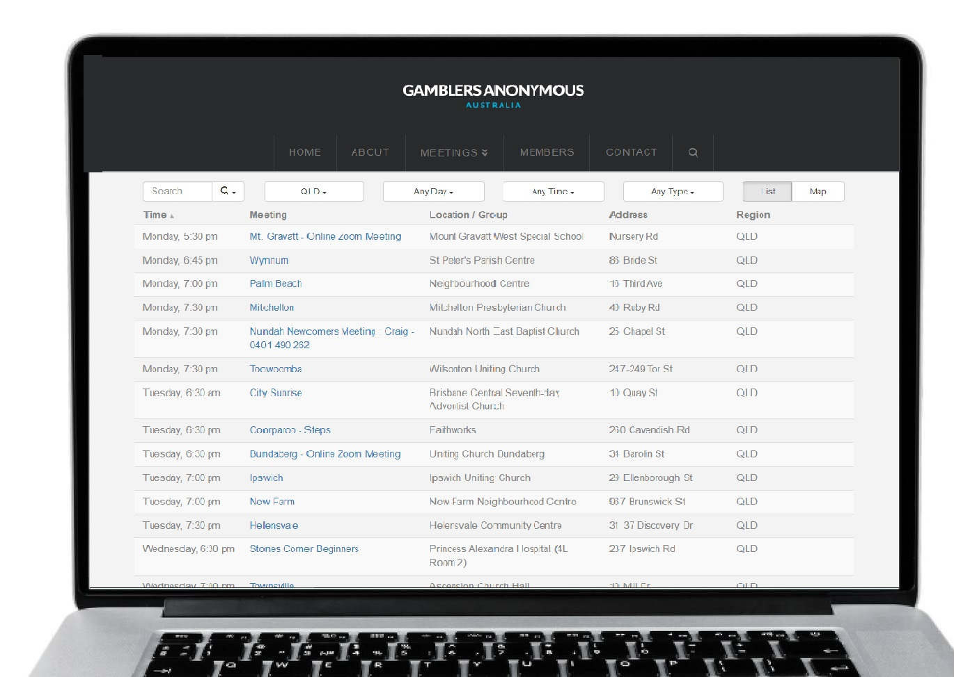
Group therapy support services
Gamblers Anonymous Queensland
0467 655 799
www.gaaustralia.org.au
Gam-Anon Queensland
0467 655 799
www.gaaustralia.org.au/gam-anon/
Notes:
Speaker’s notes:
There are also various support groups available. Gamblers Anonymous Australia provides group therapy and support across Australia. Members can meet either face-to-face or online, either weekly or whenever suits them, to listen and speak with other people who are experiencing similar gambling-related challenges. Your patient can find more information about session times and locations at the Gamblers Anonymous Australia website, by clicking the ‘Queensland meetings’ tab.
Similarly, Gam-Anon Queensland provides group therapy for people impacted by someone else’s gambling, including partners, family, friends and colleagues. Members can also meet either face-to-face or online. Your patient can find more information at the website on screen.
References:
Gamblers Anonymous. (2024). Home. www.gaaustralia.org.au

Slide 18
Further education resources
Learn about gambling and online gambling
Why people gamble
Links to other issues
Stages of change
Factors that contribute to harmful gambling
Gambling and young people
Gambling in culturally diverse communities
Gambling in Aboriginal and Torres Strait Islander communities
For more information, visit gamblinghelponline.org.au
Notes:
Speaker’s notes:
As a professional working with someone who may be experiencing gambling harm, it’s important to understand the potential risks and impacts of gambling, as well as the services that are available to support them. If you’d like to learn more, Gambling Help Online offers free education for professionals to further educate themselves about gambling. This includes: further learning on gambling and online gambling; how gaming works; gambling in specific populations, such as young people, Aboriginal and Torres Strait Islander communities and multicultural populations; gambling harm; and links to other issues, including mental health issues, substance use and family violence, etc. These resources can help you feel more confident and prepared for conversations with your patients and make it easier for them to open up about their experiences with gambling. You can find more information at the Gambling Help Online website.
References:
Gambling Help Online. (2024). Identifying gambling harm. https://www.gamblinghelponline.org.au/support-yourself-or-others/taking-action/identifying-gambling-harm?language_content_entity=en

Slide 19
Questions?

