Slide 1
Gambling and gaming
Notes:
Version: September 2024.

Slide 2
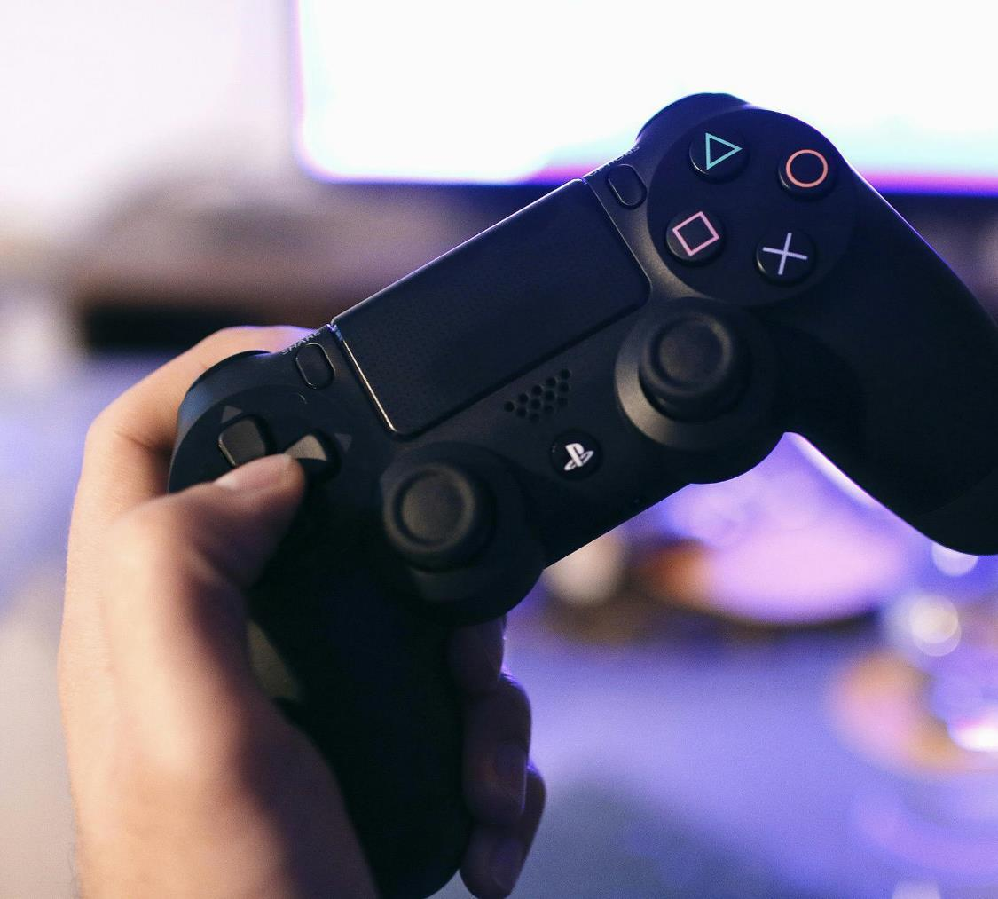
Overview
What is gaming?
Gaming and gambling
Key features
Potential harms
Strategies for safer gaming
Notes:
Speaker’s notes:
In the next few slides, we’re going to talk about gambling and gaming. We’ll start with a definition of gaming, explore the link between gaming and gambling, including some key features and examples, look at the potential harms, and talk about strategies to protect yourself or a loved one.

Slide 3
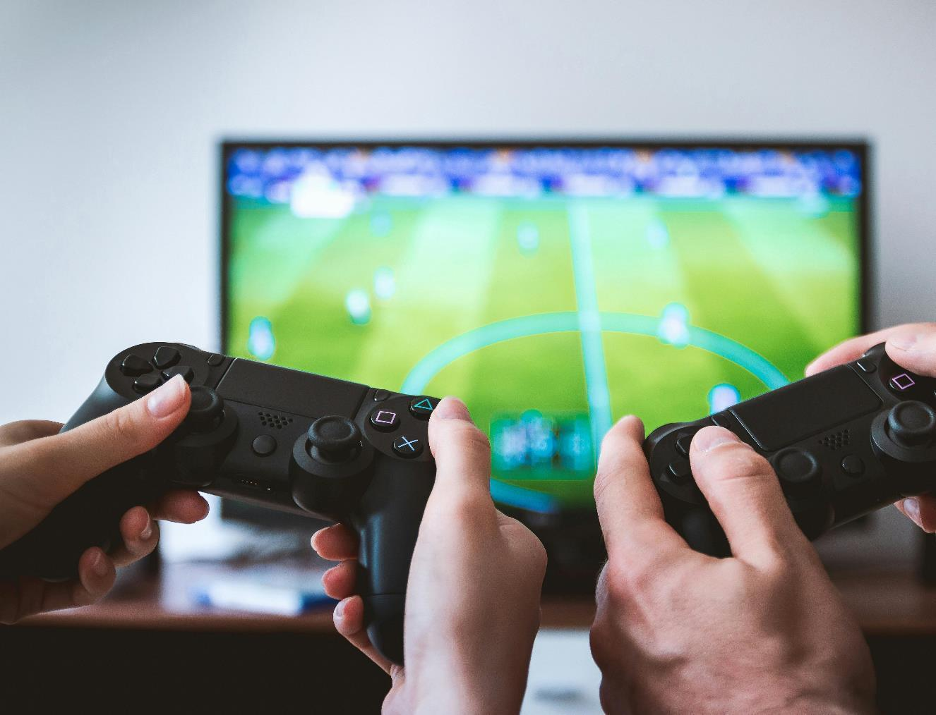
What is gaming?
Gaming refers to the act of playing video games
Popular form of entertainment
81% of Australians play video games
The average age of video game players in Australia is 35 years
Notes:
Speaker’s notes:
Let’s start with a definition. Gaming, as many of you will know, refers to the act of playing video games. This can be through a dedicated gaming console, computer or Smartphone, and generally involves audiovisual content, speakers or headphones, and a webcam. Gaming is a very popular form of entertainment in Australia, with a 2023 report highlighting that 81% of all Australians play video games. While gaming is popular amongst adolescents and young people, many adults also play video games. The same 2023 report found that the average age of video game players in Australia is 35 years. Gaming can have many positive impacts, as many people play to have fun and to connect with others. However, sometimes it can have harmful effects.
References:
IGEA. (2023). Australia Plays 2023. https://igea.net/2023/08/australia-plays-2023/

Slide 4
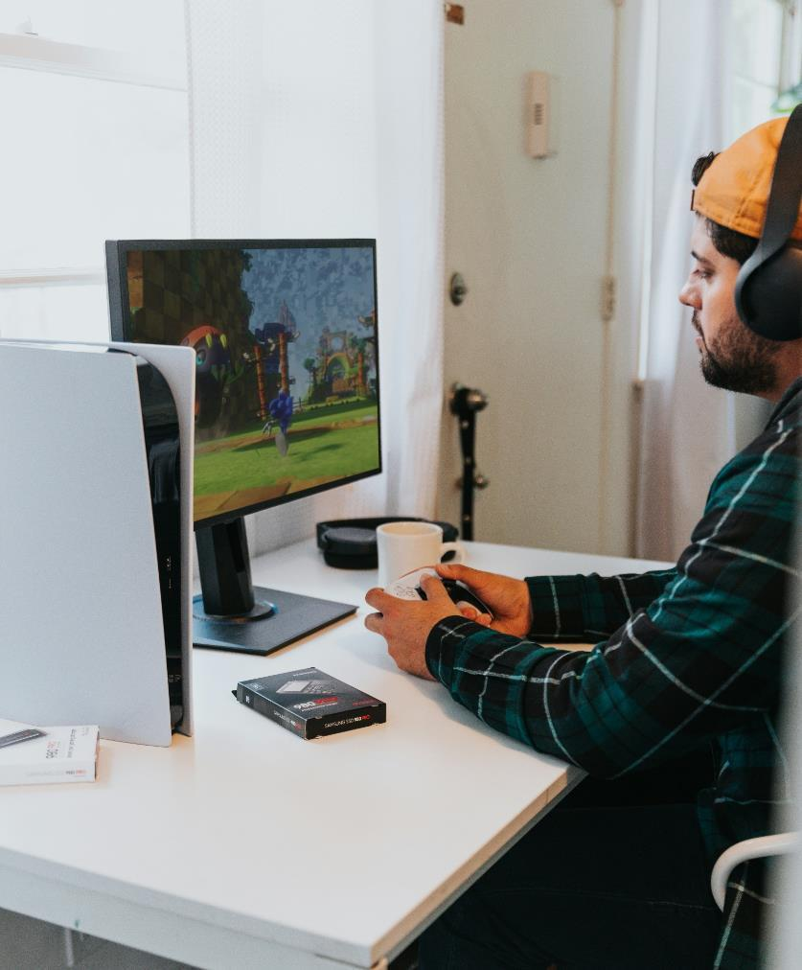
Gaming and gambling
Simulated gambling refers to games which imitate the core characteristics of gambling or include gambling-like activities
Can include both virtual currencies and real money
40%
of young people aged between 12 and 17 years play games that have gambling components
Notes:
Speaker’s notes:
Whilst gaming and gambling are defined as separate activities, they share many similarities. This includes appearance, interactive features, and elements of chance. Games that resemble traditional gambling activities or include gambling-like activities are commonly referred to as ‘simulated gambling’. Simulated gambling games imitate many of the core characteristics of gambling, such as the look, sound and actions, but do not provide an opportunity to bet, win or lose real money. However, in some games, players can use real money to purchase virtual currencies, upgrades or to increase game time. The NSW Youth Gambling Study 2020 found that around 40% of young people aged between 12 and 17 years play games that have gambling components.
References:
Gambling Help Online. (2024). How gaming works. https://www.gamblinghelponline.org.au/support-yourself-or-others/understanding-gambling/how-gaming-works
GambleAware. (2024). Gaming, gambling, and young people. https://www.gambleaware.nsw.gov.au/supporting-someone/supporting-young-people/gaming-gambling-and-young-people
Australian Institute of Family Studies. (2022). What is the link between video gaming and gambling?. https://aifs.gov.au/research/commissioned-reports/what-link-between-video-gaming-and-gambling

Slide 5
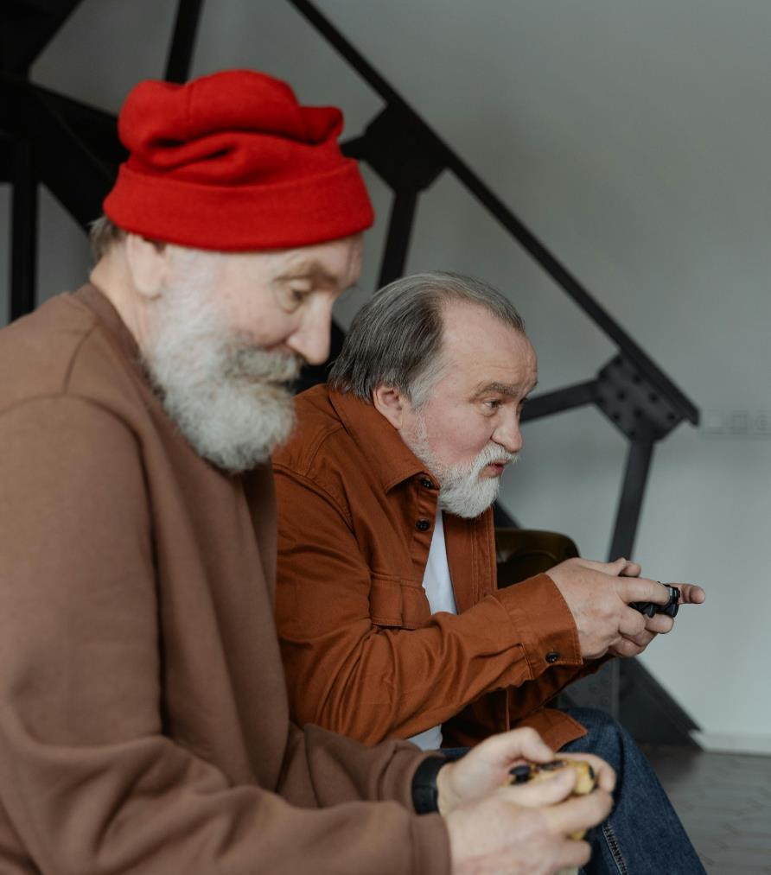
Types of simulated gambling
Social casino games
Look and work like real casino games, such as blackjack or pokies
Rather than playing with real money, the player wins points or in-game currency, like coins or jewels
Notes:
Speaker’s notes:
It can be difficult to know what is gaming and what is gambling. We’re going to look now at some of the different kinds of simulated gambling games.
Social casino games are the easiest example of simulated gambling, as the game looks and works like real games in a casino, such as blackjack or pokies. But, instead of playing with real money, the player wins points or in-game currency, like coins or jewels.
References:
Gambling Help Online. (2024). How gaming works. https://www.gamblinghelponline.org.au/support-yourself-or-others/understanding-gambling/how-gaming-works
GambleAware. (2024). Gaming, gambling, and young people. https://www.gambleaware.nsw.gov.au/supporting-someone/supporting-young-people/gaming-gambling-and-young-people
Australian Institute of Family Studies. (2022). What is the link between video gaming and gambling?. https://aifs.gov.au/research/commissioned-reports/what-link-between-video-gaming-and-gambling
Gambling Research Australia. (2021). Second National Study of Interactive Gambling in Australia. https://www.gamblingresearch.org.au/publications/second-national-study-interactive-gambling-australia-2019-20

Slide 6
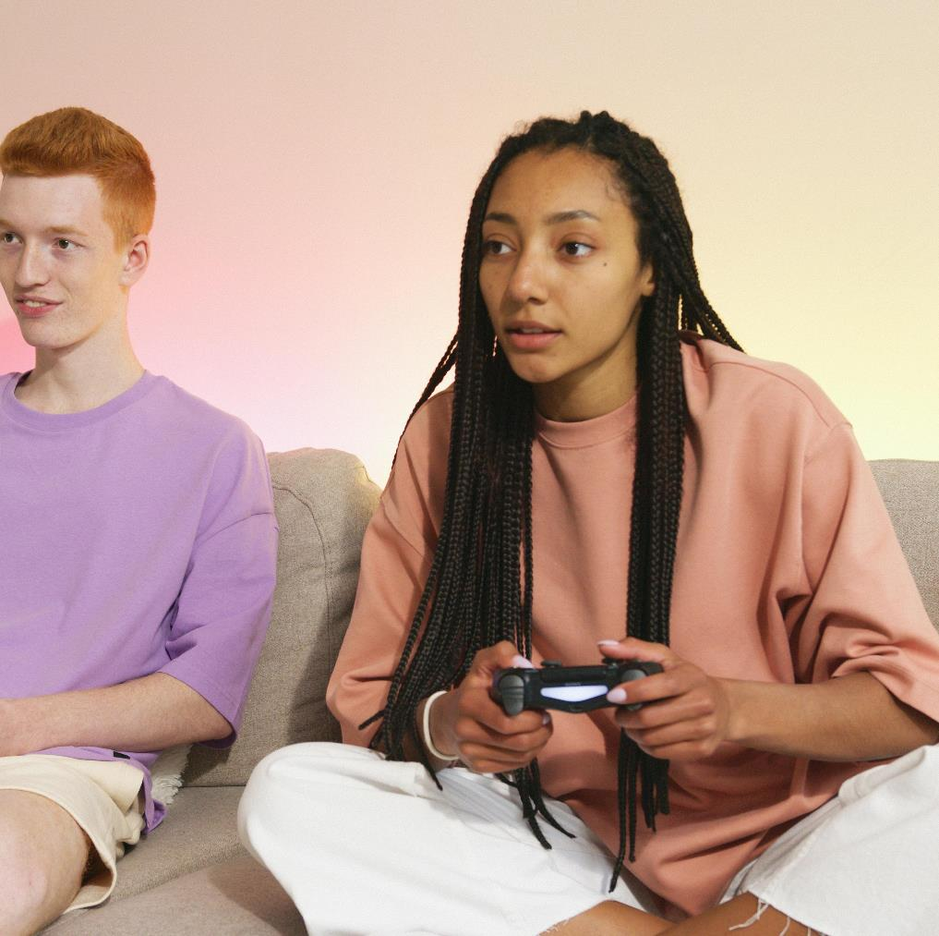
Types of simulated gambling
Loot boxes
Virtual treasure chests containing items that players can use to help advance them in the game
Contents of the box is unknown to the player until opened
Can be earned through playing or purchased using real money
Notes:
Speaker’s notes:
Loot boxes are virtual treasure chests that can be opened in a game, containing random items that can help players advance in the game or change the appearance of their avatar. Much like gambling, the contents of the box is unknown to the player, until the box is opened. Loot boxes can be earned through gameplay or purchased using real money. Loot box items are often traded among players or sold for cash.
References:
Gambling Help Online. (2024). How gaming works. https://www.gamblinghelponline.org.au/support-yourself-or-others/understanding-gambling/how-gaming-works
GambleAware. (2024). Gaming, gambling, and young people. https://www.gambleaware.nsw.gov.au/supporting-someone/supporting-young-people/gaming-gambling-and-young-people
Australian Institute of Family Studies. (2022). What is the link between video gaming and gambling?. https://aifs.gov.au/research/commissioned-reports/what-link-between-video-gaming-and-gambling
Gambling Research Australia. (2021). Second National Study of Interactive Gambling in Australia. https://www.gamblingresearch.org.au/publications/second-national-study-interactive-gambling-australia-2019-20

Slide 7
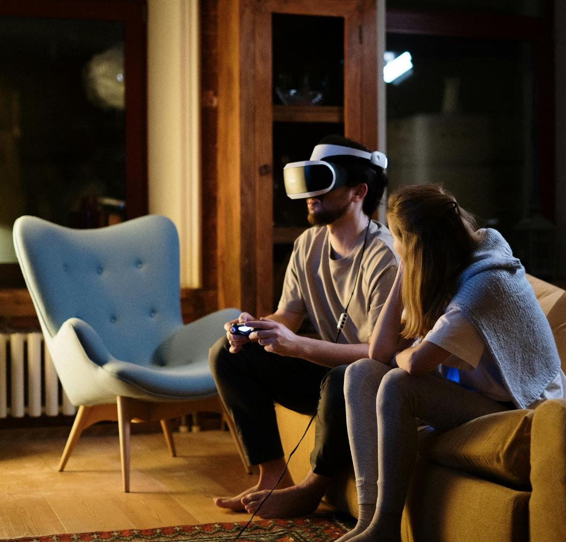
Types of simulated gambling
Skin betting
Items that players can acquire to change the appearance of their character, like clothes or weapons
Can be won, obtained through chance or purchased using game currency or real money
Notes:
Speaker’s notes:
Skin betting is another common feature. The term ‘skin’ refers to an item that players can acquire to change the appearance of their character, such as clothes or weapons. Skins can be won, obtained through chance, or purchased using in-game currencies. Some games allow players to purchase or trade skins for real money. There are also online marketplaces and gambling websites where people bet on skins.
References:
Gambling Help Online. (2024). How gaming works. https://www.gamblinghelponline.org.au/support-yourself-or-others/understanding-gambling/how-gaming-works
GambleAware. (2024). Gaming, gambling, and young people. https://www.gambleaware.nsw.gov.au/supporting-someone/supporting-young-people/gaming-gambling-and-young-people
Australian Institute of Family Studies. (2022). What is the link between video gaming and gambling?. https://aifs.gov.au/research/commissioned-reports/what-link-between-video-gaming-and-gambling
Gambling Research Australia. (2021). Second National Study of Interactive Gambling in Australia. https://www.gamblingresearch.org.au/publications/second-national-study-interactive-gambling-australia-2019-20

Slide 8
Impact of simulated gambling
Leads to false ideas about the chances of winning
Possible to become addictive
Normalises real gambling
Leads to greater uptake of real gambling
40%
more likely to gamble as an adult if a person plays simulated gambling games as a teenager
Notes:
Speaker’s notes:
Simulated gambling in games can have big impacts. Firstly, studies have found that the odds of winning in simulated gambling games – such as social casino games – is much higher than in real gambling. This can give the false impression to the player that winning whilst betting is easy or frequent.
Next, gambling-like games can become addictive, just like real gambling. Simulated gambling games can release dopamine in the brain, giving players the same rush as gambling, and leading someone to feel happy or like they’re on a high. This feeling can leave players craving more, which can encourage someone to engage in real gambling activities.
Lastly, simulated gambling normalises real gambling. It can make gambling seem easy, fun and like a normal part of life.
All of these factors can lead to greater uptake of real gambling activities. This was evidenced in a 2022 Australian Government report which found that young people who played simulated gambling games during adolescence (aged 16-17) were 40% more likely to spend real money on gambling when they became young adults (aged 18-19).
References:
Gambling Help Online. (2024). How gaming works. https://www.gamblinghelponline.org.au/support-yourself-or-others/understanding-gambling/how-gaming-works
GambleAware. (2024). Gaming, gambling, and young people. https://www.gambleaware.nsw.gov.au/supporting-someone/supporting-young-people/gaming-gambling-and-young-people
Australian Institute of Family Studies. (2022). What is the link between video gaming and gambling?. https://aifs.gov.au/research/commissioned-reports/what-link-between-video-gaming-and-gambling
ABC News. (2022). What are social casino games, and why do people become addicted?. https://www.abc.net.au/news/2022-03-01/social-casino-games-and-why-people-become-addicted/100861446

Slide 9
Strategies for safer gaming
Monitor your gaming
Play with other people
Gamble with a clear mind
Take a break from gaming
Participate in other activities
Notes:
Speaker’s notes:
There are lots of things you can do to protect yourself from the risks of gaming and their gambling-like features.
1. Monitor your gaming. Keeping track of your gaming, including how often you play games, how long you play them for, and the money you spend on in-game purchases, can help you to better understand the impact of your gaming.
2. Play with other people in the room. Even if you play games with other people online, it’s a good idea to have people around you while you play. This way, you can keep track of how much time and money you’re spending on the game. The people around you can also remind you to take a break when you’ve been playing for a while.
3. Gamble with a clear mind. Try to avoid drinking alcohol or using drugs while you’re gaming. Gaming while under the influence might mean you’re more likely to play for longer and make impulsive purchases within the game.
4. Take a break. Step back from the game before you make an impulsive purchase. Give yourself some time to think about the purchase and decide whether it’s something you really want or need. Some gaming consoles let you schedule break reminders in the game itself, and there are phone apps that do the same thing.
5. Participate in other activities. We all need balance in our lives. It’s important to make sure you’re also doing other activities you enjoy, like sport, art, hanging out with friends, and getting outside.
References:
Gambling Help Online. (2024). How gaming works. https://www.gamblinghelponline.org.au/support-yourself-or-others/understanding-gambling/how-gaming-works

Slide 10
Questions?

