Slide 1
The Basics about
Gambling
Notes:
Version: September 2024.

Slide 2
Acknowledgement of Country
We acknowledge the Traditional Custodians of the lands and waters on which we meet today.
We pay our respects to Elders past, present and emerging.
We extend that respect to Aboriginal and Torres Strait Islander peoples here today.
Notes:
Note for presenter:
Please include the name of the First Nations group(s) who are the Traditional Custodians of the land where the presentation is being conducted.
Speaker’s notes:
We’d like to start by acknowledging the Traditional Custodians of the land on which we meet today, the (people) of the (nation), and pay our respects to Elders past, present and emerging, and extend that respect to Aboriginal and Torres Strait Islander peoples here today. We recognise their continuing connection to lands, waters and communities as the original storytellers and sharers of knowledge in Australia and understand the important role that Aboriginal and Torres Strait Islander peoples contribute to conversations about gambling and gambling harm minimisation.

Slide 3
Gambling Help services
Gambling Help Services are free and funded by the Queensland Government
We provide support for people experiencing gambling harm
We deliver community education and counselling services
[Add community educator contact information here.]
Notes:
Note for presenter:
Please include the relevant GHS community educator contact information.
Speaker’s notes:
To start, we’d like to briefly talk about who we are and what we do. Gambling Help services are free Government-funded services delivered by a network of community-based specialist support agencies, like ours. We provide support to people experiencing gambling harm, including those impacted by someone else's gambling. We deliver community education and training, like what we’re doing here today, and participate in networking activities to teach the community more about safer gambling and gambling harm. You can find our contact information on the screen.
References:
Gambling Help Queensland. (2024). About us. https://www.gamblinghelpqld.org.au/about-us

Slide 4
Our services
Call the 24/7 Gambling Helpline on 1800 858 858
Face-to-face counselling locations
Online counselling and real time chat
Notes:
Speaker’s notes:
As well as community education, we also deliver counselling for people experiencing gambling harm. Our services are free and confidential. We provide safe, warm and non-judgmental environments for people to talk about their experiences of gambling harm and together, we find ways to make changes in that person’s life. Our counselling services are available face-to-face, over the phone, or online.
References:
Gambling Help Queensland. (2024). About us. https://www.gamblinghelpqld.org.au/about-us

Slide 5
Overview
Introduction to gambling
Popularity of gambling
Gambling harm
Signs of gambling harm
Gambling harm risk factors
Useful tips for safer gambling
Pathways to seek help
Notes:
Speaker’s notes:
In this module, we will talk about the basics of gambling. You will learn about gambling and its popularity in Australia, gambling harm and its signs and risk factors, tips for safer gambling and pathways to seek support if you or someone you know needs help.

Slide 6
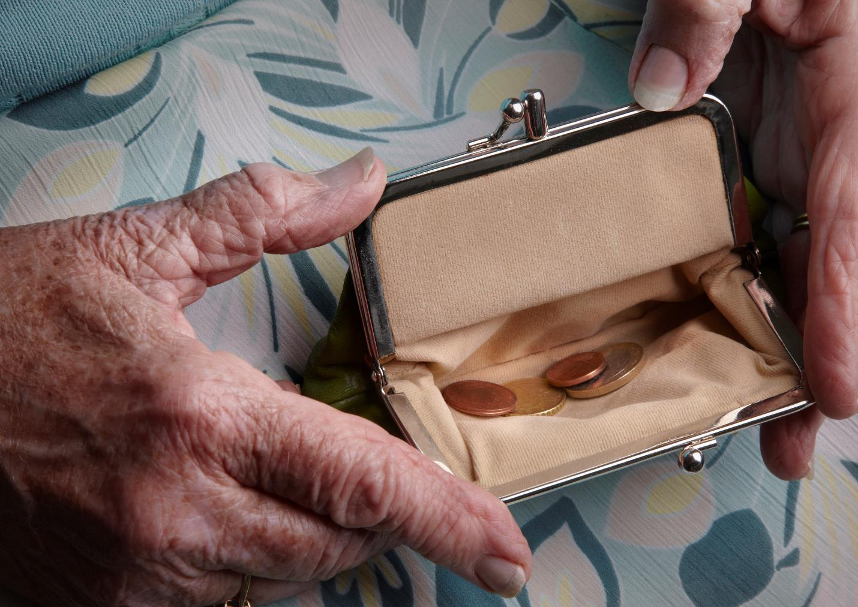
What is gambling?
The act of wagering or betting money or something else of value on an uncertain outcome to try to win more things of value
It always involves a risk or chance
Notes:
Speaker’s notes:
Gambling, as you will likely already know, is the act of wagering or betting money or something of value on an event with an uncertain outcome with the hope of winning more money or things of value than was wagered. Gambling involves risking something for the chance of winning more.
References:
Gambling Help Online. (2022). Learn about gambling. https://www.gamblinghelponline.org.au/support-yourself-or-others/understanding gambling/what-is-gambling?language_content_entity=en

Slide 7
What can people gamble on?
Lotteries and scratchies
Race betting
Sports betting
Pokies
Casino games
Keno and bingo
Other novelty events
Notes:
Speaker’s notes:
Someone can gamble on anything deemed to be of value or interest. In Australia, people can gamble on lotteries and scratchies; race betting, such as horse, greyhound and harness racing; sports betting, like the NRL and AFL; the pokies and more. People can gamble at a hotel, club or casino, in their own home, or through websites and mobile apps, like Sportsbet and TAB.
References:
Queensland Government. (2024). Queensland Gambling Survey 2023. https://www.publications.qld.gov.au/dataset/liquor-and-gambling-research
Australian Gambling Research Centre. (2023). Gambling participation and experience of harm in Australia. Australian Institute of Family Studies. https://www.publications.qld.gov.au/dataset/liquor-and-gambling-research/resource/4267f3c2-950b-407e-b88f-d31e116cedcb

Slide 8
Popularity of gambling in Queensland
70% of Queenslanders gambled in 2023
Men are more likely than women to gamble
on pokies, race and sports betting, keno and table games
18–34-year-olds gamble more than other age groups
on pokies, sports betting and table games
Notes:
Speaker’s notes:
The Queensland Gambling Survey 2023 found that around 70% of Queensland adults had gambled in the last 12 months. It found that men had significantly higher gambling participation rates than females for pokies, betting on races and sports, keno, and casino table games. People aged 18-34 years had higher gambling participation rates for pokies, sports betting and casino table games compared to other age groups.
References:
Queensland Government. (2024). Queensland Gambling Survey 2023. https://www.publications.qld.gov.au/dataset/liquor-and-gambling-research

Slide 9
Is it normal to gamble?
Gambling seems normal due to…
The promotion and advertising of gambling products
The support of gambling within communities
Online gambling platforms
Notes:
Speaker’s notes:
Gambling in Australia seems very normal and common. It’s easy to think that everybody does it and that it’s simple and fun. Some things seem so normal to gamble on, you might not even know it’s considered gambling – like entering a raffle at your local community event.
But there are several factors which contribute to why gambling can seem so normal. These include: the promotion and advertising of gambling products on TV and online, making them seem like a regular, easy and fun activity; the support of gambling by socially and culturally valued groups within communities, such as community clubs, and sporting teams and codes; and the accessibility of online gambling platforms, which can be used at any time of the day. Together, these things make gambling seem so normal that it’s easy to think there is no risk or harm involved. But it’s important to know there is always risk and there is always the chance that you will lose.
References:
Thomas, S, Pitt, H, Bestman, A, Randle, M, McCarthy, S, Daube, M 2018, The determinants of gambling normalisation: causes, consequences and public health responses, Victorian Responsible Gambling Foundation, Melbourne.

Slide 10
The odds of winning
1st division in Gold Lotto: 1 in 8.1 million
1st division in Powerball: 1 in 134.5 million
Top prize on the pokies: up to 1 in 7 million
The 10 number jackpot on Keno: 1 in 8.9 million
The top prize on an Instant Scratch-It game: 1 in 1.7 million
The trifecta in a 13 horse race: 1 in 1,700
Notes:
Speaker’s notes:
While gambling is viewed by many as a fun activity, the chances of winning are actually very low.
Let’s look at your odds of winning on different types of gambling products: 1st division in Gold Lotto (one game): 1 in 8,145,060; 1st division in Powerball (one game): 1 in 134,490,400; Top prize on the pokies (playing maximum lines): up to 1 in 7,000,000; The 10 number jackpot on Keno (one game): 1 in 8,911,711; The top prize on an Instant Scratch-Its $5 Crossword game: 1 in 1,700,000; The trifecta in a 13 horse race: 1 in 1,716.
By comparison, you have a higher chance of finding a 4-leaf clover on your first try than winning 1st division in Powerball, or a better chance of dating a millionaire than winning the trifecta in a 13-horse race, and a higher chance of winning an Olympic medal than winning the 10 number jackpot on Keno.
It’s important to remember that this isn’t an accident. Gambling is a business designed to make gambling providers money. The pokies have a built-in “assured percentage loss” of what you bet, which means the gambling provider makes a guaranteed profit. Always remember that if you gamble, there is a high probability you will lose and that the odds will always be in the house’s favour. It is important to be aware of these odds when thinking about the role of gambling in your own life.
References:
Queensland Government. (2020). The real odds of winning when gambling. https://www.qld.gov.au/community/getting-support-health-social-issue/gambling-harm-support/gambling-winning-odds
Queensland Government. (2014). In-venue signage for gaming licensees. https://www.publications.qld.gov.au/dataset/in-venue-signage-for-gaming-licensees
Gambling Help Online. (2022). Learn about gambling. https://www.gamblinghelponline.org.au/support-yourself-or-others/understanding-gambling/what-is-gambling?language_content_entity=en

Slide 11
Gambling and the brain
Gambling releases dopamine
Similar effect on the brain to alcohol or drugs
Gambling frequently can change the way dopamine impacts the brain
Notes:
Speaker’s notes:
When a person has a win while gambling, the brain releases a chemical called ‘dopamine’ that makes people feel good. It is the same chemical released when someone drinks alcohol or uses drugs. This feeling can make a person want to keep gambling, so they can continue to feel good.
But when someone gambles often, the brain can get used to the dopamine, which can make it harder to keep getting that good feeling. This might lead someone to gamble more and more to feel the same level of pleasure.
Some gambling products, like pokies, make our brains think that we’re winning, even if we’re not. Their design – such as flashing lights, confetti and celebratory sounds – can trick our brains into thinking we’ve won, or almost won. These are called “near misses”. Research has found that near misses have the same impact on the brain as an actual win. This is how it can become difficult to stop gambling.
References:
Anselme, P., & Robinson, M. J. (2013). What motivates gambling behavior? Insight into dopamine’s role. Frontiers in Behavioral Neuroscience, 7. https://doi.org/10.3389/fnbeh.2013.00182
Gambler’s Help. (2024). Gambling and how it affects the brain. https://gamblershelp.com.au/learn-about-gambling/gambling-and-how-it-affects-the-brain/

Slide 12
Why do people gamble?
Recreation or excitement
Try to win back losses
Try to deal with difficult emotions and life challenges
Notes:
Speaker’s notes:
There are many reasons why people gamble. ​
Gambling can be a recreational activity for some people, like watching a movie or going to a theme park. People may gamble for excitement, entertainment with family and friends, or to try winning money. ​
People can also gamble for other reasons. This may be to relieve boredom; to try to feel better about themselves; to win back losses or solve financial problems; to avoid sadness, worry, loneliness or other difficult emotions; to avoid relationship problems, work stress or struggles with other life challenges; or to cope with trauma.
References:
Gambling Help Queensland. (2024). Signs of gambling harm. https://www.gamblinghelpqld.org.au/signs-of-gambling-harm

Slide 13
Gambling harm
Any negative impact that gambling can have on a person and the people close to them
Includes
Health and wellbeing
Finances
Relationships
Culture
Work or study
Notes:
Speaker’s notes:
Gambling harm is a term used to describe the many ways that gambling can impact a person’s life. It refers to any negative impact that gambling can have on a person and the people close to them. It can include harm to a person’s health and wellbeing, their finances, their relationships, their culture, and their work or study.
Gambling harm can be experienced on a spectrum, ranging from minor or less frequent negative experiences to severe or ongoing impacts. It can be experienced by anybody, no matter how long a person has been gambling or how frequently. Gambling harm can even occur many years after a person’s actual gambling has stopped.
References:
Langham, E., Thorne, H., Browne, M., et al. (2015). Understanding gambling related harm: a proposed definition, conceptual framework, and taxonomy of harms. BMC Public Health, 16(1). https://doi.org/10.1186/s12889-016-2747-0

Slide 14
Signs of gambling harm
Financial signs
Emotional signs
Less money to spend
Decreased savings
Borrowing or taking money
Struggles to buy basic items
Needing financial assistance
Distress, shame or guilt
Struggles with self-worth
Less interest in goals or plans
Mental health concerns
Suicidal thoughts or behaviours
Notes:
Speaker’s notes:
It can be difficult to know if someone's gambling is harmful. It helps to understand some of the common signs of gambling harm so you can look out for it in yourself or someone you know. The common signs include financial signs, emotional signs, relationship signs, and health signs.
Financial signs include: having less money to spend on luxury items like holidays or electronics or spending less on non-gambling related entertainment like family outings and social activities; having decreased savings; borrowing or taking money from family or friends without their consent; spending less on family expenses like health care, education or insurance; struggling to buy basic items like food, housing, clothing or transport; or needing assistance to pay for bills from family, friends or welfare organisations.
Emotional signs include: seeming worried or distressed; struggling with self-worth or pride; seeming less interested in goals or plans for the future; reporting feeling hopeless, anxious or depressed; and struggling with suicidal thoughts.
References:
Langham, E., Thorne, H., Browne, M., et al. (2015). Understanding gambling related harm: a proposed definition, conceptual framework, and taxonomy of harms. BMC Public Health, 16(1). https://doi.org/10.1186/s12889-016-2747-0
Browne, M, Langham, E, Rawat, V, et al. (2016) Assessing gambling-related harm in Victoria: a public health perspective. Victorian Responsible Gambling Foundation, Melbourne.

Slide 15
Signs of gambling harm
Relationship signs
Health signs
Dishonest communication
Reduced engagement in family and social activities
Withdrawal or disengagement
Changes to diet
Decreased physical activity
Reduced sleep
Increased smoking, alcohol or drug intake
Notes:
Speaker’s notes:
Relationship signs – dishonestly communicating with others, including lying about or hiding gambling; reducing the quality and amount of time spent with others, including spending less time at family or social events; and becoming disengaged, withdrawn or neglectful of relationship responsibilities.
Health signs – making changes to diet, like choosing more takeout or junk food options; doing less physical activity; experiencing struggles with their sleep, either through reduced quality of sleep, time spent asleep or trouble getting to sleep; and smoking, drinking alcohol or using drugs more often.
References:
Langham, E., Thorne, H., Browne, M., et al. (2015). Understanding gambling related harm: a proposed definition, conceptual framework, and taxonomy of harms. BMC Public Health, 16(1). https://doi.org/10.1186/s12889-016-2747-0
Browne, M, Langham, E, Rawat, V, et al. (2016) Assessing gambling-related harm in Victoria: a public health perspective. Victorian Responsible Gambling Foundation, Melbourne.

Slide 16
Gambling harm risk factors
Big changes in life
Mental ill-health
Drugs or alcohol use
Previous experience of gambling harm
Notes:
Speaker’s notes:
There are factors in our lives that can increase our risk of experiencing gambling harm.
Some of these factors include: recent major changes to life, including separation or divorce, job loss, or the death of a loved one; struggles with mental health; excess use of drugs or alcohol; having experienced gambling harm before; or having a parent, partner or close friend who has experienced gambling harm.
References:
Gambling Help Queensland. (2024). Signs of gambling harm. https://www.gamblinghelpqld.org.au/signs-of-gambling-harm
Langham, E., Thorne, H., Browne, M., et al. (2015). Understanding gambling related harm: a proposed definition, conceptual framework, and taxonomy of harms. BMC Public Health, 16(1). https://doi.org/10.1186/s12889-016-2747-0
Browne, M, Langham, E, Rawat, V, et al. (2016) Assessing gambling-related harm in Victoria: a public health perspective. Victorian Responsible Gambling Foundation, Melbourne.

Slide 17
Louise’s story
Notes:
Speaker’s notes:
It can help to understand what gambling harm looks and feels like by hearing it from someone who has experienced it. Louise is a mother and grandmother who lives in Hervey Bay in Queensland. This is her story.
References:
Office of Liquor and Gaming Regulation. (2021). 'When gambling took over...' Louise. https://www.youtube.com/watch?v=fQ0GD0_SzCk

Slide 18
Tips for safer gambling
Understand the risk
Set limits with your money
Set limits with your time
Gamble with a clear mind
Maintain balance in life
Notes:
Speaker’s notes:
These tips can help you avoid gambling harm and practice safer gambling.
Tip 1: Understand the risk.
When we’re honest with ourselves about the risks of gambling, it’s easier to understand that the likelihood of winning isn’t very high. Remember the gambling industry exists to make a profit. There is a high chance you will lose, and the odds will always be in the house’s favour.
Tip 2: Set limits with your money.
Decide in advance the amount of money you will spend on gambling per week or month. Keep an eye on your current and past spending. Try to look for patterns or trends.
Tip 3: Set limits with your time.
It can be easy to lose track of time. Set start times and finish times for when you will gamble. Choose an ideal duration for play. Set a timer to remind you to stop or take a break in play.
Tip 4: Only gamble with a clear mind.
Sometimes when we’re having fun, we can be tempted to gamble while drinking or using drugs. But this can be dangerous as it changes the way we make decisions. Likewise, try not to gamble when you’re feeling down, stressed or bored as this can also lead us to make different choices.
Tip 5: Maintain balance in your life.
Remember that gambling shouldn’t take up all of your time. It is important to balance your time with other important things in your life, like spending time with friends and family, playing a sport or starting a creative project. If you find that your gambling is taking up too much of your time or you’re spending less time partaking in other important parts of your life, it might be time to seek help.
References:
Gambling Help Queensland. (2024). Tips for Safer Gambling. https://www.gamblinghelpqld.org.au/tips-to-avoid-risky-gambling
Multnomah County. (2024). 10 Tips for Safer Gambling. https://www.multco.us/behavioral-health/10-tips-safer-gambling
Responsible Gambling Council. (2024). Take a Safer Approach to Gambling: How to take precautions from the risks of gambling (especially online). https://www.responsiblegambling.org/for-the-public/safer-play/safer-gambling-tips/

Slide 19
Get support
Self-help
Ban yourself
Support services
Notes:
Speaker’s notes:
If you or someone you know is experiencing gambling harm, it might be time to get support. There are different ways you can do this. You could explore ways to support yourself, you could ban yourself from a gambling venue or product or you could seek help from our support services. In the next few slides, we’ll talk about these different pathways.
References:
Gambling Help Queensland. (2024). Let us help you. https://www.gamblinghelpqld.org.au/let-us-help-you

Slide 20
Self-help
For more information, visit gamblinghelpqld.org.au
Changing thoughts and beliefs
Managing money
Setting limits
Keeping busy
Using social support
Learning about triggers and urges
Focusing on health and wellbeing
Notes:
Speaker’s notes:
The first and often most common choice amongst people experiencing gambling harm is self-help. This refers to the different ways that you could make changes to your gambling in your own life. This might include learning to manage money or setting limits for yourself, trying to keep busy, or using your family and friends as support. Different strategies work for different people. You might find that some of these strategies work for you for some time, before you try doing something different. You can find more detailed information about self-help on the Gambling Help Queensland website.
References:
Gambling Help Queensland. (2024). Self-help. https://www.gamblinghelpqld.org.au/self-help

Slide 21
Self-exclusion
For more information, visit gamblinghelpqld.org.au
A request to be banned from specific gambling providers, products or services
Gambling providers are required to offer self-exclusion
We can help you with the self-exclusion process
Notes:
Speaker’s notes:
The next pathway is about self-exclusion (or self-ban). Self-exclusion is where you request to be banned from specific gambling providers, products or services. All licensed gambling providers in all states and territories in Australia are required to offer self-exclusion from their venues or products. You can ask for help to complete the self-exclusion process either from the venue directly or from a Gambling Help support service. For more information about how to self-exclude, visit the Gambling Help Queensland website.
References:
Gambling Help Queensland. (2024). Ban yourself from gambling. https://www.gamblinghelpqld.org.au/ban-yourself

Slide 22
Support services
Free and confidential counselling
Support is available either face-to-face, over the phone or online
Phone us:
Visit our website:
Notes:
Note for presenter:
Please include the relevant GHS phone number and hours.
Speaker’s notes:
If you or someone you know is experiencing gambling harm, you can seek help from our support services. We offer free and confidential counselling services to both the person experiencing gambling harm and the people close to them. You can seek this support either face-to-face, over the phone or online. Our counsellors will always provide non-judgmental support. We’ll talk about the reasons you’ve decided to seek help and make plans together for the changes we can make to your gambling, your relationships and your life. You can find our phone number and website on the screen.

Slide 23
Other local support services
Support service | Contact information
Mental health support
Domestic and family violence
Alcohol and other drug use
Financial counselling
Notes:
Note for presenter:
Please include a list of some other local support services.
Speaker’s notes:
Sometimes, people gamble because there are other factors in their life that are causing them stress or difficulty. We’ve compiled a list of some of the other support services in our area, including services to help people experiencing mental health concerns, domestic and family violence, alcohol and other drug use, or financial difficulty. You can also speak to one of our counsellors and they can get you in touch with the other support you need.

Slide 24
Gambling Help support services
Gambling Help Queensland
1800 858 858
www.gamblinghelpqld.org.au
Gambling Help Online
1800 858 858
www.gamblinghelponline.org.au
Notes:
Speaker’s notes:
There are also other services available, outside of our local area. Gambling Help Queensland provide 24/7 support for anyone affected by gambling across Queensland, through their free hotline displayed on screen. Find more information at the Gambling Help Queensland website.
Gambling Help Online provide 24/7 free online support across Australia. You can speak to a counsellor either on an online chat, email or over the phone at any time of the day. You can find more information at the Gambling Help Online website.
References:
Gambling Help Queensland. (2024). Home. www.gamblinghelpqld.org.au
Gambling Help Online. (2024). Home. www.gamblinghelponline.org.au

Slide 25
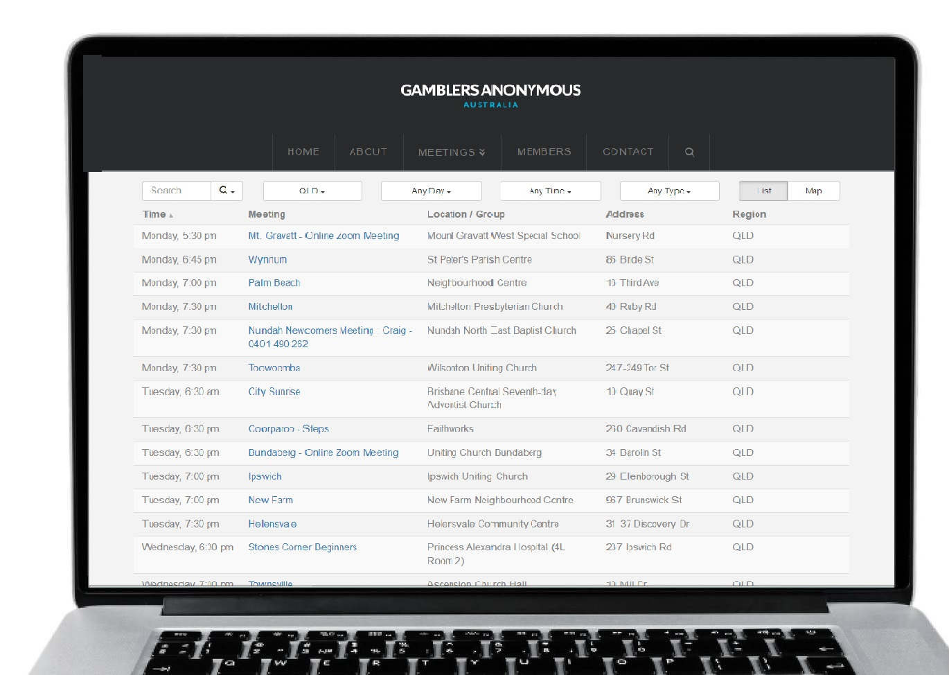
Group therapy support services
Gamblers Anonymous Queensland
0467 655 799
www.gaaustralia.org.au
Gam-Anon Queensland
0467 655 799
www.gaaustralia.org.au/gam-anon/
Notes:
Speaker’s notes:
There are also various support groups available. Gamblers Anonymous Queensland provides group therapy and support across Queensland. Members can meet either face-to-face or online, either weekly or whenever suits them, to listen and speak with other people who are experiencing similar gambling-related challenges. You can find more information about session times and locations at the Gamblers Anonymous Australia website, by clicking the ‘Queensland meetings’ tab.
Similarly, Gam-Anon Queensland provides group therapy for people impacted by someone else’s gambling, including partners, family, friends and colleagues. Members can also meet either face-to-face or online. You can find more information at the website on screen.
References:
Gamblers Anonymous. (2024). Home. www.gaaustralia.org.au

Slide 26
Gambling harm consultations
Do you have lived experience of gambling harm?
You can make a difference to the policies and programs that support people with lived experience of gambling harm in Queensland.
Register your interest at qld.gov.au/gamblingharmconsultations
Notes:
Speaker’s notes:
The Queensland Government is looking for people who have lived experience of gambling harm who would like to share their knowledge and expertise. By registering to share their experiences of gambling harm, Queenslanders can make a meaningful difference to ensure that the policies and programs developed by the Queensland Government better support the needs of people affected by gambling harm. If you have experienced gambling harm, either through your own gambling or someone else’s, you can share your voice by registering your interest on the Queensland Government website.
References:
Queensland Government. (2024). Gambling harm consultations. www.qld.gov.au/gamblingharmconsultations

Slide 27
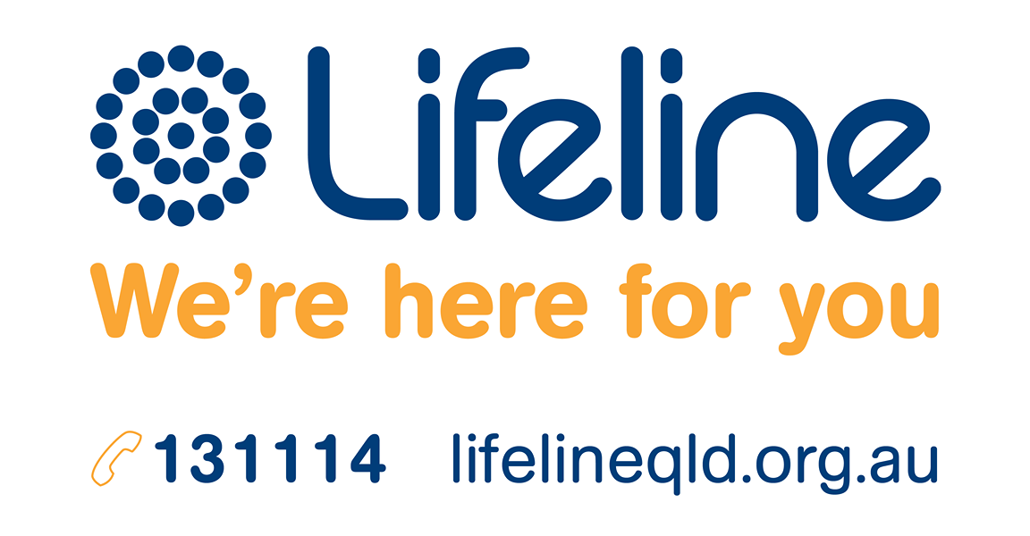
Crisis support
Notes:
Speaker’s notes:
If anything we have talked about today raises immediate concern for you, please know you are not alone. Help is always available. You can call the number on the screen or visit the Lifeline website.
References:
Lifeline. (2024). Home. www.lifelineqld.org.au

Slide 28
Questions?

