Slide 1
Gambling and mental health
Notes:
Version: September 2024.

Slide 2
Just to let you know…
Some of the content we are about to talk about in the next few slides might be difficult or confronting
If you think engaging in a conversation about mental ill-health might be harmful or distressing for you right now, we understand
Beyond Blue: 1300 224 636 | www.beyondblue.org.au
Lifeline: 13 11 14 | www.lifeline.org.au
Notes:
Speaker’s notes:
Some of the content we are about to talk about in the next few slides might be difficult or confronting. If you think engaging in a conversation about mental ill-health might be harmful or distressing for you right now, we understand. We encourage you to step outside for the next 15-20 minutes.
Please know help is available. You can find free and confidential support using the contact information displayed on screen.

Slide 3
Overview
What is mental health?
Signs of mental ill-health
Gambling and mental health
Mental health building blocks
Support services
Notes:
Speaker’s notes:
In this module, we’re going to talk about the link between gambling and mental health. We’ll start with a definition of mental health, explore the signs of mental ill-health, its link to gambling, and talk about strategies to look after your mental health and available support services.

Slide 4
What is mental health?
A state of wellbeing where an individual realises their own abilities and can contribute to their community
Integral part of a person’s overall health and wellbeing
Exists on a complex continuum, which is experienced differently by every person
Notes:
Speaker’s notes:
Mental health, as many of you will know, refers to a state of wellbeing in which an individual realises their own abilities, can cope with the normal stresses of life, can learn and work productively and is able to make a contribution to their community. Mental health is an integral part of a person’s overall health and wellbeing, as it underpins our ability to make decisions, build relationships and shape the world we live in.
Whilst society often talks about mental disorders – like anxiety, depression, schizophrenia or Post-Traumatic Stress Disorder (PTSD) – mental health is much more nuanced. It exists on a complex continuum, which is experienced differently by every person. This means that what might be deemed a normal degree of distress or difficulty for one person can look very different for somebody else. It’s important to keep this in mind when we talk about mental health.
References:
World Health Organisation. (2022). Mental health. https://www.who.int/news-room/fact-sheets/detail/mental-health-strengthening-our-response

Slide 5
Signs of mental ill-health
Worried, anxious, or easily irritated
Unhappy, depressed, or unmotivated
Changes to sleep or eating
Quieter or more withdrawn
Disconnected or detached
Guilty, worthless or empty
Notes:
Speaker’s notes:
It’s important to know that everybody’s mental health is different and so, the signs of mental ill-health can look different in everybody. However, there are several common signs of mental ill-health. This might include feeling worried, anxious, or easily irritated; feeling unhappy, depressed, or unmotivated to do things you usually enjoy; experiencing changes to sleep or eating, including sleeping or eating too little or too much; feeling quieter or more withdrawn than usual; feeling disconnected or detached from yourself and others; or feeling guilty, worthless or empty.
References:
Queensland Government. (2024). Signs of mental illness. https://www.qld.gov.au/health/mental-health/signs

Slide 6
Gambling and mental health
People who experience gambling harm are more likely to experience mental ill-health
Includes feelings of sadness, anxiety, anger, guilt and shame
40%
of people who experience gambling harm also have depression or anxiety
Notes:
Speaker’s notes:
Now, let’s talk about the link between gambling and mental health. Research tells us that people who experience gambling harm are more likely to experience mental ill-health. About 40% of people who experience gambling harm also have depression or anxiety, with many others reporting feelings of sadness, anxiety, anger, guilt, shame, self-doubt and feelings of failure. Generally, people who are experiencing both gambling harm and mental ill-health usually experience mental health difficulties first and use gambling as a coping mechanism. However, it can also work the other way too – where people who are experiencing gambling harm also experience mental ill-health because of their gambling.
References:
Gambling Help Online. (2024). Gambling and mental health issues. https://www.gamblinghelponline.org.au/support-yourself-or-others/understanding-gambling/gambling-and-mental-health-issues
Dowling, N. A., Cowlishaw, S., et al. (2015). Prevalence of psychiatric co-morbidity in treatment-seeking problem gamblers: A systematic review and meta-analysis. The Australian and New Zealand journal of psychiatry, 49(6), 519–539. https://doi.org/10.1177/0004867415575774

Slide 7
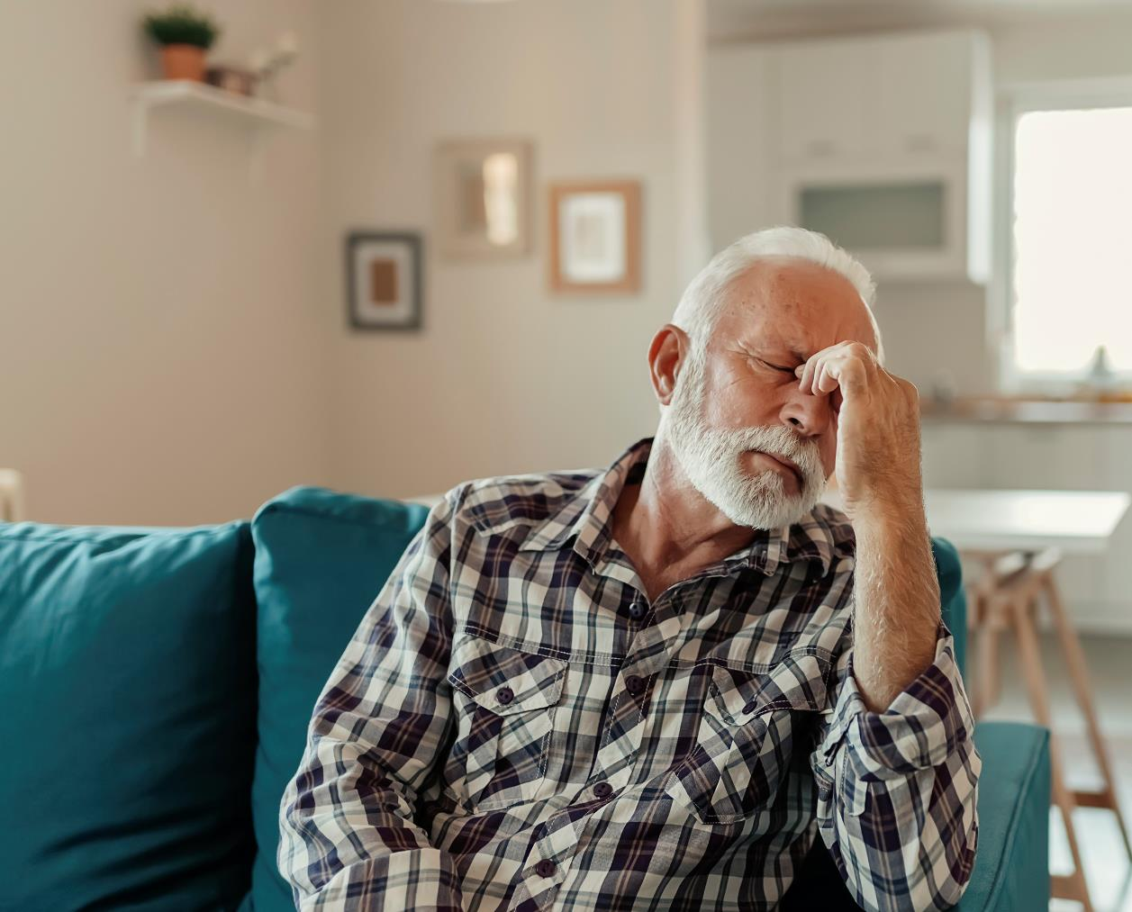
Gambling and mental health
Gambling harm can lead to mental ill-health because of…
Financial challenges
Relationship stress
Feelings of powerlessness and struggles with self-worth
Shame, guilt or fear of judgment
Increased risk of self-harm or considering suicide.
Notes:
Speaker’s notes:
People who experience gambling harm often experience mental health struggles because of their gambling. This is for several reasons, including financial challenges and increased debt; or relationship stress and increased tension or conflict. People who experience both gambling harm and mental ill-health can also struggle with feelings of powerlessness, desperation and poor self-worth due to the addictive nature of gambling which can lead someone to feel like they have a lack of control over their life. They might also experience feelings of shame, guilt, or fear of judgement because of the societal stigma towards people who experience gambling harm. That’s why there can be a strong link between gambling and mental health issues. People who have issues with gambling are also at increased risk of harming themselves or considering suicide, often because of considerable financial losses or debt.
References:
Gambling Help Online. (2024). Gambling and mental health issues. https://www.gamblinghelponline.org.au/support-yourself-or-others/understanding-gambling/gambling-and-mental-health-issues
Langham, E., Thorne, H., Browne, M., et al. (2015). Understanding gambling related harm: a proposed definition, conceptual framework, and taxonomy of harms. BMC Public Health, 16(1). https://doi.org/10.1186/s12889-016-2747-0
Browne, M, Langham, E, Rawat, V, et al. (2016) Assessing gambling-related harm in Victoria: a public health perspective. Victorian Responsible Gambling Foundation, Melbourne.

Slide 8
Other considerations
The connection between gambling and mental ill-health is complex
It can involve many other factors, including…
Family crisis or relationship breakdown
Financial stress
Substance misuse
Domestic and family violence
Homelessness
Other life stresses
Notes:
Speaker’s notes:
It’s important to understand that the connection between gambling and mental ill-health is complex. It can involve many other factors, including family crisis or relationship breakdown, financial stress, substance misuse, domestic and family violence, homelessness, and other life stresses like work or study stress. It is important to be mindful of how the different parts of somebody’s life can affect a person and the choices they make.
References:
Gambling Help Online. (2024). Gambling and family violence. https://www.gamblinghelponline.org.au/support-yourself-or-others/understanding-gambling/gambling-and-family-violence

Slide 9
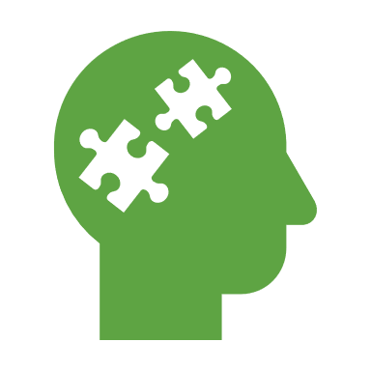
Mental health building blocks
Get healthy
Keep learning
Show kindness
Connect more
Take notice
Embrace nature
For more information, visit mentalwellbeing.initiatives.qld.gov.au
Notes:
Speaker’s notes:
There are many different ways you can support your mental health, and different strategies work for different people. We’re going to talk about the six building blocks for good mental health – get healthy, keep learning, show kindness, connect more, take notice and embrace nature. These strategies are part of a larger Queensland Government initiative called Dear Mind. If you’d like to find out more information about this initiative, or how you can support your mental health more broadly, visit the website on the screen. We’re now going to talk about each of these building blocks.
References:
Queensland Government. (2024). Your mental wellbeing. https://www.mentalwellbeing.initiatives.qld.gov.au

Slide 10
Get healthy
Taking good care of your body is one of the most important things you can do to improve your mental wellbeing
Prioritise physical activity
Eat well
Get plenty of rest
Notes:
Speaker’s notes:
Taking good care of your body is one of the most important things you can do to improve your mental wellbeing. A healthy, well-nourished and rested body provides the foundation for your mind to function at its best. You can take better care of your body in three different ways:
Prioritise physical activity. Physical activity releases feel-good chemicals into our bodies, like endorphins and serotonin. These chemicals can make you feel good, lift your mood, increase your energy levels and improve your sleep. There’s many different ways you can move your body, from taking your dog for a walk to high intensity interval training. Whichever way you choose to move your body, it’s a good idea to aim for at least 30 minutes of physical activity each day.
Eat well. We all know that we’re meant to eat our veggies. But did you know that eating a healthy diet directly impacts your brain function? Eating the right balance of nutrients can improve your energy levels, sleep patterns and general health, leaving you fresh and ready to handle life’s day to day challenges.
Get plenty of rest. Sleep gives your brain important ‘down time’ to process and store the information it receives during the day. Not getting enough sleep affects your mood and ability to concentrate and can also lead to anxiety and depression. It’s not always easy to get good sleep, especially if you’re busy. But it’s a good idea to aim for at least eight hours each night.
References:
Queensland Government. (2024). Your mental wellbeing. https://www.mentalwellbeing.initiatives.qld.gov.au

Slide 11
Keep learning
Keeping your mind engaged with new ideas and experiences is an important part of your mental wellbeing
Think about what activities you might enjoy and try something new
Notes:
Speaker’s notes:
Keeping your mind engaged with new ideas and experiences is an important part of your mental wellbeing. This could be as easy as doing a daily Sudoku, learning a new skill through an online tutorial or listening to an informative podcast. Your ability to reason and make good decisions depends on how well your brain interprets and processes information. Doing regular mental challenges trains these mental pathways, improving their effectiveness and refreshing old or unhelpful thought patterns. Research shows that lifelong learning may improve brain function and prevent or delay the symptoms of dementia. Think about what activities you might enjoy and try something new!
References:
Queensland Government. (2024). Your mental wellbeing. https://www.mentalwellbeing.initiatives.qld.gov.au

Slide 12
Show kindness
Did you know that one of the best ways to be kind to yourself is to be kind to others?
Try an act of giving, like volunteering or helping a neighbour
Try an act of gratitude, like writing down something you are grateful for each day
Notes:
Speaker’s notes:
One of the best ways to be kind to yourself is to be kind to others. Research tells us that performing an act of kindness triggers the release of a chemical called oxytocin. This stimulates the area of your brain associated with social connection and trust, which makes you feel good. Showing gratitude can improve your self-esteem, enhance empathy, reduce aggression and even help you sleep better. Acts of gratitude create strong positive emotions and practising them regularly will also help build your mental resilience. You can show kindness in many ways. Try an act of giving, like volunteering or helping a neighbour, or an act of gratitude, like sending a thank you note or just writing down something you are grateful for each day.
References:
Queensland Government. (2024). Your mental wellbeing. https://www.mentalwellbeing.initiatives.qld.gov.au

Slide 13
Connect more
Feeling connected to people, groups, places and culture plays an important part in your mental wellbeing
Strong social networks can help in times when you might need extra support
Think about what activities you could try to connect with people around you
Notes:
Speaker’s notes:
Feeling connected to people, groups, places and culture plays an important part in your mental wellbeing. Regular positive interactions stimulate the production of a feel-good chemical in your brain called dopamine which boosts your mood. Fostering stronger relationships and connections to your community can also strengthen your social networks for times when you might need extra support. There are plenty of ways you can make meaningful connections with people. This could include spending time with family and friends, inviting co-workers or classmates for lunch, or joining a team or club. Think about what activities you could try to connect with the people around you.
References:
Queensland Government. (2024). Your mental wellbeing. https://www.mentalwellbeing.initiatives.qld.gov.au

Slide 14
Take notice
Mindfulness is about connecting with your immediate thoughts and feelings without judging them
You can practise mindfulness anywhere by taking a deep breath and allowing yourself to focus only on the present
Take a moment the next time you feel stressed to practice some mindfulness
Notes:
Speaker’s notes:
Daily life can be busy and stressful. But an easy way to calm that pressure is by taking a moment to stop and focus on the present. Mindfulness is about connecting with your immediate thoughts and feelings without judging them. You can practise mindfulness anywhere by taking a deep breath, then allowing yourself to focus only on what is happening in that moment – both in the world around you and in your mind. Studies have shown that mindfulness has a strong positive effect on your mental wellbeing. By directing your attention to what is happening in the present, you’re less likely to focus on worrying about things from the past, or things that might happen in the future. Take a moment the next time you feel stressed to practice some mindfulness.
There are plenty of free apps, podcasts and short guided meditations available online that can help strengthen your mental wellbeing. You can find some recommended apps and links on the Dear Mind website.
References:
Queensland Government. (2024). Your mental wellbeing. https://www.mentalwellbeing.initiatives.qld.gov.au

Slide 15
Embrace nature
Spending time in nature has big benefits for your mental wellbeing
Linked to improved mood, reduced stress, improved immune system and lowered blood pressure
Think about what ways you enjoy spending time outside
Notes:
Speaker’s notes:
Spending time in nature has big benefits for your mental wellbeing. Studies have shown that spending time in nature can improve your mood and reduce stress. It’s also been shown to have wider health benefits like building your immune system and lowering your blood pressure. More time outdoors also means that you’ll get more exposure to the sun. Sun exposure helps produce mood-stabilising chemicals like serotonin and gives your vitamin D levels a boost, which helps regulate your sleep cycles. There are plenty of ways to enjoy nature, like walking through local bushland, going for a picnic, kayaking or even doing some gardening. Environmentally friendly activities like recycling and composting can also help you feel a deeper connection with the world around you. Think about what ways you enjoy spending time outside and find new ways to connect with the natural world.
References:
Queensland Government. (2024). Your mental wellbeing. https://www.mentalwellbeing.initiatives.qld.gov.au

Slide 16
Support services
Free and confidential counselling
Support is available either face-to-face, over the phone or online
Phone us:
Visit our website:
Notes:
Note for presenter:
Please include the relevant GHS phone number and hours.
Speaker’s notes:
If you or someone you know is experiencing gambling harm, you can seek help from our support services. We offer free and confidential counselling services to both the person experiencing gambling harm and the people close to them. You can seek this support either face-to-face, over the phone or online. Our counsellors will always provide non-judgmental support. We’ll talk about the reasons you’ve decided to seek help and make plans together for the changes we can make to your gambling, your relationships and your life. You can find our phone number and website on the screen.

Slide 17
Other local support services
Support service | Contact information
Mental health support
Domestic and family violence
Alcohol and other drug use
Financial counselling
Notes:
Note for presenter:
Please include a list of some other local support services.
Speaker’s notes:
Sometimes, people gamble because there are other factors in their life that are causing them stress or difficulty. We’ve compiled a list of some of the other support services in our area, including services to help people experiencing mental health concerns, domestic and family violence, alcohol and other drug use, or financial difficulty. You can also speak to one of our counsellors and they can get you in touch with the other support you need.

Slide 18
Support services
Beyond Blue
1300 224 636
www.beyondblue.org.au
Lifeline
13 11 14
www.lifeline.org.au
Notes:
Speaker’s notes:
If you or someone you know is experiencing mental-ill health, you can also seek help from other support services. Beyond Blue and Lifeline are free, confidential services that provide 24/7 support to people experiencing mental ill-health across Australia. Their counsellors are professionally qualified and experienced in mental ill-health support and guidance. You can contact them using the information displayed on screen.
References:
Beyond Blue. (2024). About us Beyond Blue. https://www.beyondblue.org.au/about
Headspace. (2024). Our services. https://headspace.org.au/services/

Slide 19
Gambling Help support services
Gambling Help Queensland
1800 858 858
www.gamblinghelpqld.org.au
Gambling Help Online
1800 858 858
www.gamblinghelponline.org.au
Notes:
Speaker’s notes:
There are also other services available, outside of our local area. Gambling Help Queensland provide 24/7 support for anyone affected by gambling across Queensland, through their free hotline displayed on screen. Find more information at the Gambling Help Queensland website.
Gambling Help Online provide 24/7 free online support across Australia. You can speak to a counsellor either on an online chat, email or over the phone at any time of the day. You can find more information at the Gambling Help Online website.
References:
Gambling Help Queensland. (2024). Home. www.gamblinghelpqld.org.au
Gambling Help Online. (2024). Home. www.gamblinghelponline.org.au

Slide 20
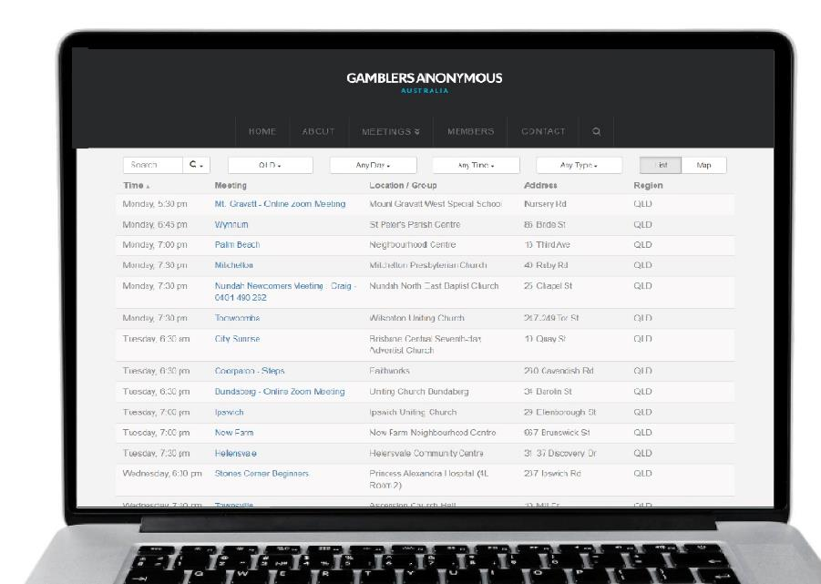
Group therapy support services
Gamblers Anonymous Queensland
0467 655 799
www.gaaustralia.org.au
Gam-Anon Queensland
0467 655 799
www.gaaustralia.org.au/gam-anon/
Notes:
Speaker’s notes:
There are also various support groups available. Gamblers Anonymous Queensland provides group therapy and support across Queensland. Members can meet either face-to-face or online, either weekly or whenever suits them, to listen and speak with other people who are experiencing similar gambling-related challenges. You can find more information about session times and locations at the Gamblers Anonymous Australia website, by clicking the ‘Queensland meetings’ tab.
Similarly, Gam-Anon Queensland provides group therapy for people impacted by someone else’s gambling, including partners, family, friends and colleagues. Members can also meet either face-to-face or online. You can find more information at the website on screen.
References:
Gamblers Anonymous. (2024). Home. www.gaaustralia.org.au

Slide 21
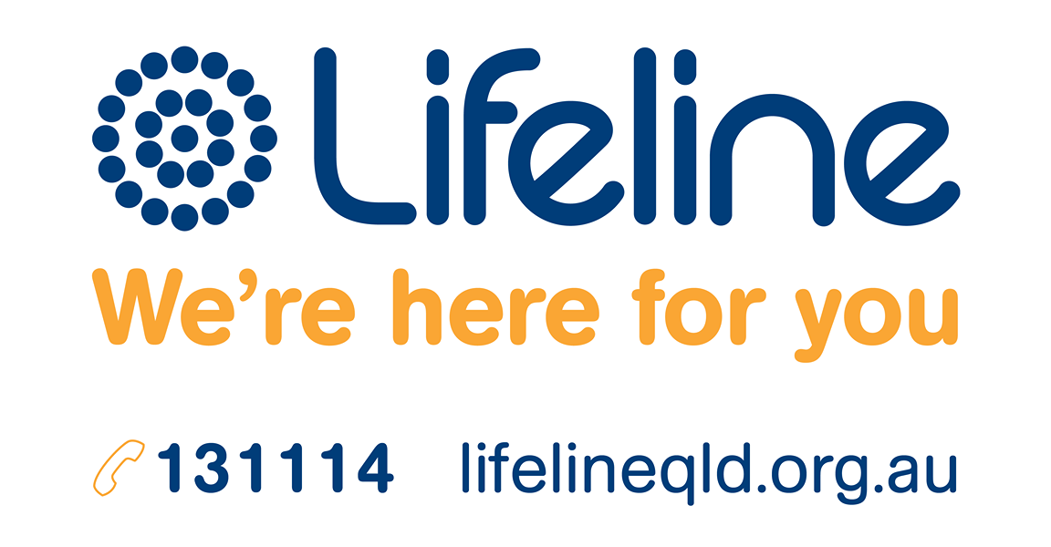
Crisis support
Notes:
Speaker’s notes:
If anything we have talked about today raises immediate concern for you, please know you are not alone. Help is always available. You can call the number on the screen or visit the Lifeline website.
References:
Lifeline. (2024). Home. www.lifelineqld.org.au

Slide 22
Questions?

