Slide 1


Odds of winning
Notes:
Version: September 2024.

Slide 2
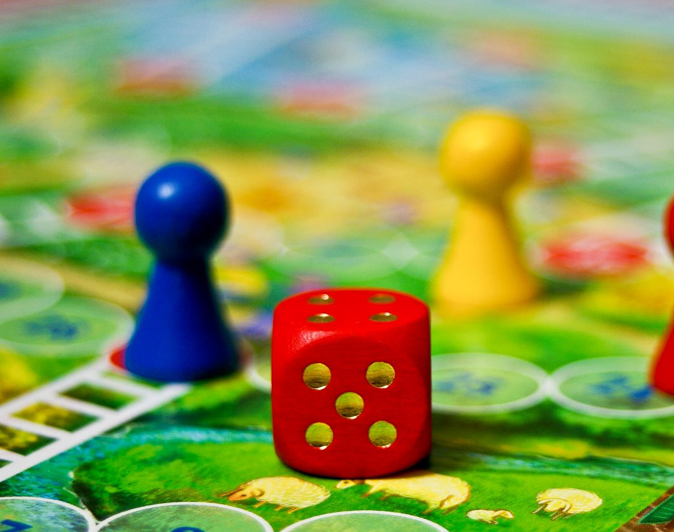
Overview
Gambling myths and facts
Odds of winning the lottery
Odds of winning on the pokies
Sports betting
Useful tips for safer gambling
Notes:
Speaker’s notes:
While gambling is viewed by many as a fun activity, the chances of winning are actually very low. In the next few slides, we’ll talk about common gambling myths and facts, the odds of winning on the lottery and on the pokies, sports betting and give you some useful tips for safer gambling.

Slide 3




Gambling myths and facts
Gambling is never a way to earn an income
Outcomes in games of chance are completely random
Results are unpredictable and cannot be influenced
Every game is independent, no matter the time or money spent
Notes:
Speaker’s notes:
Let’s start by talking about some common gambling myths and facts.
Myth 1: Gambling is a good way to make money.
Fact: Gambling should never be seen as a way to earn an income. It always involves risk and uncertainty.
Myth 2: Using special techniques or strategies will help you win.
Fact: Outcomes in games of chance are random. No matter how you pick the numbers in the lottery or play the pokies, you cannot influence the odds.
Myth 3: A gaming machine can be "due" to pay out.
Fact: Results of any spin on a gaming machine are random and unpredictable. It is not true that machines are more likely to pay-out at a particular time of day or after a certain amount of time. Outcomes on the pokies are completely random.
Myth 4: The longer you gamble on a machine the more likely you'll win a big prize.
Fact: Each spin on a gaming machine is independent of previous spins, no matter the amount of time or money you've spent playing.
Myth 5: "If I keep betting, my luck will change and I can win back the money I've lost.“
Fact: Feeling that it's time you had a win, or needing a win, will not change your odds of winning. Each time you place a bet, the outcome is independent of the previous bet (and any bets you may have made before). The odds of winning don’t change, whether you've won or lost money in the past. Avoid chasing your losses and never bet more than you can afford to lose.
References:
Gambling Help Queensland. (2024). Facts and myths. https://www.gamblinghelpqld.org.au/facts-and-myths
Responsible Gambling Council. (2024). Common myths about gambling. https://responsiblegambling.org/for-the-public/about-gambling/gambling-myths/

Slide 4
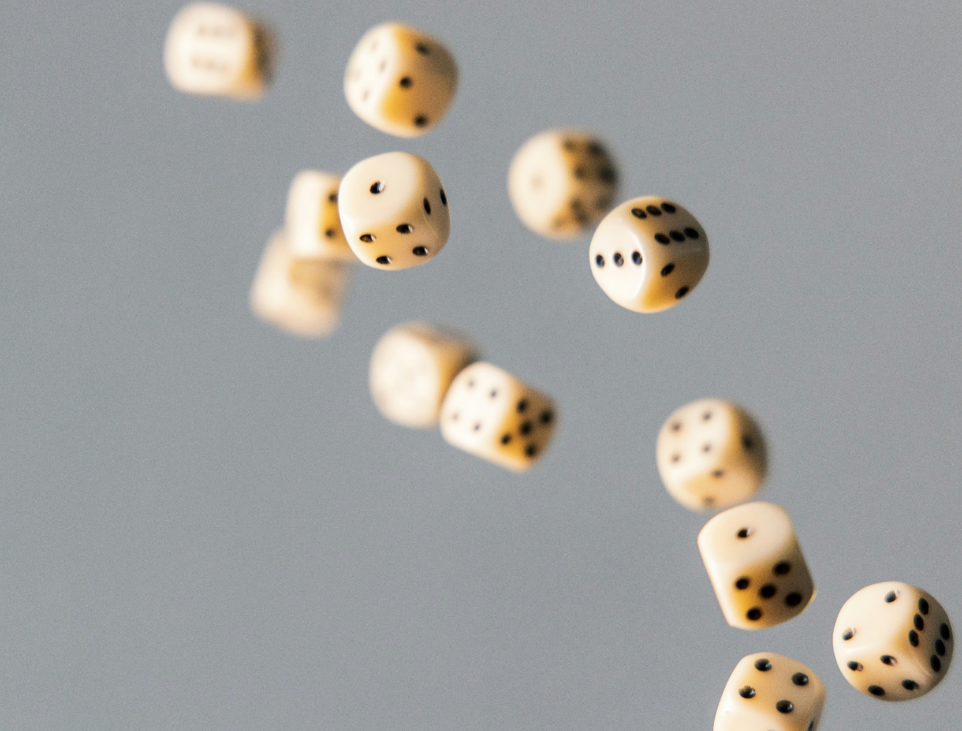
Odds of winning the lottery
1st division in Gold Lotto: 1 in 8 million
1st division in Powerball: 1 in 134 million
You have better odds of finding a 4-leaf clover on your first try or getting a hole in one!
Notes:
Speaker’s notes:
Let’s look at your odds of winning different types of lotteries: 1st division in Gold Lotto: 1 in 8,145,060; 1st division in Powerball: 1 in 134,490,400. By comparison, you have a higher chance of finding a 4-leaf clover on your first try than winning 1st division in Powerball and a better chance of getting a hole in one than winning 1st division in Gold Lotto.
References:
Queensland Government. (2020). The real odds of winning when gambling. https://www.qld.gov.au/community/getting-support-health-social-issue/gambling-harm-support/gambling-winning-odds
Queensland Government. (2014). In-venue signage for gaming licensees. https://www.publications.qld.gov.au/dataset/in-venue-signage-for-gaming-licensees
Gambling Help Online. (2022). Learn about gambling. https://www.gamblinghelponline.org.au/support-yourself-or-others/understanding-gambling/what-is-gambling?language_content_entity=en

Slide 5

Odds of winning on the pokies
The odds of winning the top prize on the pokies is up to 1 in 7 million. You’ve got better odds of dating a supermodel!
Pokies have been designed for you to lose
Remember: the odds are always in the house’s favour
Notes:
Speaker’s notes:
The odds of winning on the pokies are also just as low. If someone does win something, it is generally very small prizes, and they are more likely to be credits or free plays rather than money. In fact, the more someone plays, the more they’ll end up losing. Over time, most people lose most of the money they put in the machines.
The odds of winning the top prize on the pokies (playing maximum lines) is up to 1 in 7 million. By comparison, you've got a better chance of dating a supermodel than winning the top prize on the pokies!
It’s important to remember that this isn’t an accident. Gambling is a business designed to make gambling providers money. The pokies have a built-in “assured percentage loss” of what you bet, which means the gambling provider makes a guaranteed profit. Always remember that if you gamble, there is a high probability you will lose and that the odds will always be in the house’s favour. It is important to be aware of these odds when thinking about the role of gambling in your own life.
References:
Queensland Government. (2020). The real odds of winning when gambling. https://www.qld.gov.au/community/getting-support-health-social-issue/gambling-harm-support/gambling-winning-odds
Queensland Government. (2014). In-venue signage for gaming licensees. https://www.publications.qld.gov.au/dataset/in-venue-signage-for-gaming-licensees
Gambling Help Online. (2022). Learn about gambling. https://www.gamblinghelponline.org.au/support-yourself-or-others/understanding-gambling/what-is-gambling?language_content_entity=en

Slide 6

Forget the bet, enjoy the game
Notes:
Speaker’s notes:
For sports betting and racing, the odds change depending on the team or horse, past performances and conditions on the day. No matter how much you research or study the form guide, or know your favourite league inside-out, it’s impossible to know all the variables that can affect a result. Winning is a matter of chance, not skill.
We’re all constantly bombarded by advertising, signage and online promotions, tempting us to bet on sport. Sports betting ads can make your chances of winning seem attractive, easy and risk-free. They make betting seem like a fun, social activity that goes hand in hand with being a sports fan. But, in reality, the odds are always stacked against you and the chances are you’re going to lose.
That’s why we’re encouraging Queenslanders to forget the bet and enjoy the game. Remember all the reasons you watch sport —for the excitement, the roar of the crowd, thrill of victory and the fun you have with friends, watching your favourite athletes in action. Check out this video from our favourite Brisbane Heat players about what they love about sport.
References:
Office of Liquor and Gaming Regulation. (2023). Forget the bet. Enjoy the game. https://www.youtube.com/watch?v=D-utRWLIrjE
Queensland Government. (2023). Understand the issue with sports betting. https://www.qld.gov.au/community/getting-support-health-social-issue/gambling-harm-support/forget-the-bet/understand-the-issue-with-sports-betting

Slide 7





Tips for safer gambling
Understand the risk
Set limits with your money
Set limits with your time
Gamble with a clear mind
Maintain balance in life
Notes:
Speaker’s notes:
These tips can help you avoid gambling harm and practice safer gambling.
Tip 1: Understand the risk.
When we’re honest with ourselves about the risks of gambling, it’s easier to understand that the likelihood of winning isn’t very high. Remember the gambling industry exists to make a profit. There is a high chance you will lose, and the odds will always be in the house’s favour.
Tip 2: Set limits with your money.
Decide in advance the amount of money you will spend on gambling per week or month. Keep an eye on your current and past spending. Try look for patterns or trends.
Tip 3: Set limits with your time.
It can be easy to lose track of time. Set start times and finish times for when you will gamble. Choose an ideal duration for play. Set a timer to remind you to stop or take a break in play.
Tip 4: Only gamble with a clear mind.
Sometimes when we’re having fun, we can be tempted to gamble while drinking or using drugs. But this can be dangerous as it changes the way we make decisions. Likewise, try not to gamble when you’re feeling down, stressed or bored as this can also lead us to make different choices.
Tip 5: Maintain balance in your life.
Remember that gambling shouldn’t take up all of your time. It is important to balance your time with other important things in your life, like spending time with friends and family, playing a sport or starting a creative project. If you find that your gambling is taking up too much of your time or you’re spending less time partaking in other important parts of your life, it might be time to seek help.
References:
Gambling Help Queensland. (2024). Tips for Safer Gambling. https://www.gamblinghelpqld.org.au/tips-to-avoid-risky-gambling
Multnomah County. (2024). 10 Tips for Safer Gambling. https://www.multco.us/behavioral-health/10-tips-safer-gambling
Responsible Gambling Council. (2024). Take a Safer Approach to Gambling: How to take precautions from the risks of gambling (especially online). https://www.responsiblegambling.org/for-the-public/safer-play/safer-gambling-tips/

Slide 8
Questions?

