Slide 1
Gambling Harm
Notes:
Version: September 2024.

Slide 2
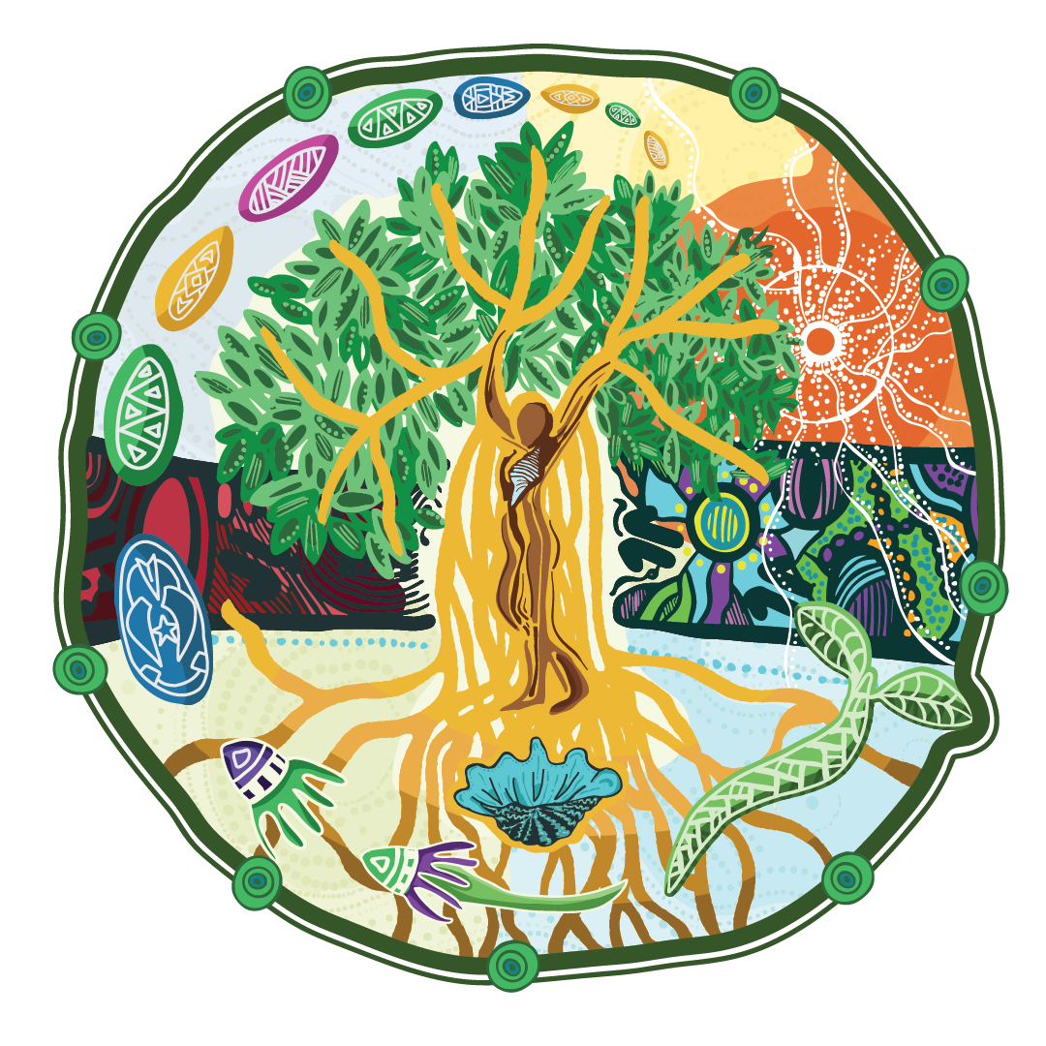
Acknowledgement of Country
We acknowledge the Traditional Custodians of the lands and waters on which we meet today.
We pay our respects to Elders past, present and emerging.
We extend that respect to Aboriginal and Torres Strait Islander peoples here today.
Notes:
Note for presenter:
Please include the name of the First Nations group(s) who are the Traditional Custodians of the land where the presentation is being conducted.
Speaker’s notes:
We’d like to start by acknowledging the Traditional Custodians of the land on which we meet today, the (people) of the (nation), and pay our respects to Elders past, present and emerging, and extend that respect to Aboriginal and Torres Strait Islander peoples here today. We recognise their continuing connection to lands, waters and communities as the original storytellers and sharers of knowledge in Australia and understand the important role that Aboriginal and Torres Strait Islander peoples contribute to conversations about gambling and gambling harm minimisation.

Slide 3
Gambling Help services
Gambling Help Services are free and funded by the Queensland Government
We provide support for people experiencing gambling harm
We deliver community education and counselling services
[Add community educator contact information here.]
Notes:
Note for presenter:
Please include the relevant GHS community educator contact information.
Speaker’s notes:
To start, we’d like to briefly talk about who we are and what we do. Gambling Help services are free Government-funded services delivered by a network of community-based specialist support agencies, like ours. We provide support to people experiencing gambling harm, including those impacted by someone else's gambling. We deliver community education and training, like what we’re doing here today, and participate in networking activities to teach the community more about safer gambling and gambling harm. You can find our contact information on the screen.
References:
Gambling Help Queensland. (2024). About us. https://www.gamblinghelpqld.org.au/about-us

Slide 4
Our services
Call the 24/7 Gambling Helpline on 1800 858 858
Face-to-face counselling locations
Online counselling and real time chat
Notes:
Speaker’s notes:
As well as community education, we also deliver counselling for people experiencing gambling harm. Our services are free and confidential. We provide safe, warm and non-judgmental environments for people to talk about their experiences of gambling harm and together, we find ways to make changes in that person’s life. Our counselling services are available face-to-face, over the phone, or online.
References:
Gambling Help Queensland. (2024). About us. https://www.gamblinghelpqld.org.au/about-us

Slide 5
Overview
Definition of gambling harm
Affected others
Signs of gambling harm
Gambling harm risk factors
Pathways to seek support
Notes:
Speaker’s notes:
In this module, you will learn about the term gambling harm, who it impacts, some key signs to keep an eye out for, its risk factors and pathways to seek support.

Slide 6
Gambling harm
Any negative impact that gambling can have on a person and the people close to them
Includes
Health and wellbeing
Finances
Relationships
Culture
Work or study
Notes:
Speaker’s notes:
Gambling harm is a term used to describe the many ways that gambling can impact a person’s life. It refers to any negative impact that gambling can have on a person and the people close to them. It can include harm to a person’s health and wellbeing, their finances, their relationships, their culture, and their work or study.
Gambling harm can be experienced on a spectrum, ranging from minor or less frequent negative experiences to severe or ongoing impacts. It can be experienced by anybody, no matter how long a person has been gambling or how frequently. Gambling harm can even occur many years after a person’s actual gambling has stopped.
References:
Langham, E., Thorne, H., Browne, M., et al. (2015). Understanding gambling related harm: a proposed definition, conceptual framework, and taxonomy of harms. BMC Public Health, 16(1). https://doi.org/10.1186/s12889-016-2747-0

Slide 7
Affected others
Gambling harm impacts many people, not just the person who gambles
Affected others include
Partner/Spouse
Children
Other family members
Friends
Work colleagues
Broader community members
Notes:
Speaker’s notes:
It is important to know that gambling harm isn’t only about the person who gambles. It also impacts the people close to them, including their partner, children, other family members, friends, work colleagues, other important relationships, and broader communities. These people are called ‘affected others’.
When we talk about gambling harm, we always talk about how it impacts everyone – people who gamble and affected others. This helps us understand the many ways that gambling harm can impact people’s lives and our community as a whole.
References:
Langham, E., Thorne, H., Browne, M., et al. (2015). Understanding gambling related harm: a proposed definition, conceptual framework, and taxonomy of harms. BMC Public Health, 16(1). https://doi.org/10.1186/s12889-016-2747-0
Browne, M, Langham, E, Rawat, V, et al. (2016) Assessing gambling-related harm in Victoria: a public health perspective. Victorian Responsible Gambling Foundation, Melbourne.

Slide 8
Signs of gambling harm
Financial signs
Emotional signs
Relationship signs
Health signs
Cultural signs
Work signs
Legacy signs
Notes:
Speaker’s notes:
It can be difficult to know if someone's gambling is harmful. It helps to understand some of the common signs of gambling harm so you can look out for it in yourself or someone you know. The common signs include financial signs, emotional or psychological signs, relationship signs, health signs, cultural signs, work or study signs, and legacy signs.
The following slides will explain each of these different types of gambling harm.
References:
Langham, E., Thorne, H., Browne, M., et al. (2015). Understanding gambling related harm: a proposed definition, conceptual framework, and taxonomy of harms. BMC Public Health, 16(1). https://doi.org/10.1186/s12889-016-2747-0
Browne, M, Langham, E, Rawat, V, et al. (2016) Assessing gambling-related harm in Victoria: a public health perspective. Victorian Responsible Gambling Foundation, Melbourne.

Slide 9
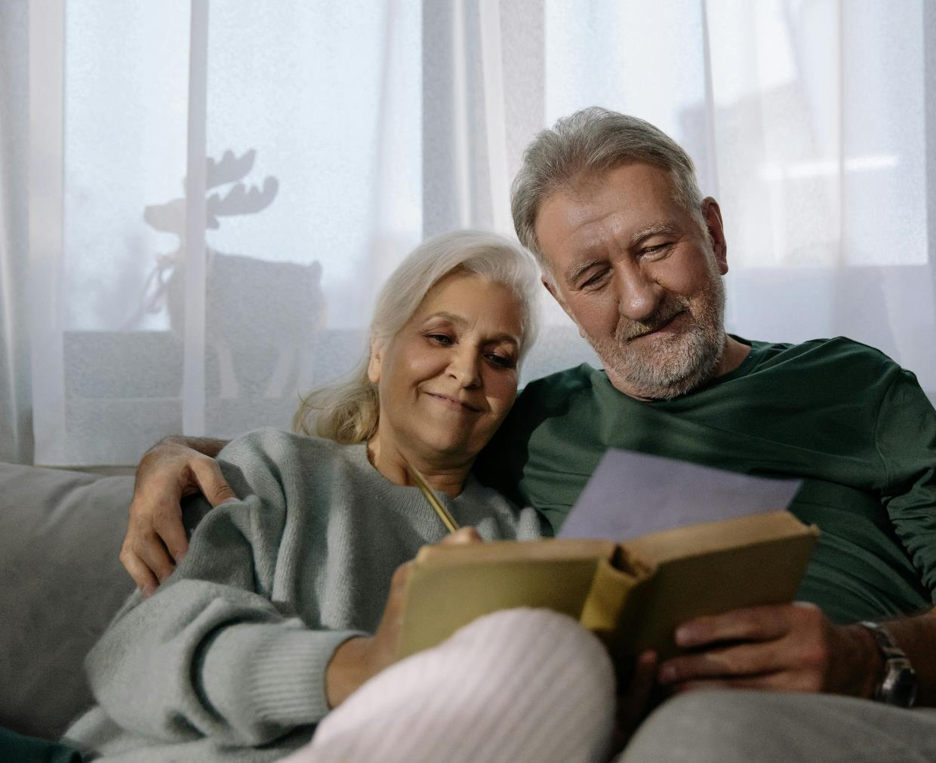
Financial harm
Decreased savings
Borrowing or taking money
Spending less on important expenses
Struggling to buy basic items
Needing assistance to pay for bills
Notes:
Speaker’s notes:
The first type of gambling harm is financial.
Someone who is showing financial signs of gambling harm might: have less money to spend on luxury items like holidays or electronics; be spending less on non-gambling related entertainment like family outings, social activities, or artistic, cultural or sporting events; have decreased savings; be looking for new or different ways to make money, like accessing more credit or finding additional employment; sell household items to obtain more cash; borrow or take money from family or friends without their consent; be spending less on family expenses like health care, education or insurance; have struggles buying basic items like food, housing, clothing or transport; or need assistance to pay for bills from family, friends or welfare organisations.
References:
Langham, E., Thorne, H., Browne, M., et al. (2015). Understanding gambling related harm: a proposed definition, conceptual framework, and taxonomy of harms. BMC Public Health, 16(1). https://doi.org/10.1186/s12889-016-2747-0
Browne, M, Langham, E, Rawat, V, et al. (2016) Assessing gambling-related harm in Victoria: a public health perspective. Victorian Responsible Gambling Foundation, Melbourne.

Slide 10
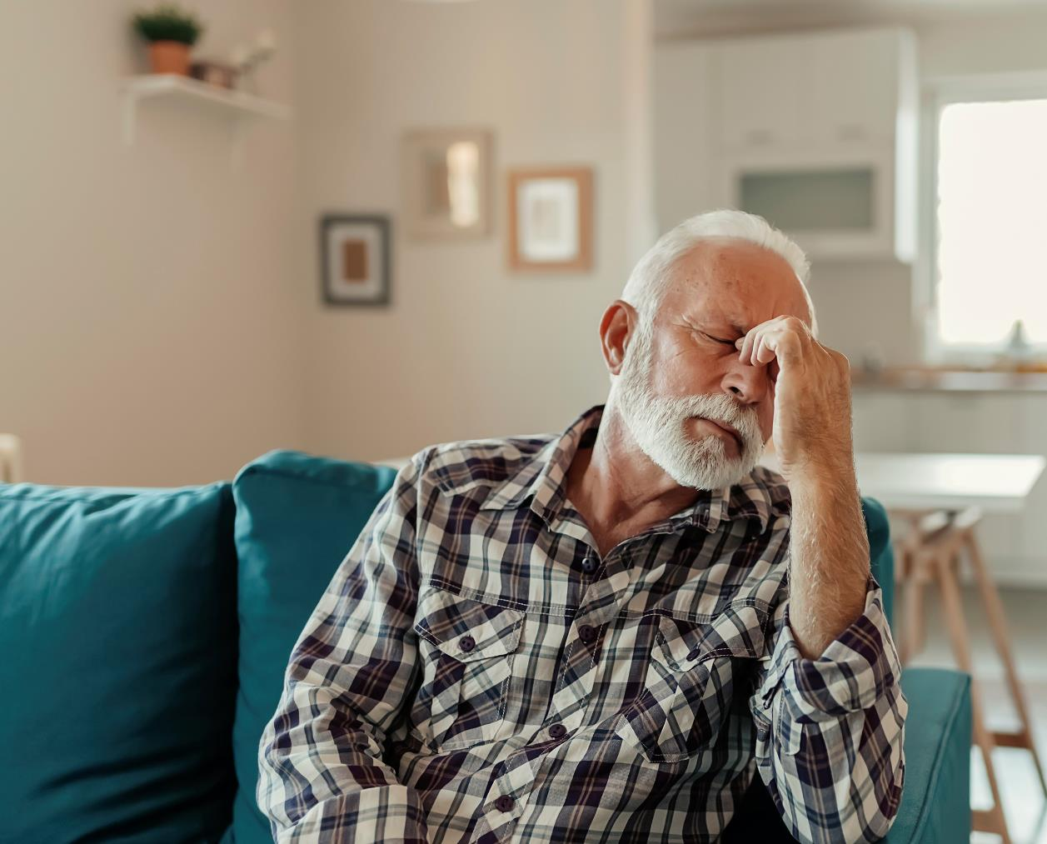
Emotional or psychological harm
Distress or insecurity
Struggles with self-worth
Fears of judgment from others
Desperation or powerlessness
Less interest in goals or plans
Mental health concerns
Suicidal thoughts or behaviours
Notes:
Speaker’s notes:
The second type of gambling harm which you could look out for in yourself or someone you know is about emotional or psychological harm.
Someone who is displaying signs of emotional harm would typically have: increased feelings of distress, shame, or guilt; heightened feelings of insecurity, vulnerability, or failure; struggles with self-worth or pride; fears of being judged, perceived or stigmatised; increased sense of desperation; increased feelings of powerlessness, particularly in relation to their gambling habits or their life in general; decreased interest in goals and plans for the future; or suicidal thoughts or behaviours.
Affected others can also experience signs of emotional harm. This includes feelings of frustration or anxiety towards a person’s gambling behaviour or communication; and feelings of distress, shame or guilt towards their ability to help a person who gambles.
References:
Langham, E., Thorne, H., Browne, M., et al. (2015). Understanding gambling related harm: a proposed definition, conceptual framework, and taxonomy of harms. BMC Public Health, 16(1). https://doi.org/10.1186/s12889-016-2747-0
Browne, M, Langham, E, Rawat, V, et al. (2016) Assessing gambling-related harm in Victoria: a public health perspective. Victorian Responsible Gambling Foundation, Melbourne.

Slide 11
Relationships harm
Dishonest communication
Reduced time spent with others
Withdrawal from relationship responsibilities
Increased tension
Increased conflict
Notes:
Speaker’s notes:
The next type of gambling harm affects relationships. This refers to the different ways gambling can impact a person’s relationships with their partner, children, other family members, friends, work colleagues, community members and other important people in their life.
Some signs to keep a look out for include: dishonestly communicating with others, including lying about or hiding one’s gambling; becoming increasingly unreliable or unavailable in relationships, including seeming increasingly distant or preoccupied; reducing the quality and amount of time spent with others, including spending less time at family or social events; becoming disengaged, withdrawn or neglectful of relationship responsibilities; experiencing increasing tension in relationships; and having more common or more severe conflict with others.
References:
Langham, E., Thorne, H., Browne, M., et al. (2015). Understanding gambling related harm: a proposed definition, conceptual framework, and taxonomy of harms. BMC Public Health, 16(1). https://doi.org/10.1186/s12889-016-2747-0
Browne, M, Langham, E, Rawat, V, et al. (2016) Assessing gambling-related harm in Victoria: a public health perspective. Victorian Responsible Gambling Foundation, Melbourne.

Slide 12
Health harm
Changes to diet
Less physical activity
Reduced sleep
Frequent injury or illness
Increased blood pressure
Increased smoking, alcohol or drug use
Increased frequency of violence
Notes:
Speaker’s notes:
The fourth type of gambling harm refers to harm to a person’s health.
Someone who is displaying signs of health harm might: have made some changes to their diet, like choosing more takeout or junk food options; be doing less physical activity; be experiencing struggles with their sleep, either through reduced quality of sleep, time spent asleep or trouble getting to sleep; have more frequent injury or illness, including more headaches or migraines, generally from staring at a screen for a long time; have increased blood pressure; be smoking, drinking alcohol or using drugs more often; or have more experiences of violence, including self-harm.
References:
Langham, E., Thorne, H., Browne, M., et al. (2015). Understanding gambling related harm: a proposed definition, conceptual framework, and taxonomy of harms. BMC Public Health, 16(1). https://doi.org/10.1186/s12889-016-2747-0
Browne, M, Langham, E, Rawat, V, et al. (2016) Assessing gambling-related harm in Victoria: a public health perspective. Victorian Responsible Gambling Foundation, Melbourne.

Slide 13
Cultural harm
Culturally-based shame or guilt
Reduced engagement in cultural practices
Decreased connection to culture
Social exclusion or isolation
Challenges with identity
Notes:
Speaker’s notes:
The next type of gambling harm is called cultural harm. This refers to the many ways gambling can impact upon the communities someone is a part of, whether they be religious, cultural, or social.
Some possible signs include: feelings of shame or guilt related to cultural roles and expectations; reduced engagement and contribution towards cultural rituals or practices; decreased connection to cultural communities; feeling or experiencing social exclusion or isolation; or increased challenges with perception of identity as related to culture.
Affected others can also experience cultural harm. This can be through disrupted cultural practices or rituals; interrupted or disjointed cultural cohesion; and by experiencing grief or loss of contact with community members.
References:
Langham, E., Thorne, H., Browne, M., et al. (2015). Understanding gambling related harm: a proposed definition, conceptual framework, and taxonomy of harms. BMC Public Health, 16(1). https://doi.org/10.1186/s12889-016-2747-0
Browne, M, Langham, E, Rawat, V, et al. (2016) Assessing gambling-related harm in Victoria: a public health perspective. Victorian Responsible Gambling Foundation, Melbourne.

Slide 14
Work or study harm
Reduced performance
Increased absence
Decreased focus
Consequences from work or study institution
Reduced availability to volunteer
Notes:
Speaker’s notes:
The next type of gambling harm affects a person’s work or study.
This might look like: reduced performance due to tiredness or distraction; increased absence due to time spent gambling, tiredness or ill health; decreased focus or attention span, due to desire to gamble or gambling-related stresses; consequences from work or educational institution, including penalties or disciplinary action; or loss of job, suspension or exclusion from work or study.
Affected others can also experience signs of gambling harm at work or study, such as increased absence due to supporting someone who gambles; increased workload to support a team member who gambles; or reduced availability to contribute to work, study, or volunteering.
References:
Langham, E., Thorne, H., Browne, M., et al. (2015). Understanding gambling related harm: a proposed definition, conceptual framework, and taxonomy of harms. BMC Public Health, 16(1). https://doi.org/10.1186/s12889-016-2747-0
Browne, M, Langham, E, Rawat, V, et al. (2016) Assessing gambling-related harm in Victoria: a public health perspective. Victorian Responsible Gambling Foundation, Melbourne.

Slide 15
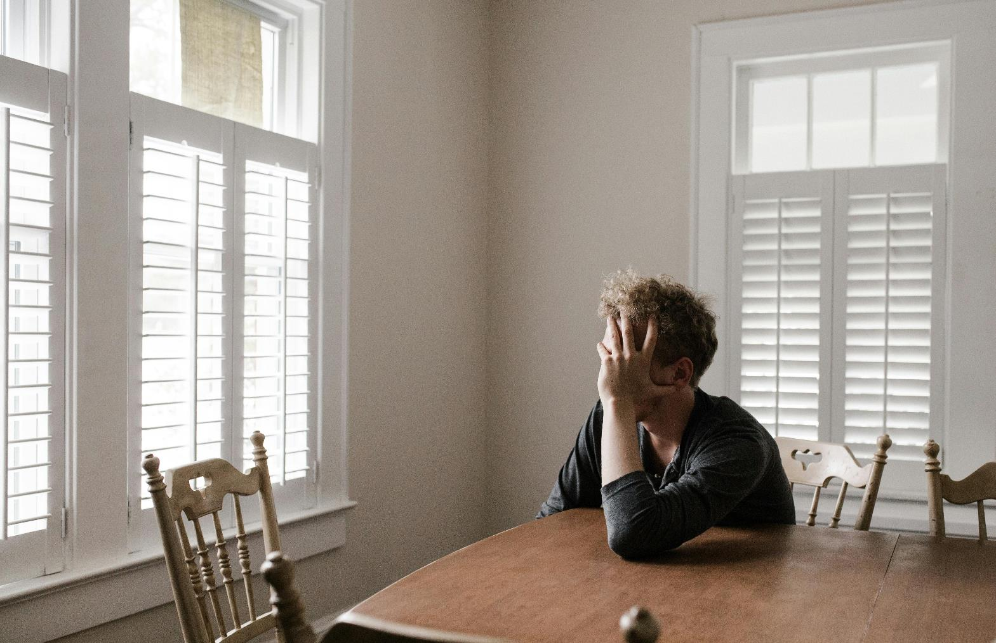
Legacy harm
Loss of major life events
Ongoing financial harm
Loss of primary relationships
Changes to location or career
Homelessness
Incarceration
Notes:
Speaker’s notes:
The last type of gambling harm is called legacy harm. Legacy harm refers to the potential ongoing consequences of gambling that can sometimes have lifelong or intergenerational impacts. It is important to know that this type of harm is not felt by everyone who experiences gambling harm, but it is possible.
Someone who experiences legacy harm might: lose the potential for major life events like engagement, marriage, or children; experience ongoing financial harm that impacts their or their family or community’s major assets and superannuation; experience a loss of primary relationships or social connections; need to move cities/states or to change career due to the impact of gambling or other harms; or experience homelessness or jail time.
References:
Langham, E., Thorne, H., Browne, M., et al. (2015). Understanding gambling related harm: a proposed definition, conceptual framework, and taxonomy of harms. BMC Public Health, 16(1). https://doi.org/10.1186/s12889-016-2747-0
Browne, M, Langham, E, Rawat, V, et al. (2016) Assessing gambling-related harm in Victoria: a public health perspective. Victorian Responsible Gambling Foundation, Melbourne.

Slide 16
Louise’s story
Notes:
Speaker’s notes:
It can help to understand what gambling harm looks and feels like by hearing it from someone who has experienced it. Louise is a mother and grandmother who lives in Hervey Bay in Queensland. This is her story.
References:
Office of Liquor and Gaming Regulation. (2021). 'When gambling took over...' Louise. https://www.youtube.com/watch?v=fQ0GD0_SzCk

Slide 17
Gambling harm risk factors
Social risk factors
Gender: men are more at-risk than women
Age: 18–34-year-olds
Occupation: blue collar workers
Notes:
Speaker’s notes:
As Louise talks about, there are factors in our lives that can increase our risk of experiencing gambling harm. We have separated these into social risk factors and individual risk factors.
Firstly, let’s talk about social risk factors. Research tells us that there are groups of people who are more vulnerable to gambling harm. In general, men are more at-risk than women. Some research published in 2023 says that amongst men in Australia who gamble, 53% are at-risk of harm. Similarly, people who are aged between 18-34 years are more likely to experience gambling harm than any other age category, but young people under the age of 18 are also of increasing concern.
Likewise, a person’s job can make them more at-risk. People in blue-collar jobs, like construction, vehicle drivers, and factory workers, can be more vulnerable to experiencing gambling harm, according to research.
It can help to be aware of these social risk factors when trying to understand your or your loved one’s risk of gambling harm.
References:
Australian Institute for Health and Wellbeing. (2023). Gambling in Australia. https://www.aihw.gov.au/reports/australias-welfare/gambling
Binde, P., & Romild, U. (2020). Risk of problem gambling among occupational groups: A population and registry study. Nordic Studies on Alcohol and Drugs: NAT, 37(3), 262–278. https://doi.org/10.1177/1455072519899779
Australian Gambling Research Centre. (2023). Gambling participation and experience of harm in Australia. Australian Institute of Family Studies. https://www.publications.qld.gov.au/dataset/liquor-and-gambling-research/resource/4267f3c2-950b-407e-b88f-d31e116cedcb

Slide 18
Gambling harm risk factors
Individual risk factors
Big changes in life
Mental ill-health
Drugs or alcohol use
Previous experience of gambling harm
Notes:
Speaker’s notes:
There are also individual risk factors which can make someone more vulnerable to experiencing gambling harm. These are about particular circumstances in our lives.
Some of these factors include: recent major changes to life, including separation or divorce, job loss, or the death of a loved one; struggles with mental health, including anxiety and depression; excess use of drugs or alcohol; having experienced gambling harm before; or having a parent, partner or close friend who has experienced gambling harm.
References:
Gambling Help Queensland. (2024). Signs of gambling harm. https://www.gamblinghelpqld.org.au/signs-of-gambling-harm
Langham, E., Thorne, H., Browne, M., et al. (2015). Understanding gambling related harm: a proposed definition, conceptual framework, and taxonomy of harms. BMC Public Health, 16(1). https://doi.org/10.1186/s12889-016-2747-0
Browne, M, Langham, E, Rawat, V, et al. (2016) Assessing gambling-related harm in Victoria: a public health perspective. Victorian Responsible Gambling Foundation, Melbourne.

Slide 19
Get support
Self-help
Ban yourself
Support services
Notes:
Speaker’s notes:
If you or someone you know is experiencing gambling harm, it might be time to get support. There are different ways you can do this. You could explore ways to support yourself, you could ban yourself from a gambling venue or product or you could seek help from our support services. In the next few slides, we’ll talk about these different pathways.
References:
Gambling Help Queensland. (2024). Let us help you. https://www.gamblinghelpqld.org.au/let-us-help-you

Slide 20
Self-help
For more information, visit gamblinghelpqld.org.au
Changing thoughts and beliefs
Managing money
Setting limits
Keeping busy
Using social support
Learning about triggers and urges
Focusing on health and wellbeing
Notes:
Speaker’s notes:
The first and often most common choice amongst people experiencing gambling harm is self-help. This refers to the different ways that you could make changes to your gambling in your own life. This might include learning to manage money or setting limits for yourself, trying to keep busy, or using your family and friends as support. Different strategies work for different people. You might find that some of these strategies work for you for some time, before you try doing something different. You can find more detailed information about self-help on the Gambling Help Queensland website.
References:
Gambling Help Queensland. (2024). Self-help. https://www.gamblinghelpqld.org.au/self-help

Slide 21
Self-exclusion
For more information, visit gamblinghelpqld.org.au
A request to be banned from specific gambling providers, products or services
Gambling providers are required to offer self-exclusion
We can help you with the self-exclusion process
Notes:
Speaker’s notes:
The next pathway is about self-exclusion (or self-ban). Self-exclusion is where you request to be banned from specific gambling providers, products or services. All licensed gambling providers in all states and territories in Australia are required to offer self-exclusion from their venues or products. You can ask for help to complete the self-exclusion process either from the venue directly or from a Gambling Help support service. For more information about how to self-exclude, visit the Gambling Help Queensland website.
References:
Gambling Help Queensland. (2024). Ban yourself from gambling. https://www.gamblinghelpqld.org.au/ban-yourself

Slide 22
Support services
Free and confidential counselling
Support is available either face-to-face, over the phone or online
Phone us:
Visit our website:
Notes:
Note for presenter:
Please include the relevant GHS phone number and hours.
Speaker’s notes:
If you or someone you know is experiencing gambling harm, you can seek help from our support services. We offer free and confidential counselling services to both the person experiencing gambling harm and the people close to them. You can seek this support either face-to-face, over the phone or online. Our counsellors will always provide non-judgmental support. We’ll talk about the reasons you’ve decided to seek help and make plans together for the changes we can make to your gambling, your relationships and your life. You can find our phone number and website on the screen.

Slide 23
Other local support services
Support service | Contact information
Mental health support
Domestic and family violence
Alcohol and other drug use
Financial counselling
Notes:
Note for presenter:
Please include a list of some other local support services.
Speaker’s notes:
Sometimes, people gamble because there are other factors in their life that are causing them stress or difficulty. We’ve compiled a list of some of the other support services in our area, including services to help people experiencing mental health concerns, domestic and family violence, alcohol and other drug use, or financial difficulty. You can also speak to one of our counsellors and they can get you in touch with the other support you need.

Slide 24
Gambling Help support services
Gambling Help Queensland
1800 858 858
www.gamblinghelpqld.org.au
Gambling Help Online
1800 858 858
www.gamblinghelponline.org.au
Notes:
Speaker’s notes:
There are also other services available, outside of our local area. Gambling Help Queensland provide 24/7 support for anyone affected by gambling across Queensland, through the free hotline displayed on screen. Find more information at the Gambling Help Queensland website.
Gambling Help Online provide 24/7 free online support across Australia. You can speak to a counsellor either on an online chat, email or over the phone at any time of the day. You can find more information at the Gambling Help Online website.
References:
Gambling Help Queensland. (2024). Home. www.gamblinghelpqld.org.au
Gambling Help Online. (2024). Home. www.gamblinghelponline.org.au

Slide 25
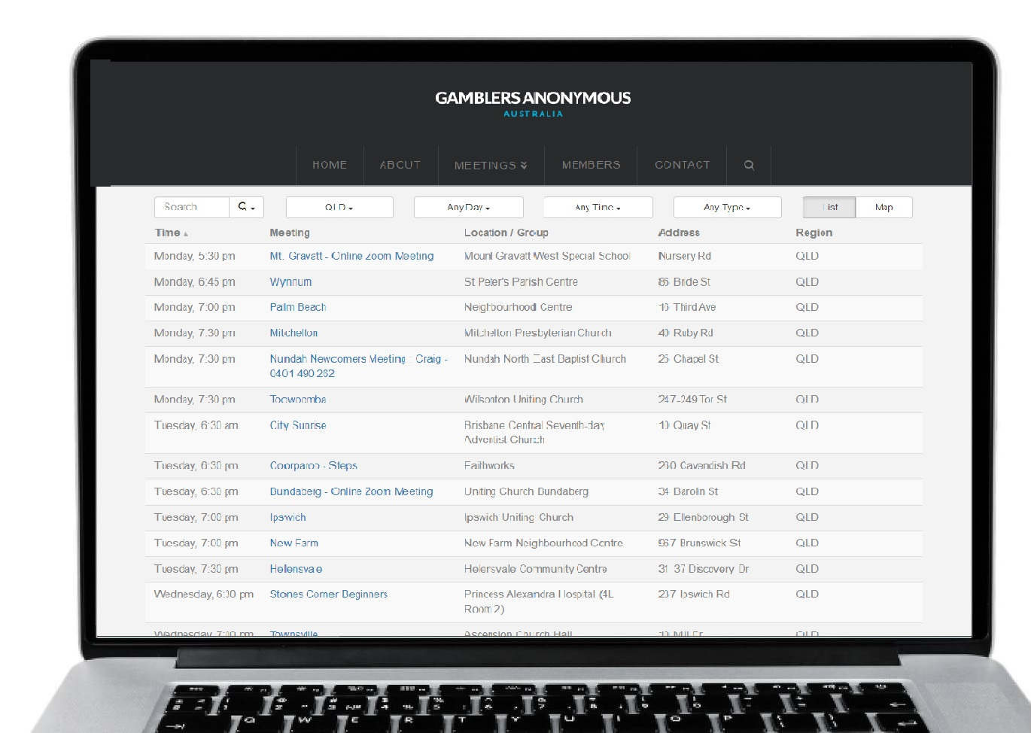
Group therapy support services
Gamblers Anonymous Queensland
0467 655 799
www.gaaustralia.org.au
Gam-Anon Queensland
0467 655 799
www.gaaustralia.org.au/gam-anon/
Notes:
Speaker’s notes:
There are also various support groups available. Gamblers Anonymous Queensland provides group therapy and support across Queensland. Members can meet either face-to-face or online, either weekly or whenever suits them, to listen and speak with other people who are experiencing similar gambling-related challenges. You can find more information about session times and locations at the Gamblers Anonymous Australia website, by clicking the ‘Queensland meetings’ tab.
Similarly, Gam-Anon Queensland provides group therapy for people impacted by someone else’s gambling, including partners, family, friends and colleagues. Members can also meet either face-to-face or online. You can find more information at the website on screen.
References:
Gamblers Anonymous. (2024). Home. www.gaaustralia.org.au

Slide 26
Gambling harm consultations
Do you have lived experience of gambling harm?
You can make a difference to the policies and programs that support people with lived experience of gambling harm in Queensland.
Register your interest at qld.gov.au/gamblingharmconsultations
Notes:
Speaker’s notes:
The Queensland Government is looking for people who have lived experience of gambling harm who would like to share their knowledge and expertise. By registering to share their experiences of gambling harm, Queenslanders can make a meaningful difference to ensure that the policies and programs developed by the Queensland Government better support the needs of people affected by gambling harm. If you have experienced gambling harm, either through your own gambling or someone else’s, you can share your voice by registering your interest on the Queensland Government website.
References:
Queensland Government. (2024). Gambling harm consultations. www.qld.gov.au/gamblingharmconsultations

Slide 27
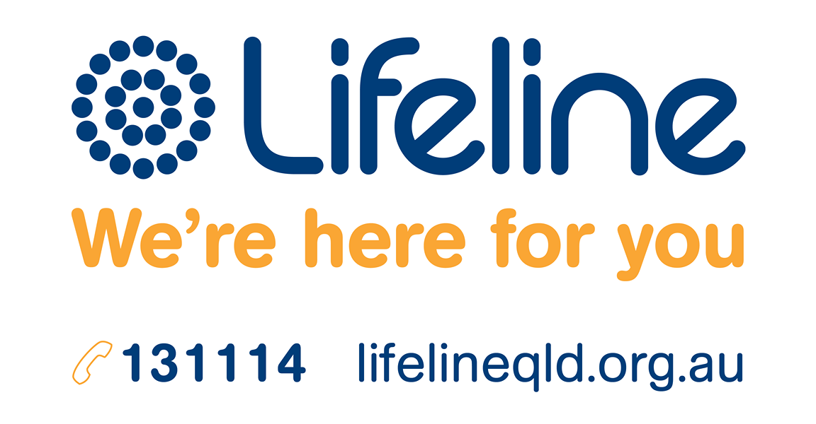
Crisis support
Notes:
Speaker’s notes:
If anything we have talked about today raises immediate concern for you, please know you are not alone. Help is always available. You can call the number on the screen or visit the Lifeline website.
References:
Lifeline. (2024). Home. www.lifelineqld.org.au

Slide 28
Questions?

