Slide 1


Self-exclusion and limit setting
Notes:
Version: September 2024.

Slide 2

Overview
What is self-exclusion?
Benefits of self-exclusion
Venue self-exclusion
Online self-exclusion
Limit setting on online betting
Gambling bank blocks
Pre-commitment programs
Get support
Notes:
Speaker’s notes:
In the next few slides, we’re going to talk about self-exclusion and limit setting. We’ll discuss both physical and online self-exclusion and its benefits, the process and specific details. We’ll talk about online limit setting through gambling apps and websites, gambling blocks on credit and debit cards, pre-commitment programs, and give you the tools to set gambling limits in your own life.

Slide 3

What is self-exclusion?
A voluntary request to be banned from specific gambling providers, products or services
Self-exclusion can be temporary or permanent
Gambling providers are required to offer self-exclusion
Notes:
Speaker’s notes:
Self-exclusion refers to a request to be banned from specific gambling providers, products or services. It involves voluntarily registering to be temporarily or permanently blocked from all licensed Australian online gambling providers, such as TAB, Sportsbet, Ladbrokes, etc., or from going to certain places where people can gamble, like clubs, pubs, TABs or casinos. Depending on the venue, someone might be excluded from the whole venue, gaming areas, or certain gambling activities. They might still be allowed to go to other parts of the venue, like bistros or dining areas. By law, licensed gambling providers in all states and territories in Australia must give customers the option to self-exclude from their venues or products.
References:
Gambling Help Queensland. (2024). Ban yourself from gambling. https://www.gamblinghelpqld.org.au/ban-yourself
Gambling Help Online. (2024). Venue self-exclusion. https://www.gamblinghelponline.org.au/support-yourself-or-others/taking-action/self-exclusion
Gambling Help Online. (2024). Online self-exclusion. https://www.gamblinghelponline.org.au/support-yourself-or-others/taking-action/online-self-exclusion?language_content_entity=en

Slide 4

Benefits of self-exclusion
Potential immediate change to gambling
Allows time to implement other long-term strategies
Ability to choose gambling products and venues
Can be an important first step
Notes:
Speaker’s notes:
Self-exclusion can be an important tool for people looking to make changes to their gambling. It can provide them with immediate control over their gambling, which can empower them to implement more long-term strategies. It also allows them to choose which types of gambling products or venues they would like to be excluded from, giving them power to make their own decisions. People can choose to ban themselves from gambling products or venues near their homes, workplaces, and other places they frequently visit, as well as the routes they usually take between these places. Others might choose to ban themselves from online platforms, so it’s not as easy for them to gamble. Whichever ways someone chooses to self-exclude, it can be an important first step to reduce or stop gambling.
References:
Gambling Help Online. (2024). Venue self-exclusion. https://www.gamblinghelponline.org.au/support-yourself-or-others/taking-action/self-exclusion
Gambling Help Online. (2024). Online self-exclusion. https://www.gamblinghelponline.org.au/support-yourself-or-others/taking-action/online-self-exclusion?language_content_entity=en

Slide 5



The venue self-exclusion process
Self-exclusion is easy, free and takes less than 15 minutes.
Speak to a Customer Liaison Officer
Complete a Self-exclusion notice (Form 3A)
Take home your Self-exclusion order (Form 3B)
Notes:
Speaker’s notes:
To self-exclude from online gambling providers or physical venues in Queensland, there are separate processes. First, let’s talk about the process to self-exclude from physical venues or gambling products in Queensland. It’s important to know that other states and territories in Australia have different processes. The venue self-exclusion process in Queensland is easy, free and generally takes less than 15 minutes. Each venue has a nominated person to help with the self-exclusion process. In Queensland, they are usually called the Customer Liaison Officer and are trained to assist customers who might be struggling with their gambling. This person will provide you with the self-exclusion forms and the contact details of your local Gambling Help service. They will help you complete a Self-exclusion notice (Form 3A) and may ask to take a photo of you or for a copy of your driver’s license. Then, the Customer Liaison Officer will record your details and provide you with a completed Self-exclusion order (Form 3B) for you to take home.
You can also exclude yourself remotely from one or more venues, without having to physically enter a venue. This is called a remote self-exclusion. A Gambling Help counsellor will need to contact the venue on your behalf if you want to put a remote self-exclusion in place. Your local Gambling Help service can assist you with every step of this process.
If you are interested in self-excluding from venues in other states or territories, you can find more information at the Gambling Help Online website.
References:
Gambling Help Queensland. (2024). Ban yourself from gambling. https://www.gamblinghelpqld.org.au/ban-yourself
Gambling Help Online. (2024). Venue self-exclusion. https://www.gamblinghelponline.org.au/support-yourself-or-others/taking-action/self-exclusion

Slide 6

Venue self-exclusion details
24-hour cooling off period, followed by a 5-year ban
Can ask to cancel your self-exclusion after 1 year
The venue must keep your information confidential
Venue staff can remove you from the premise
The venue may receive a fine if you breach your self-exclusion
Notes:
Speaker’s notes:
Once you have completed the self-exclusion forms and received the written self-exclusion order back from the venue or venues, you have a 24-hour cooling off period. After this, your self-exclusion will remain in effect for 5 years, and you can ask to cancel your self-exclusion after 1 year. The venue is required to maintain a register of excluded persons. This means that the only people who will know about your self-exclusion are the staff at the venue who need to monitor exclusions. The venue must otherwise keep your information confidential. If someone signs a self-exclusion agreement, it's supported by the law. This means that if you are identified at a venue or gaming area or take part in a gambling product that you are excluded from, venue staff must prevent you from entering or remaining in the venue. Breaking the agreement can also lead to penalties, which could be a fine for the venue. Once the agreed-upon exclusion period is over, you can decide whether to self-exclude again for another period. If not, you will be allowed back into the venue.
References:
Gambling Help Queensland. (2024). Ban yourself from gambling. https://www.gamblinghelpqld.org.au/ban-yourself
Gambling Help Online. (2024). Venue self-exclusion. https://www.gamblinghelponline.org.au/support-yourself-or-others/taking-action/self-exclusion

Slide 7


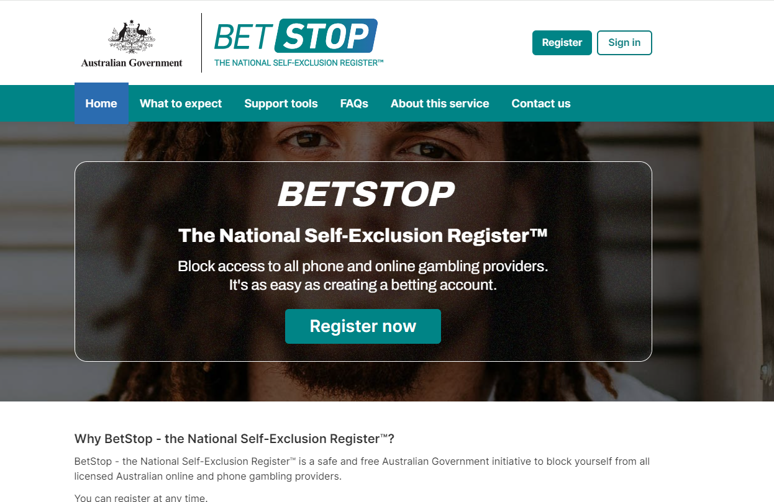
BetStop
The National Self-Exclusion Register
A free service that can help you to exclude yourself from all licensed online gambling providers in a single step
If you choose to self-exclude, online gambling providers cannot:
  let you place a bet
  let you open a new account
  send you marketing messages
Notes:
Speaker’s notes:
Now, we’re going to talk about online self-exclusion. BetStop – the National Self-Exclusion Register™ is a free service that will help you to exclude yourself from all licensed online gambling providers in a single step. If you choose to self-exclude using BetStop, you will be excluded from the websites and apps of all the approximately 150 licensed online wagering providers in Australia. These gambling providers will be required to close all your betting accounts and cannot let you place a bet, let you open a new account or send you marketing messages. They must also refund any credit balance you have. If you have self-exclusions in place for venues in Queensland, and want to self-exclude from online gambling platforms, you will need to register with BetStop separately. You can also register your self-exclusion with individual online gambling providers, through each provider.
References:
Gambling Help Online. (2024). Online self-exclusion. https://www.gamblinghelponline.org.au/support-yourself-or-others/taking-action/online-self-exclusion?language_content_entity=en
Australian Communications and Media Authority. (2024). BetStop – the National Self-Exclusion Register™. https://www.acma.gov.au/betstop-national-self-exclusion-registertm
Australian Government. (2024). BetStop. https://www.betstop.gov.au/

Slide 8
The online self-exclusion process
BetStop is easy, free and takes about 5 minutes.
Gather your personal information
Decide a period to self-exclude
Register online at betstop.gov.au/signup
Notes:
Speaker’s notes:
The online self-exclusion process is easy, free and generally takes about 5 minutes. All you need to register is a mobile phone number, email address and either an Australian driver’s licence or a Medicare card. BetStop ensures your personal details are protected. You will need to choose a period to self-exclude, from a minimum of three months up to a lifetime. To protect your privacy, BetStop advise that you don’t use a public computer (for example, at a library) to register.
References:
Gambling Help Online. (2024). Online self-exclusion. https://www.gamblinghelponline.org.au/support-yourself-or-others/taking-action/online-self-exclusion?language_content_entity=en
Australian Communications and Media Authority. (2024). BetStop – the National Self-Exclusion Register™. https://www.acma.gov.au/betstop-national-self-exclusion-registertm
Australian Government. (2024). BetStop. https://www.betstop.gov.au/

Slide 9

Online self-exclusion details
Your self-exclusion will take effect once your registration has been approved
You can extend the duration of your self-exclusion at any time
You can apply to be removed from the register after the first 3 months
Notes:
Speaker’s notes:
Once your registration has been approved on the BetStop website, your self-exclusion will take effect immediately. You can extend the duration of your self-exclusion at any time. You can apply to be removed from the register after the first 3 months. If you apply to be removed from the register, you must confirm that you have received counselling or advice on your decision to end your self-exclusion from a qualified counsellor, psychologist or doctor. When the agreed period of self-exclusion is over, you can choose to self-exclude for another period or apply to have your gambling accounts reopened.
References:
Gambling Help Online. (2024). Online self-exclusion. https://www.gamblinghelponline.org.au/support-yourself-or-others/taking-action/online-self-exclusion?language_content_entity=en
Australian Communications and Media Authority. (2024). BetStop – the National Self-Exclusion Register™. https://www.acma.gov.au/betstop-national-self-exclusion-registertm
Australian Government. (2024). BetStop. https://www.betstop.gov.au/

Slide 10
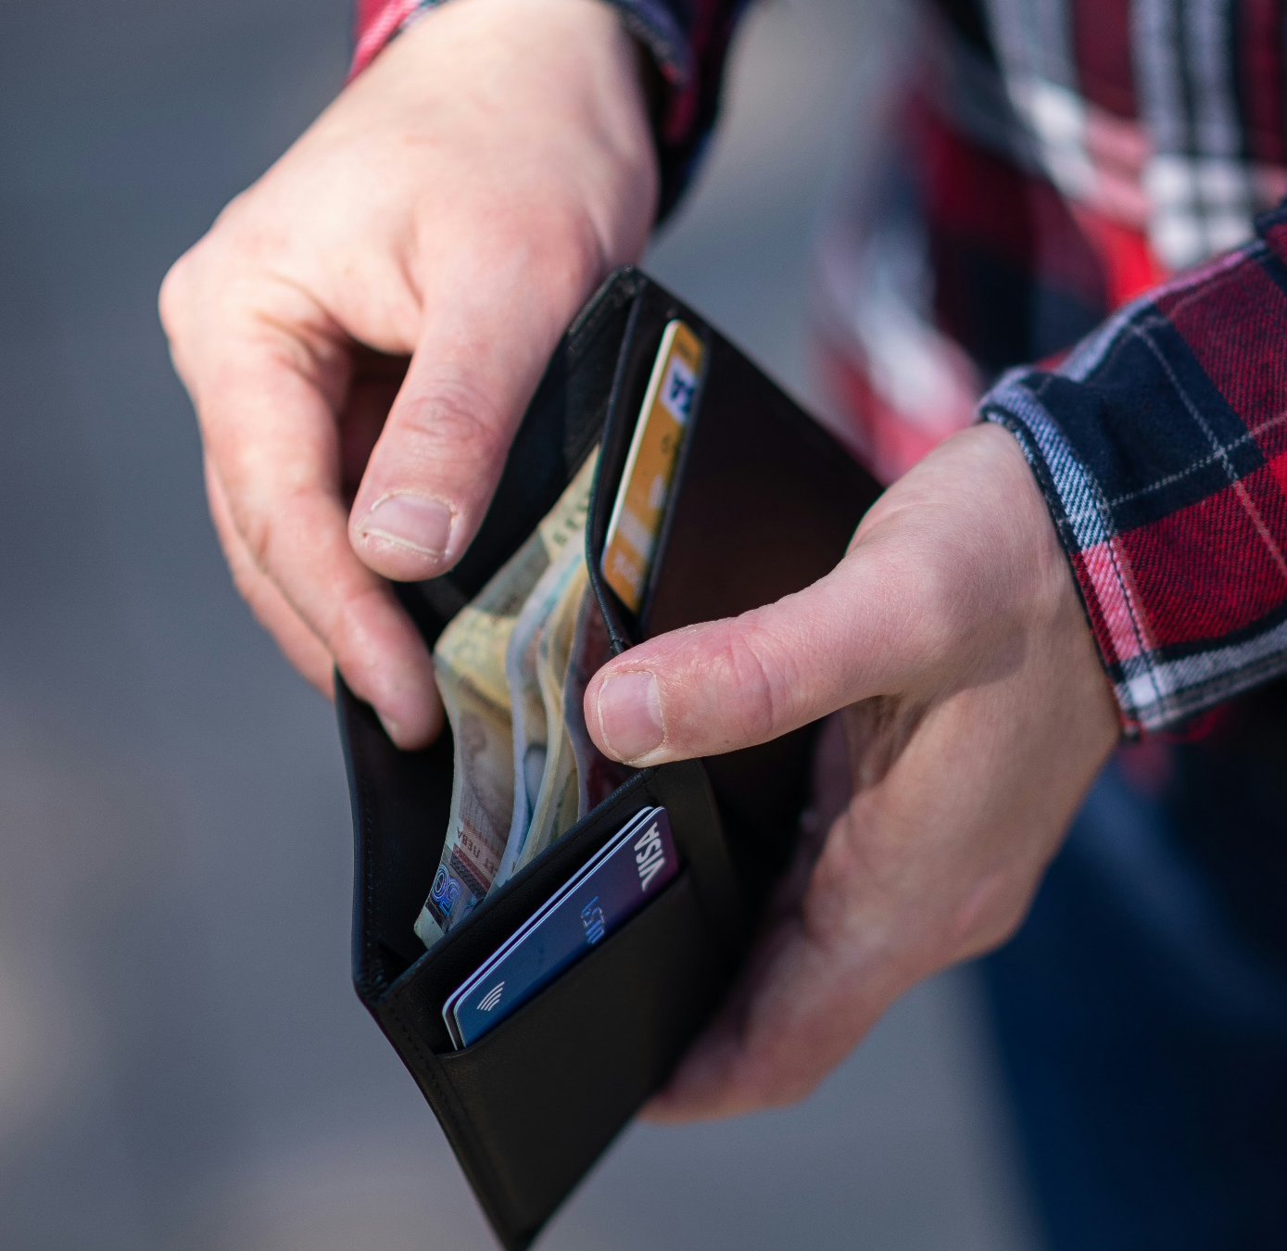
Limit setting
Setting limits can be an effective tool to reduce gambling
You could try different strategies, including:
  Limits on online betting
  Gambling bank blocks
  Pre-commitment on the pokies
Notes:
Speaker’s notes:
Another effective tool to reducing your gambling is to set yourself limits. You can do this in a few different ways, including setting limits to your online gambling accounts, putting gambling blocks on your bank accounts, and setting limits on the pokies through pre-commitment programs. We’re going to talk about these different strategies.

Slide 11

Limits on online betting
You can set different types of limits to your online betting accounts
This includes the:
  Amount of money you can gamble or put into your account
  Amount of time between deposits
  Notifications, marketing, and promotional emails and messages
Notes:
Speaker’s notes:
Firstly, let’s talk about setting limits on your online betting accounts. A deposit limit restricts the amount of money a customer can transfer into a betting account within a specified period (e.g. per day, week or month), and is binding. This means that once the limit is reached, the customer cannot top up the account until the relevant period ends. By law, Australian online gambling providers must prompt customers to set a deposit limit when opening a betting account, and annually thereafter. Many online gambling providers will also allow people to set a minimum amount of time between deposits, set maximum bets to limit how much they can spend on an individual bet, and opt-out of notifications, marketing, and promotional emails and messages. Choosing to set limits on your online betting accounts can be a useful tool to reducing or stopping your gambling.
References:
Victorian Responsible Gambling Foundation. (2023). Online gambling and limit setting. https://responsiblegambling.vic.gov.au/about-us/news-and-media/online-gambling-and-limit-setting/
Gambling Help Online. (2024). Online protection for gambling. https://www.gamblinghelponline.org.au/support-yourself-or-others/taking-action/online-protection-gambling

Slide 12

Gambling bank blocks
A gambling block means a credit or debit account cannot be used to pay for gambling products or activities
You can:
  Set limits on your cards or withdrawals
  Create alerts
  Get cards that don’t allow gambling transactions
You can usually activate a gambling block through your banking app
Notes:
Speaker’s notes:
Putting gambling blocks on your credit and debit cards is another effective tool to limit your gambling. A gambling block on a credit or debit account means the account cannot be used to pay for gambling products or activities. It may include declining gambling transactions; putting limits on daily withdrawals and transactions; allowing the customer to create an alert if their balance goes above a certain level set by them; and providing credit cards that do not allow gambling transactions. You can activate a gambling block on your account with most Australian banks, usually through your banking app. If you need, you can contact your bank for help in activating a gambling block on your accounts.
References:
Gambler’s Help. (2024). Gambling blocks on credit and debit cards. https://gamblershelp.com.au/lets-talk-gambling/blocking-gambling-transactions-credit-and-debit-cards/
Gambling Help Online. (2024). Online protection for gambling. https://www.gamblinghelponline.org.au/support-yourself-or-others/taking-action/online-protection-gambling

Slide 13

Pre-commitment programs
A limit on the amount of money or time someone can spend on the pokies
Voluntarily set a maximum daily or weekly limit to time or money spent on pokies
Ask the venue you visit if this is available
Notes:
Speaker’s notes:
Another useful tool to limit your gambling is through pre-commitment programs. Pre-commitment refers to a limit on the amount of money or time someone can spend on the pokies. A person can predetermine the amount of money or time they are willing to spend gambling, and then once they reach their nominated limit, they will be required to stop using the pokies. Pre-commitment programs generally involve using a card which is programmed with the person’s nominated maximum daily or weekly limit. Whilst it isn’t compulsory in Queensland for all gambling venues to offer this program, you can voluntary opt-in to this service at some pokies venues. Ask the venue you visit if this is an option for you.
References:
BetSafe. (2024). What is Pre-Commitment? https://www.betsafe.com.au/resources/gambling_articles/what_is_precommitment
Australian Institute of Family Studies. (2017). Pre-commitment systems for electronic gambling machines. https://aifs.gov.au/resources/policy-and-practice-papers/pre-commitment-systems-electronic-gambling-machines

Slide 14



Get support
For more information, visit gamblinghelpqld.org.au
Self-help
Ban yourself
Support services
Notes:
Speaker’s notes:
We’ve just talked about important tools to help reduce or stop gambling – self-exclusion and limit-setting. You could also use different strategies to help yourself or you could seek help from our support services. You can find more detailed information about support pathways for anyone experiencing gambling harm on the Gambling Help Queensland website.
References:
Gambling Help Queensland. (2024). Let us help you. https://www.gamblinghelpqld.org.au/let-us-help-you

Slide 15
Questions?

