Slide 1
Notes:
The Youth Justice Crime Prevention Grants Program supports community-based solutions that address youth crime and improve the health, education and employment opportunities for young people.

Slide 2
Acknowledgement of Country
We respectfully acknowledge the First Nations peoples of Australia and recognise them as the Traditional Owners and Custodians of this country.
We recognise their cultural and spiritual connections with land, sea, family and community.
We pay our respects to Elders, past and present.

Slide 3
Responding to youth crime concerns in your area
The Queensland Government is committed to reducing youth crime concerns in local communities and improving community safety across Queensland.
Youth Justice Crime Prevention Grants
Supporting community-based solutions that address youth crime concerns and improve the health, education and employment opportunities for young people who may be displaying anti-social behaviours.
Locally identified areas of community concern guide the government's approach to the Youth Justice Community-based Crime Action (CBCA) grants.
Notes:
The Queensland Government is committed to reducing youth crime concerns in local communities and improving community safety across Queensland.

Slide 4
Youth Justice – our role
Support children, young people and their families to address youth crime and improve community safety.
Partner with non-government organisations and other government agencies to achieve positive outcomes for young people and their families.
Notes:
In Youth Justice, we support children, young people and their families to address youth crime and improve community safety. We do this in partnership with non-government organisations and other government agencies like education, housing and police.

Slide 5
Youth Justice – our purpose
Community-led
Place-based responses
Working together – changing the story
Keep children, young people and communities safe.
Notes:
We are committed to increasing our investment in Aboriginal and Torres Strait Islander community-controlled organisations.
Our aim is to invest in community-led, place-based responses to trial new ways of working to change the story for our communities and our children and young people.
That means working differently to do more of the things that address youth crime and keep our communities safe.

Slide 6
Our learnings about youth offending
The earlier a young person offends, the higher the risk and likelihood they will develop entrenched criminal behaviour.
age13 to 17 years can be a challenging period in a young person’s life and development.
Children and young people often face complex issues, including adverse childhood experiences, domestic and family violence, poverty and mental health issues.
Notes:
What we know about youth offending is that it is heavily influenced by a young person's peers, cognitive or brain function, environment and community perception.
We know that the earlier a young person offends, the higher the risk and likelihood they will develop entrenched criminal behaviour.
13 to 17 years of age can be a challenging period in a young person's life.
Children and young people who are at risk of coming into contact with youth justice or who become offenders often face complex issues such as adverse childhood experiences, domestic and family violence, poverty and mental health issues.

Slide 7
Youth Justice Census summary
78%
33%
27%
known to use a substance
have at least one mental health and/or behavioural disorder.
at least one diagnosed or suspected disability
Notes:
The 2022 Youth Justice Census contains information on young people under active supervision in the community, and in custody, in youth detention centres and/or watchhouses.
Data shows that of those young people:
78% were known to use a substance
33% had at least one mental health disorder and or behavioural disorder, and
27% had at least one diagnosed or suspected disability.

Slide 8
Youth Justice Census summary
78%
59%
male offenders
Identify as Aboriginal and/or Torres Strait Islander
Notes:
78% of offenders are male, and 59% of offenders identify as Aboriginal and/or Torres Strait Islander.
Connecting young people with the right support and culturally appropriate programs can make a significant impact on changing the course of their lives.

Slide 9
Youth Justice Young People summary
2019
42%
Young people charged with a criminal offence do not return to the youth justice system.
27% reduction in the overall number of young people aged 10 to 17 with a proven offence.
Notes:
Diverting young people from contact with police and courts reduces youth offending.
Approximately 42% of young people charged with a criminal offence do not return to the youth justice system.
Since 2019, we’ve seen a 27% reduction in the overall number of young people aged 10 to 17 with a proven offence.
There is no single solution to youth crime. It requires a multi-faceted approach over the long term, and this is exactly what we are asking potential applicants to help us continue to deliver.

Slide 10
A different way of working
Communities have an important role to play.
Community members are often the first to see when a young person starts to disconnect.
Youth Justice Community-based Crime Action grants (CBCA) aim to empower local communities to respond to local youth crime issues and crime prevention responses while fostering stakeholder collaboration and community engagement.
Communities and individuals want to create greater feelings of safety within the community.
Notes:
The Community-based Crime Action grants provide a different way for the Queensland Government to work with Queensland communities and build on their experience, knowledge and cultural diversity to achieve positive outcomes for young people who may be displaying anti-social behaviours.
Community members are often the first to see when a young person starts to disconnect.
The non-government sector is uniquely placed to engage and partner with communities to provide sustainable services. This grants process will help us understand how your community wants to act to reduce youth offending.
Ideas and solutions developed in consultation with the local community have the potential to transform the way we work with and respond to children, young people and their families.
Our Community-based Crime Action grants are an exciting opportunity for all of us to work together to make a difference and create safer communities.

Slide 11
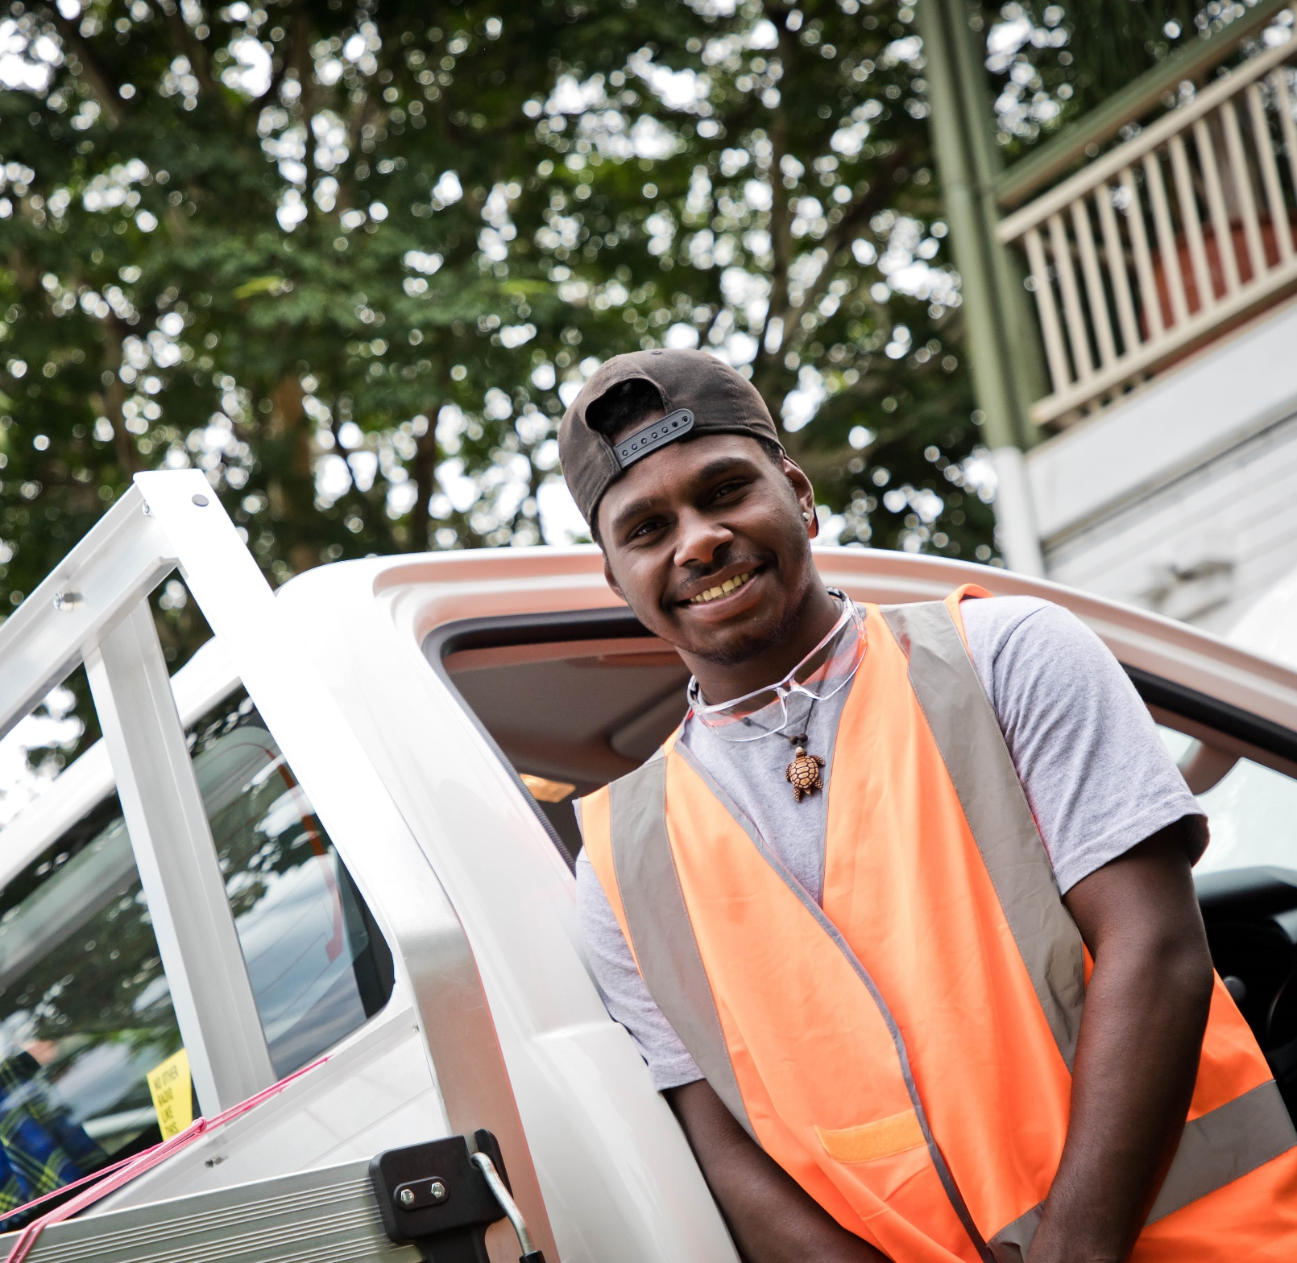
Community-based
Crime Action grants
Up to $75,000 available per project.
Multiple grant rounds per year.
Total of $5 million across Queensland.
Short term programs/projects to address identified areas of community concern
Designed in partnership with the local community.
Must be culturally safe and appropriate.
Notes:
With tougher penalties for youth crime introduced in 2023, these grants are aimed at short term projects that address identified areas of community concern.
Grants of up to $75,000 are on offer for short term or one-off local projects, with multiple grant rounds throughout the year. A total of $5,000,000 in funds is available across Queensland.
The Queensland Government will consider all project ideas that meet an identified area of community concern and are designed in partnership with the local community.
All projects must be culturally appropriate and include evidence of community support and partnerships with Aboriginal and Torres Strait Islander and/or Culturally and Linguistically Diverse peoples and communities.
Supports and resources developed in connection with your project must be culturally safe for First Nations young people, their families and communities. Most Aboriginal and Torres Strait Islander children and young people are thriving in family and community. Unfortunately, over representation in the youth justice system remains.

Slide 12
Combined Rounds 1 and 2
By combining Rounds 1 and 2 for the 2024-2025 grants, we offer more flexibility and potentially more funding for eligible projects.
Here’s a quick overview of how it works:
Original process:
Round 1 and Round 2 were separate grant cycles, each offering up to $1.25 million in funding across Queensland.
You could apply for up to $75,000 in each round, depending on your project’s timeline, with Round 1 starting in June and Round 2 in October.

Slide 13
Combined Rounds 1 and 2
Revised approach for 2024-2025.
Funding for Rounds 1 and 2 has been combined to total $2.5 million across Queensland.
You can submit up to two applications for the same project in Rounds 1 and 2 – one for each round – if the second iteration of the project follows the first iteration without interruption. Consecutive delivery is essential. If successful, you can receive up to $75,000 for each application.

Slide 14
Combined Rounds 1 and 2
Combined Rounds 1 and 2, cover the period 1 July 2024 to 31 December 2024
If successful, it is generally expected project/s will be delivered over October 2024 – April 2025.
It is expected that your project will commence within 12 weeks of signing the contract. If you receive funding for two applications to deliver the same project consecutively, the start date will be adjusted so that the project phases do not overlap.

Slide 15
Project Requirements
The response is prosocial, activity-based, and targets young people who may be displaying anti-social behaviours.
Has clear goals that address the identified areas of community concern in response to youth crime and local community concerns.
Is culturally appropriate and includes evidence of community support or partnerships with Aboriginal and Torres Strait Islander and/or Culturally and Linguistically Diverse peoples and communities.
Is targeted at prevention, early intervention, and diversionary responses aimed at keeping the community safe and supporting victims.
Notes:
Your application must describe the project, including the purpose or aim, what the benefits will be, and how you measure that. We are looking for prosocial, activity-based responses that target young people who may be displaying anti-social behaviours.
Include a project plan that shows what activities or products will be delivered, why it is innovative and how your project will respond to the needs of your community. Tell us what evidence you have that this response should work, and how it will contribute to the local identified areas of community concern.
We want to know how your project will support the cultural diversity in your community. Demonstrate any knowledge or experience you have working with young people with complex needs. Include any experience you have working with Aboriginal and/or Torres Strait Islander people and provide evidence of support from your traditional custodians, elders, or different clan groups in your community.
Ensure that your project focuses on prevention, early intervention and diversionary responses aimed at keeping the community safe and supporting victims.

Slide 16
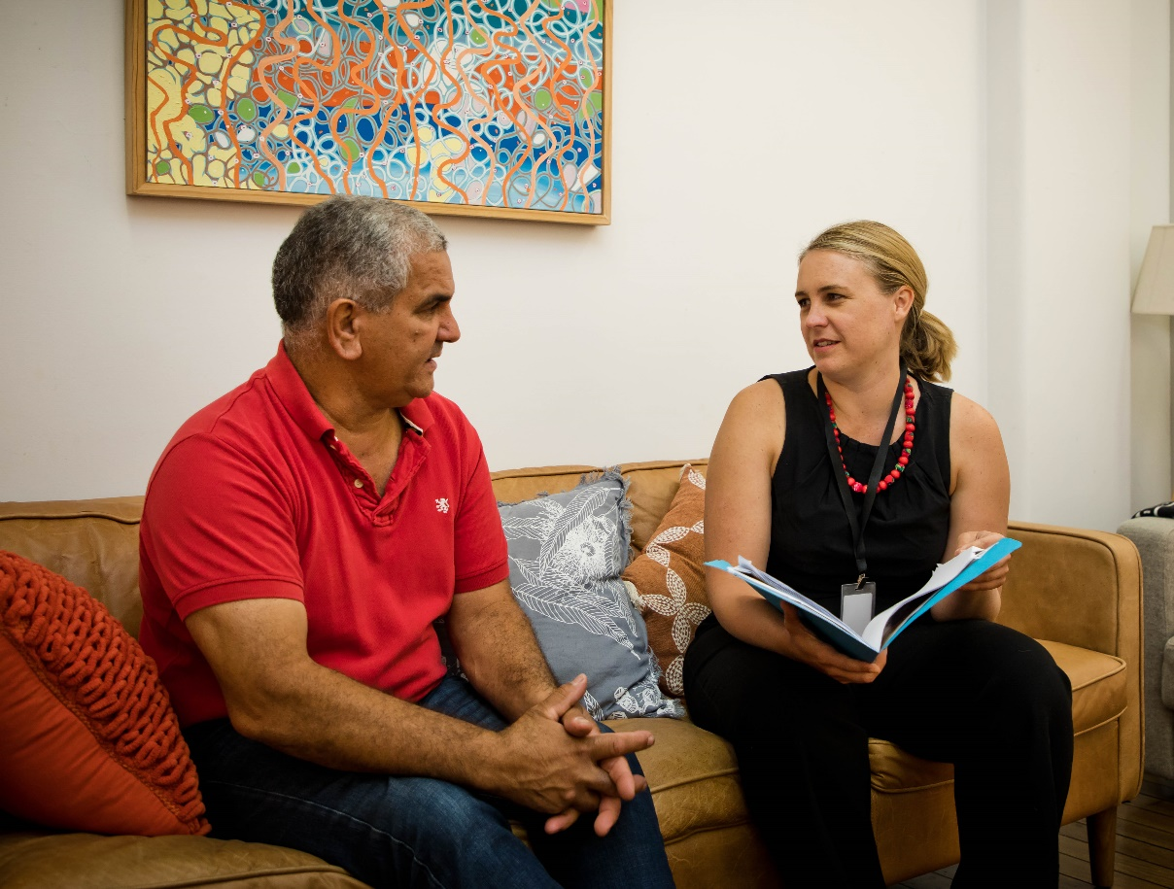
Are you eligible?
Incorporated not-for-profit
Registered business
Legal entity holding an ABN
Auspice agreement with one of the above entities
First Nations led organisations, and small and medium businesses are strongly encouraged to apply.
Notes:
To be eligible for a grant you must be an incorporated not-for-profit, registered business or legal entity holding an ABN, this includes individuals, or have an auspice agreement with an entity like one of these. First Nations led organisations, and small and medium businesses are strongly encouraged to apply.

Slide 17
Application Requirements
Budget → include in-kind support or other income.
Project must be delivered within one CBCA location→ tailor to specific community needs.
Partnerships → nominate a lead agency.
Notes:
Budget must clearly outline the costs of delivering the project and include in-kind support or other income
Project must be delivered within one CBCA location and tailored to specific community needs
Partnership proposals must nominate a lead agency who will submit the application on behalf of everyone involved. The lead agency is responsible for making sure that the contract conditions are met, reports are submitted, and that funding is acquitted to the government.

Slide 18
Grant Resources Available
Program Information and Grant Guidelines
Digital Fact Sheet
Frequently Asked Questions (FAQs)
Identified areas of community concern in response to youth crime
Youth Justice Service Response Guides
Preparing, writing, reviewing and submitting grant applications
Program design support
Notes:
Resources to support your grant application can be found online. These include the Program Information and Grant Guidelines, Digital Fact Sheet, Frequently Asked Questions, identified areas of community concern in response to youth crime factsheet, Youth Justice Service Response Guides, grant preparation and writing guides, and program design support factsheets.

Slide 19
How do I apply?
www.desbt.qld.gov.au/yjgrantscommunity
Click “Apply now” to access SmartyGrants application form.
SmartyGrants Technical Support (03) 9320 6888
I need to apply another way
Email the grants team at ,
YJ_Grants@youthjustice.qld.gov.au
and ask about your options
How to apply
How long do I have?
To find out key dates for each grant round, please visit our website.
www.desbt.qld.gov.au/yjgrantscommunity
I have a question
Head to the website to read more about the grants, or contact
YJ_Grants@youthjustice.qld.gov.au
Notes:
Head over to http://www.desbt.qld.gov.au/yjgrantscommunity. Click “Apply now” and you will be taken to a SmartyGrants application form. If you have any issues using the SmartyGrants platform, contact SmartyGrants technical support on 03 9320 6888.
If you have truly extenuating circumstances preventing your use of this platform, you must contact the Grants team for alternate options no later than two weeks prior to the grant closing date.
If you have inquiries about the grants in general, please contact YJ_Grants@youthjustice.qld.gov.au no later than one week prior to the grant closing date.
Unfortunately, late applications cannot be accepted.
Everything you need to know about how to apply is contained in the Program Information and Grants guidelines, and there's a list of frequently asked questions which are updated regularly. These can be found on the Department of Youth Justice, Employment, Small Business and Training website.

Slide 20
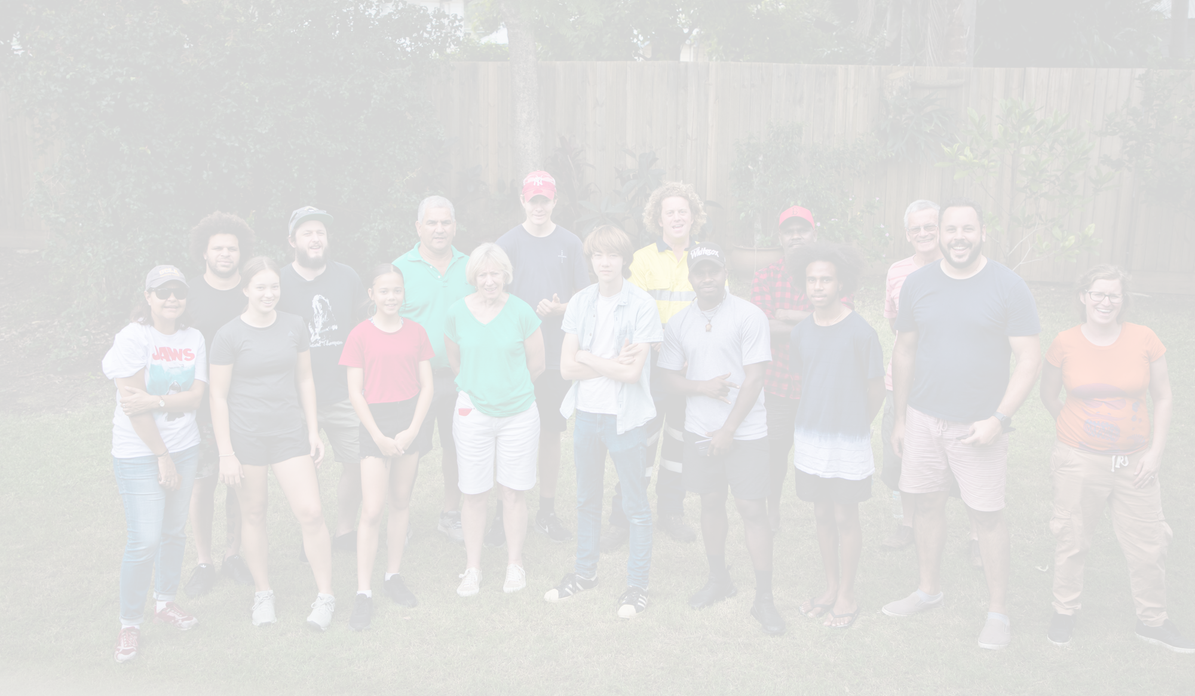
Everyone has a role to play.
Together, we can change the story of youth crime concerns and build a brighter future for young people and our communities.
Notes:
Everyone has a role to play. Together we can change the story of youth crime concerns and build a brighter future for young people and our communities.

