Slide 1

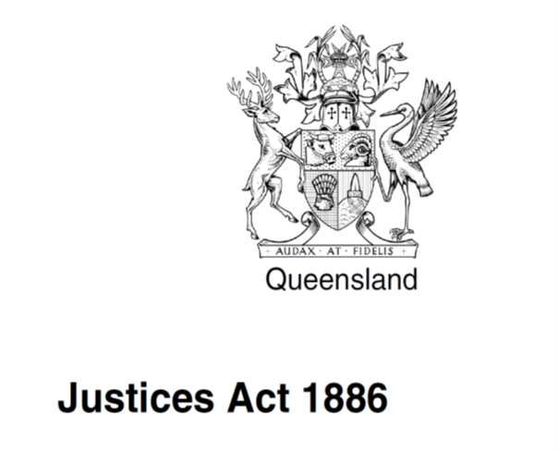

Slide 2

Criminal procedure review – Magistrates Courts
Retired District Court Judge Michael Shanahan AM
Purpose: To make new modern criminal procedure laws for the Magistrates Courts in Queensland
Looking at the Justices Act 1886
  Sets out how the Magistrates Courts conduct criminal proceedings
  Rules about how charges start, progress and are dealt with
  Other powers of the court

Slide 3
Magistrates Courts in Queensland
First court in the Queensland justice system
Works without a jury
Where all criminal charges start
Where most charges are dealt with
Transfers more serious charges to the higher courts for trial or sentence
Busiest court
Approximately 94 per cent of all criminal matters are finalised in the Magistrates Court.
In 2020 -21 there were 167,739 adult defendants dealt with on 368,407 charges. Also in that period, matters for 189 256 adult defendants were finalised. (Magistrates Court Annual Report 2020 – 2021)
In 2019-20 Aboriginal or Torres Strait Islander people accounted for over 17 percent of convicted adults in the Magistrates Courts. (Report on Government Services 2021)

Slide 4
Example Section 49 (Amendment)
If in making an order for the amendment of a complaint summons or warrant the justices consider that the defendant has been misled by the form in which the complaint summons or warrant has been made out or if it appears to them that the variance between the complaint summons or warrant and the evidence adduced at the hearing in support thereof is such that the defendant has been thereby deceived or misled, they may, and at the request of the defendant shall, upon such terms as they think fit, adjourn the hearing of the case to some future day, and in the meantime may commit the defendant, or whether or not the defendant is in custody, may grant the defendant bail or may suffer the defendant to go at large without bail.
In 2022 the Justices Act remains the key criminal procedure legislation for Queensland’s Magistrates Courts.

Slide 5
What are we not doing in the review?
Not a review of the criminal justice system – it is about criminal procedures in the Magistrates Courts
Not about criminal procedures in the District or Supreme Courts
Not about Magistrates Courts civil procedure, including domestic violence proceedings
Not a review of the justices of the peace powers or duties
Not reviewing specific criminal offences (including offence classification type) and does not include operation of other laws (eg bail, evidence, sentencing laws etc)
Not a review of sentencing options or specialist courts
Not reviewing or recommending funding arrangements
Not a review of court procedures applying to children (which are set out in the Youth Justice Act 1992)

Slide 6
Objective of the review
A new legislative framework for contemporary and effective criminal procedure laws in Queensland’s Magistrates Courts to replace the Justices Act.
My focus is on procedural laws that:
are modern and easily accessible by all
make clear rights and responsibilities
are responsive to varying needs of court users
enable better participation by court users
The Terms of Reference set out the review’s instructions

Slide 7
Consultation: Contemporary and effective laws
  What is needed to make criminal procedure laws in the Magistrates Court more modern and work better?
  What would you like to see in Magistrates Courts criminal procedures to better enable participation and fairness for all court users in criminal proceedings?
  What would you like to see more of? What would work better? What is needed?
  How can procedures be improved to ensure understanding of court processes?
  How can criminal procedure laws take into account the particular needs and preferences of vulnerable groups?

Slide 8
Human rights
The Human Rights Act 2019 protects and promotes human rights.
  Equality before the law
  Fair hearing
  Rights in criminal proceedings (including ‘minimum guarantees’ such as a person knowing what they are charged with, being able to defend themselves and having legal assistance)
New legislation must be ‘compatible’.
We need to consider people’s human rights throughout this review. We would like to hear your thoughts and ideas.

Slide 9
Issues to consider
  Guiding principles
    Fair and just for victims and defendants
    Efficient
    Simple and easy to understand
    Culturally appropriate
    Adaptive to technology
    What kinds of principles are important to you?
  Technology
    Electronic files (not paper-based)
    People appearing in court by phone or video
    How could the Magistrates Courts use technology?
    Are there issues with the Magistrates Courts relying on technology?

Slide 10
Issues to consider
  Starting proceedings
    The police can start some criminal proceedings by giving a person a notice, which tells the person that they have to come to court
    The Justices Act 1996 says that proceedings can be started by using a ‘complaint and summons’, which is outdated and can take a long time
    How can we make it simpler to start a criminal proceeding?
  In-court diversion options
    Mediation
    Deferred prosecutions
    Court based Diversion program – used in Victoria
    What are some in-court options to reduce and end contact with the criminal justice system?

Slide 11
Issues to consider
  The name of the court and the Magistrates
    In Queensland we have the Magistrates Courts and we have Magistrates
    In some other places they are called the Local Court and Judges
    What do you think they should be called? Why?

Slide 12
Where to from here?
Formal Consultation Paper on our website – submissions close 30 June 2022
General submissions close 31 August 2022
Email:
Criminal-Procedure-R@justice.qld.gov.au
Website: https://www.qld.gov.au/cpmcreview
April 2022 – consultation
June 2022 – submissions close on consultation paper
Consider submissions, undertake research and consultations to develop review report
April 2023 – review report due to Attorney-General
Further work to develop legislation

